Slide 1
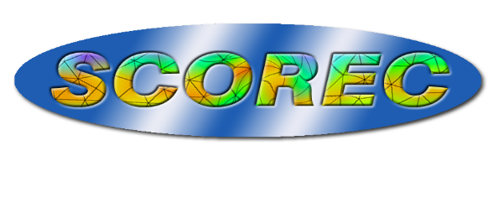
Dynamic Load Balancing of Unstructured Meshes
G. Diamond, L. Davis, C. W. Smith, M. S. Shephard
Rensselaer Polytechnic Institute

Slide 2
Outline
EnGPar – Diffusive Load Balancing
Load Balancing Unstructured Meshes
Initial Accelerating of Diffusion
Plasma Physics/PIC

Slide 3
Dynamic Load Balancing
Adaptive mesh applications require
Fast redistribution of load throughout simulation
Simultaneous balancing of multiple mesh entity dimensions
Multilevel graph methods are too memory intensive for large process counts
Diffusive methods are fast and allow incremental improvement.

Slide 4
EnGPar
Our tool for fast partition improvement accounting for multiple criteria.
Uses multi-hypergraph, N-graph, to represent user data allowing multiple types of relational connections.
Vertices: Uniquely owned, represent the main source of data.
Hyperedges: Relational connections between sets of vertices.
Different sets of hyperedges represent different types of relations.
Mulitcriteria load balancing is performed on the N-graph using local diffusive methods.

Slide 5
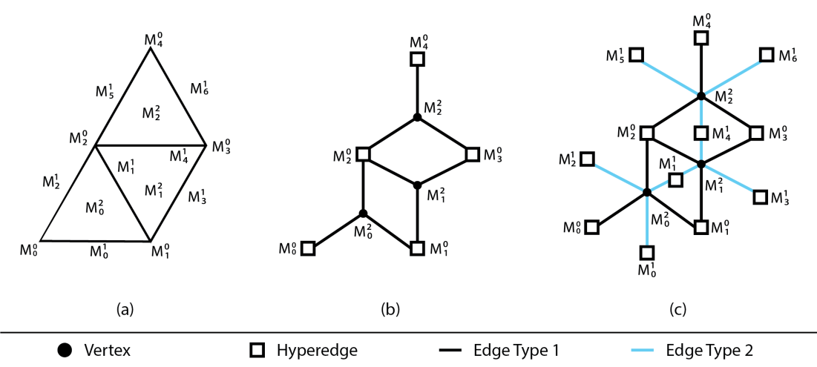
Partitioning Meshes
Unstructured meshes are typically partitioned by elements or vertices
Vertices in the N-graph represent the unique mesh dimension.
Hyperedges are constructed for other mesh dimensions of computational importance.
Computation costs proportional to the weighted balance of mesh entities.
Communication costs proportional to the mesh entities on boundary.
Equivalent to the edge cut in the N-graph
Conversion from element-partitioned mesh (a) to N-graph (b) and (c)

Slide 6
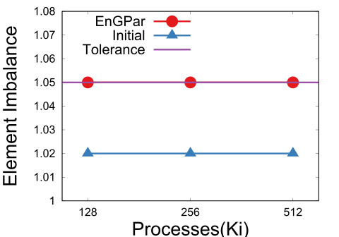
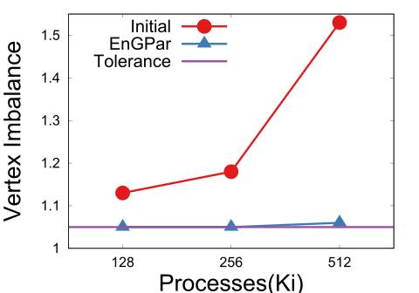
Element-Partitioned
Tests run on one billion element mesh up to 512Ki (512 * 2^10) parts
Partitions created by using ParMETIS globally up to 8Ki parts followed by locally up to 512Ki.
Goal is to balance mesh vertices and mesh elements.
Mesh vertex imbalances is reduced from 13% to 5% for 128Ki, 18% to 5% for 256Ki, and 53% to 6% for 512Ki.
Edge cut is increased by 1%.
EnGPar balances the 512Ki mesh in 4% of the time to create the partition from 8Ki parts.

Slide 7
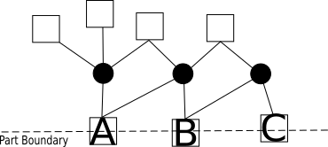
Vertex-Partitioned
Initial tests of EnGPar on a vertex-partitioned mixed mesh resulted in significant increases in edge cut as the mesh entities were balanced.
At 8Ki parts, a reduction in 7 percent point decrease in imbalance resulted in a 15% increase in edge cut.
To avoid large increases in edge cut, additional logic and a tunable parameter was added to reject migrating cavities (hyperedge and neighboring vertices) that would increase the edge cut significantly.
For each cavity we compute the ratio of intra-part pins to inter-part pins. If the ratio is greater than the tunable parameter the cavity will not be migrated.
Three hyperedges on part boundary (A,B,C). Ratio for cavity of A = 5/3, B = 3/4 , C = 1/2. B and C are good candidates for migration.

Slide 8
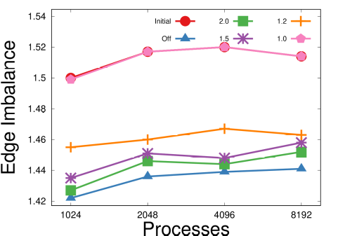
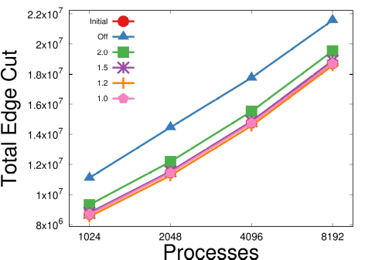
Vertex-Partitioned
Tests done on 60 million mixed element mesh up to 8Ki parts created by ParMETIS.
Vertex imbalance is restricted to be below 5%
Without the edge cut limits, a 7 percent point decrease in imbalance comes with a 15% increase in edge cut
Using the edge cut limiter at 1.2 results in a 5 percent point decrease in imbalance without increasing the edge cut.
At 2.0 imbalance is reduced by 6 percent points with a 4% increase in edge cut.

Slide 9
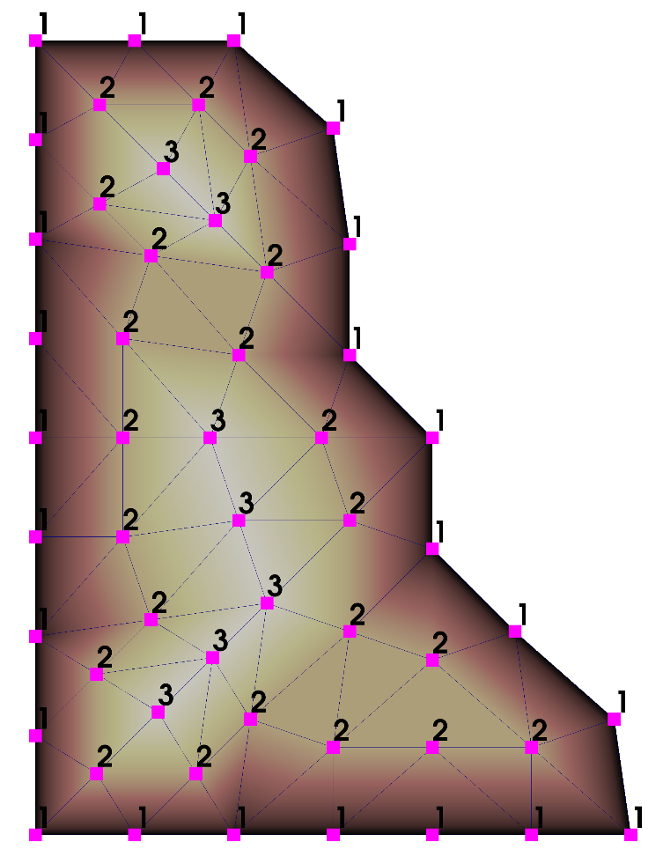
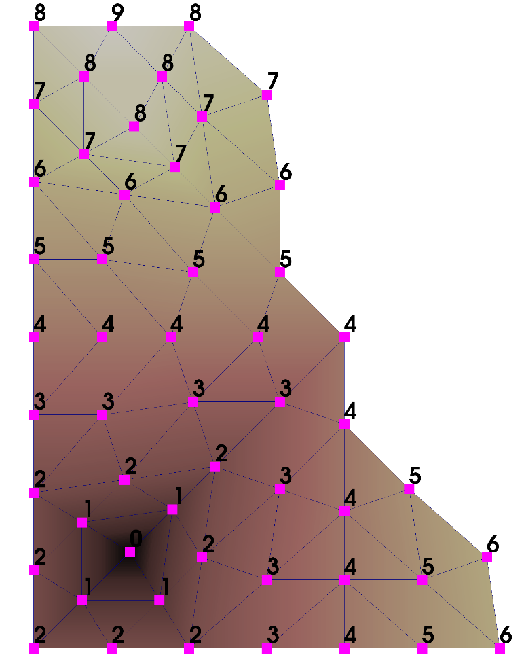
Accelerating Selection
Topological distance from the part center determines order of boundary traversal.
Outside-in (left) then inside-out (right) breadth first traversals
Use Sell-C-Sigma for memory coalescing.
Exploit uniform downward adjacencies (elms to verts) to unroll loops.
Distance computation
Sell-C-Sigma data structure (Besta and Merending, et al.)

Slide 10
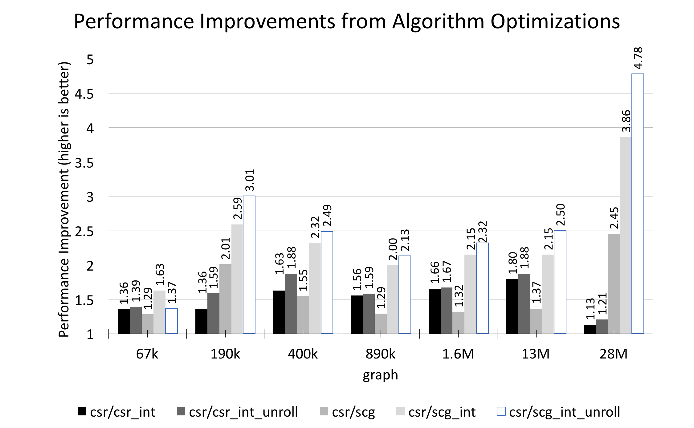
OpenCL BFS Kernels
Kernel comparison on NVIDIA 1080ti; Average of three runs shown.
scg_int_unroll is 4.78 times faster than csr on 28M graph and up to 11 times faster than serial on Intel Xeon (not shown)
csr - OpenCL parallel ‘pull’ style vtx→hyperedge using CSR scg - OpenCL parallel ‘pull’ style vtx→hyperedge using Sell-C-Sigma *_int - use 4B int for adjacency and degree lists instead of 8B long *_unroll - unroll the loop over hyperedges adjacent to a vertex

Slide 11
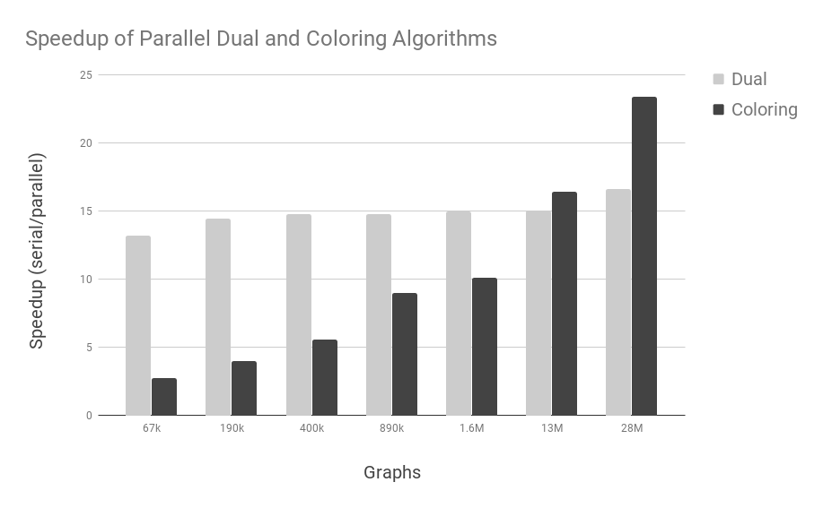
Cavity Selection
Cavity – a hyperedge on the part boundary and its adjacent vertices
Need to operate on non-overlapping cavities - Kokkos Kernels Coloring
Coloring requires CSR of graph dual – hyperedges-to-hyperedges via vertices – Kokkos unordered_map enables efficient construction (memory and time)
Ongoing work: parallel sort of selected cavities in order of distance

Slide 12
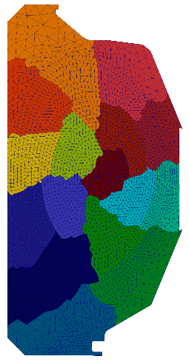
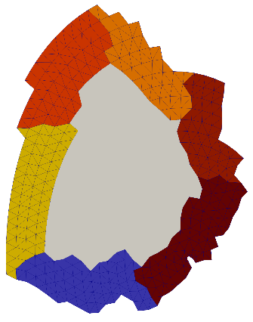
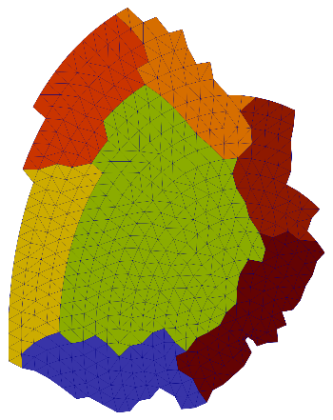
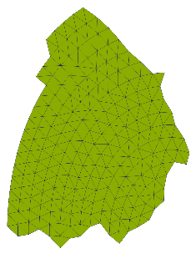
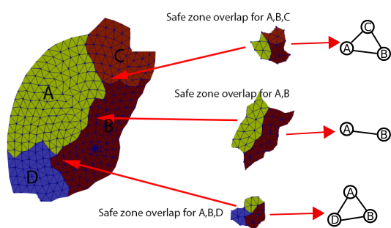
Plasma Simulation/Particle in Cell
PIC parts contain a core region and buffer elements.
Particles must remain in safe region(core + portion of buffer).
Instead of tracking each particle, track where particles can be with overlapping safe zones.
N-graph consists of subgraphs for overlapping safe zones.
Weight of vertices is set to the number of particles in overlapping safe zones.
Diffusively migrate weight(# of particles) until total weight is balanced.
Initial tests have reduced a 42% imbalance of particles to 18%.
+
=
A PICpart core – minimum safe zone
Buffer elements added
A PICpart
Overlapping safe zones between parts A,B,C,
and D near the A-B boundary

Slide 13
Closing Remarks
EnGPar performs multicriteria diffusive load balancing methods on multi-hypergraphs.
General design supports element-partitioned, vertex-partitioned meshes, particles in an unstructured mesh for PIC, etc.
Pipelined FPGA kernel implementations
Fine grain tuning (unrolling, different data formats) can improve performance greatly.

Slide 14
Thank You
Questions?
Acknowledgements:
NSF SI2-SSE: Fast Dynamic Load Balancing Tools for Extreme Scale Systems
DOE FASTMath SCIDAC Institute
CEED ECP
Argonne National Laboratory - Kazutomo Yoshii

