Slide 1
Dynamic Load Balancing and Task Mapping for Extreme-Scale Dynamic Applications
Mehmet Deveci*, Karen Devine*,
George Slota**, and Cameron Smith**
*Sandia National Laboratories
**Rensselaer Polytechnic Institute

Slide 2
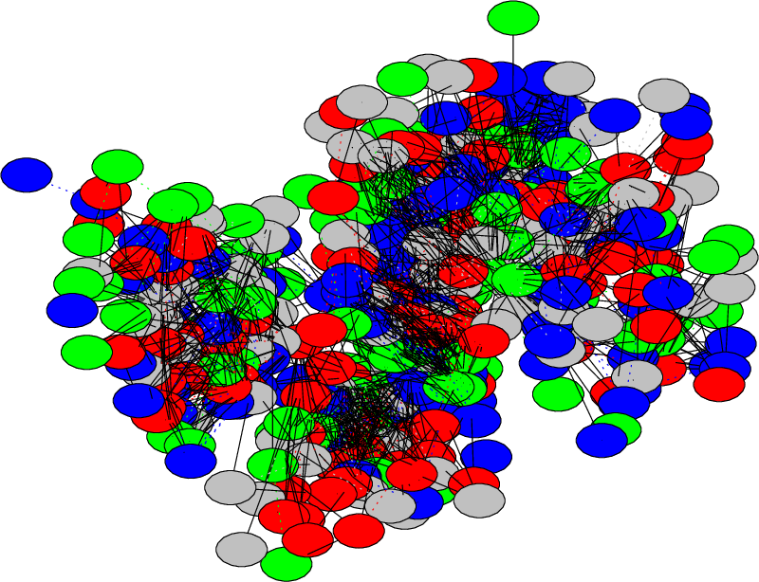
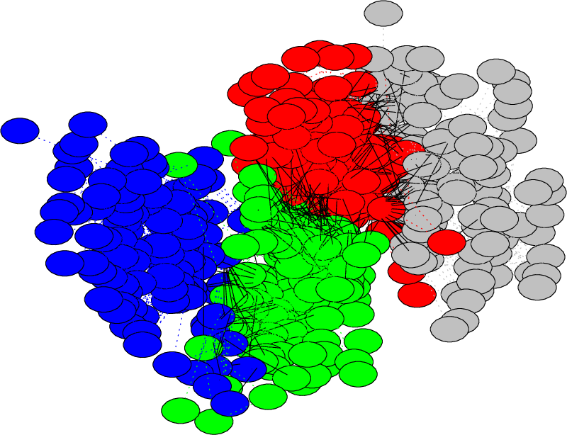
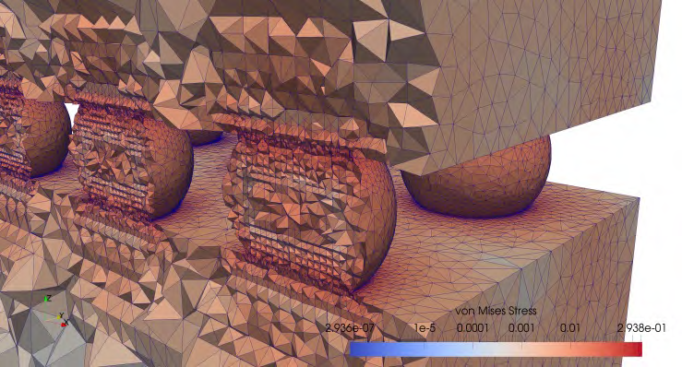
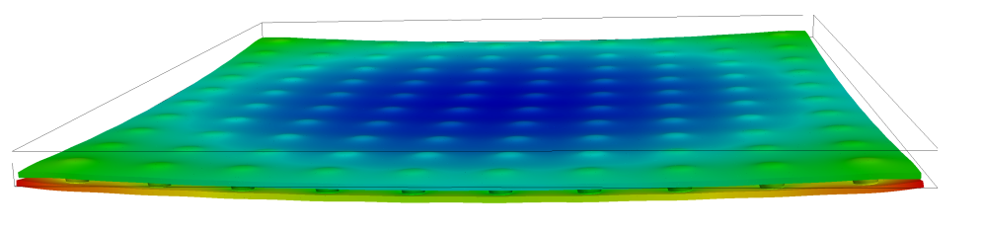
FASTMath provides advanced dynamic load balancing and task mapping for extreme scale applications
Technology Area: Unstructured Mesh Technologies
FASTMath Tasks
  Massively parallel graph algorithms
  Architecture aware load balancing and task mapping
  Multi-criteria dynamic partition improvement
Relevant Software Tools
  PuLP and XtraPuLP: Graph Partitioning using
  Label Propagation - github.com/HPCGraphAnalysis/PuLP/
  Zoltan and Zoltan2 - www.cs.sandia.gov/zoltan/
  EnGPar – scorec.github.io/EnGPar/
Applications Impacted
  Albany Multiphysics
  MFEM
  E3SM HOMME
  NNSA Sierra
The XtraPuLP graph partitioner can compute balanced multi-object partitionings of irregular trillion-edge graphs in minutes
Error-driven in-memory mesh adaptation of thermal creep in a flip-chip using Albany Multiphysics and Zoltan
Notes:
Current SOA before PISCEES: A structured grid finite difference code (1) without the ability to refine or adapt the mesh to where it is needed, such as runoff glaciers and (2) with robustness issues.
Performance is always a concern as well.
These are being solved by the bullets at the bottom (AMR or unstructured gird, improved nonlinear and linear solvers, improved use of new architectures).
What work this will enable that current State of Art does not:
Improved grid and discretization enables us to resolve the dynamics much better, including runoff glaciers and the grounding line (Ice/Ocean/Land triple point).
Robustness is critical for releasing the code to a broad community, and evn more, to release it as a subcomponent of an full Earth System Model coupled to ocean and land models.
Engagement with linear solvers experts (Adams, Tuminaro) critical for achieving speed and scalability of the major linear solver cost.
------------------------------
The colors are ice flow – red is fast and needs refinement, blue is slow and can use coarser grids
Structured grid – aimed at getting the grounding line very accurate (where ice goes from touching land to going over the ocean) – when on the bedrock a very large friction coefficient and goes to almost no friction 0 this impacts the rate of the formation ice break/ice bergs
Finite element trilinos code – static refinement – no dynamic adaptivity. Aiming for callibration and parameter inversion problem. A lot of data and coefficients in the models – want to create a self consistent initial condition and then propagate into the future so we can do better predictions. The initialization of the model is the bulk of the work – if we can’t calibrate the model so that today looks like today, there is very little hope of getting tomorrow correct.
In the first year, have written the solvers. Now can co the callibration with uncertainty – will involve quest as well.
Second part for fastmath work – implicit solvers. Nonlinear methods and Homotopy and FAS multigrid; majority of the time is in the iterative solves so have been spending a lot of time. Spans the FASTMath topic areas very well.

Slide 3
  Graphs associated with mesh-based applications present challenges at extreme scale
Massive Scale: Development of processing framework for massive (billion+ vertex, trillion+ edge) graphs
Massive Parallelism: Scalability to hundreds of thousands of cores, optimized for processing and communication patterns typical to graph computations
Important graph algorithms for applications:
  Connectivity: subroutines for graph connectivity and biconnectivity to support ice-sheet modeling applications and matrix re-ordering for solvers
  Label Propagation: widely used algorithm for irregular graph partitioning, graph clustering, and community detection applications

Slide 4
PuLP / XtraPuLP provide scalable graph partitioning for multicore and distributed memory systems
PuLP: Shared-memory multi-objective and multi-constraint partitioning designed for highly irregular graphs and meshes
XtraPuLP: Distributed implementation of PuLP using our ‘massively parallel graph processing’ framework
  Performance testing has shown scaling to trillion edge graphs and thousands of cores with partitioning completion time in minutes
Right: Strong scaling for several test instances on the NCSA Blue Waters Supercomputer. WDC12 is the largest publicly available webcrawl with 3.5 billion vertices and 130 billion edges. Other test instances are random graphs of similar scale.

Slide 5
  Architecture-aware partitioning and task mapping reduce application communication time at extreme scale
Partitioning and load balancing: assign work to processes in ways that avoid process idle time and minimize communication
Task mapping: assign processes to cores in ways that reduce messages distances and network congestion
Important in extreme-scale systems:
  Small load imbalances can waste many resources
  Large-scale networks can cause messages to travel long routes and induce congestion
Challenge to develop algorithms that…
  account for underlying architectures & hierarchies
  run effectively side-by-side with application across many platforms (multicore, GPU)

Slide 6
Zoltan/Zoltan2 suite of partitioners supports a wide range of applications
Geometric: parts contain physically close objects
  Fast to compute → good for dynamic load
  balancing
  Applications: Particle methods, contact
  detection, adaptive mesh refinement,
  architecture-aware task mapping
  Recursive Coordinate/Inertial Bisection,
  MultiJagged, Space Filling Curve
Topology-based: parts contain topologically connected objects
  Explicitly model communication costs → higher quality partitions
  Applications: Mesh-based methods,
  linear systems, circuits, social networks
  Graph (interfaces to XtraPuLP,
  ParMETIS, Scotch)
  Hypergraph
MultiJagged partition of a
particle simulation
1 2 3 4 5 6
1
2
3
4
5
6
X X X X X X
1
5
X X X X X X
X X X X X X
2
X X X X X X
6
3
X X X X X X
X X X X X X
4
Row-based partition of a sparse matrix via graph partitioning
6

Slide 7
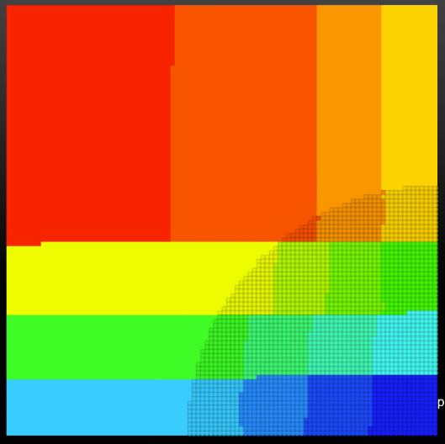
Zoltan2 is development/delivery platform for architecture-aware partitioning and task placement
MultiJagged geometric partitioner (MPI+OpenMP) provides highly scalable load balancing for large-scale computations
  Ex: redistributes coarse operators of 2.5B row matrix in multigrid code MueLu on 1M cores in 0.84 seconds
Geometric task placement reduces communication (and, thus, execution) time by placing interdependent tasks in “nearby” cores
  Ex: reduces communication time in E3SM HOMME by up to 31% on 16K cores BG/Q
Default task
placement
MultiJagged partition of an adaptive mesh into 16 parts; fast geometric partitioning is effective for dynamic applications
Custom 2x2x4
grouping
Execution time
Zoltan2 task
placement
Weak Scaling of MiniGhost (boundary-exchange proxy app); Zoltan2 task placement recovers scalability at high core counts
Number of cores

Slide 8
  EnGPar quickly reduces large imbalances on (hyper)graphs with billions of edges on up to 512K processes
Multi-(hyper)graph supports representing multiple types of dependencies (edges) between application work/data items (vertices)
Loop over app. defined list of edge types
Diffusion sends boundary edges from
heavily loaded parts to lighter parts
  Bias selection towards edges
  that are far from the graph ‘center’
  Multiple traversals of boundary
  with increasing limit of edge degree
  Receiver cancels send if it imbalances
  higher priority edge type
On a 1.3B element mesh, EnGPar reduces
a >50% vtx imbalance to 10% in 7 sec. while
maintaining a 5% elm imbalance

Slide 9
FASTMath software tools for partitioning, load balancing, task placement
PuLP and XtraPuLP: Partitioning using Label Propagation
  Scalable multi-criteria graph partitioning
  C++ with OpenMP and MPI; interface available in Zoltan2; BSD license
  Download: http://github.com/HPCGraphAnalysis/PuLP/
EnGPar
  Multicriteria partition improvement on a multi-graph
  C++ with MPI; F90 interface; fork for OpenCL evaluation
  Download: http://scorec.github.io/EnGPar/
Zoltan
  Distributed memory partitioning, load balancing, coloring, ordering, data directories
  C code with optional C++ and F90 interfaces; MPI-only
  Download: http://www.cs.sandia.gov/zoltan/
Zoltan2
  Parallel (MPI+X) partitioning, load balancing, task mapping, ordering
  Templated C++ code; use stand-alone or integrated with Trilinos classes
  Download with Trilinos: http://github.com/Trilinos

Slide 10
Application interactions
Albany Multiphysics (POC: Hansen)
  EnGPar partition improvement for adaptive unstructured mesh-based analysis
  Increase performance of finite element analysis and adaptation procedures
MFEM (POC: Kolev)
  Define criteria to efficiently balance high-order unstructured meshes using a combination of Zoltan graph-based partitioning and EnGPar partition improvement
  Increase performance of finite element analysis
CODES (POC: Carothers)
  EnGPar balancing graph of super computer process and network elements simulating an application trace
  Reduce time to solution by decreasing roll-back of speculatively executed events resulting from imbalance
E3SM (POC: Salinger, Taylor, Grindeanu)
  Zoltan2 task mapping in E3SM components and coupling
  Reduce communication time within and between E3SM components, thus reducing overall execution time
PISCEES FELIX Ice Sheet (POC: Pergo, Tuminaro)
  Connected component labeling to detect cleaving
  Better handling of cleaving in numerical solvers

