Slide 1
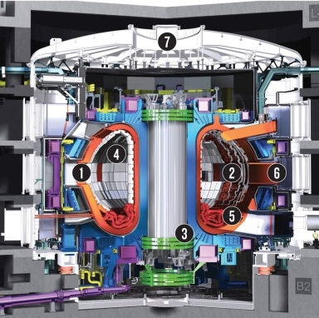
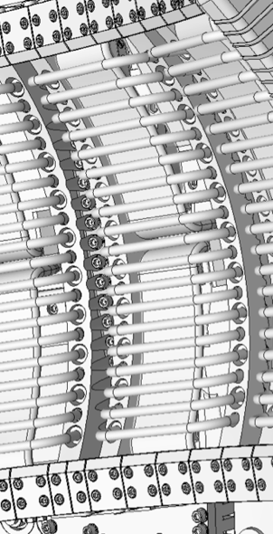
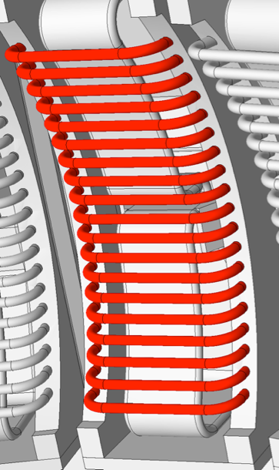
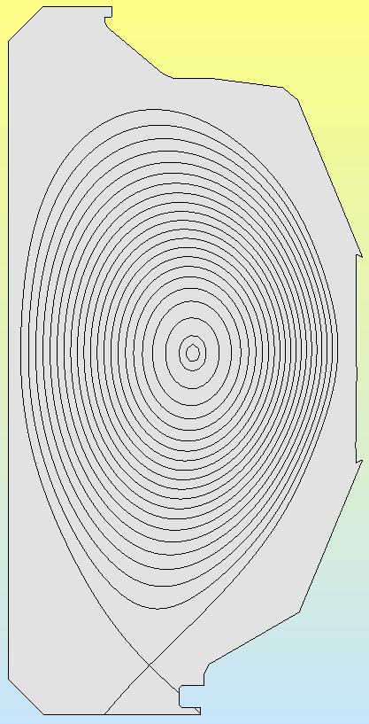
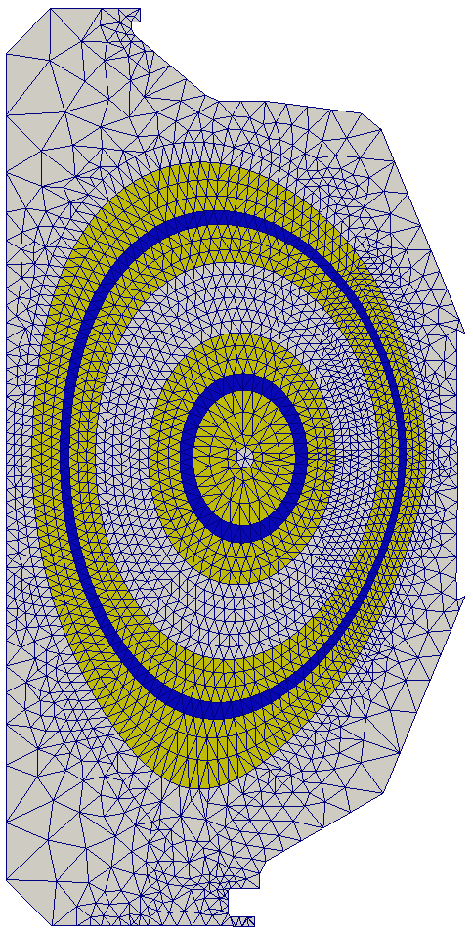
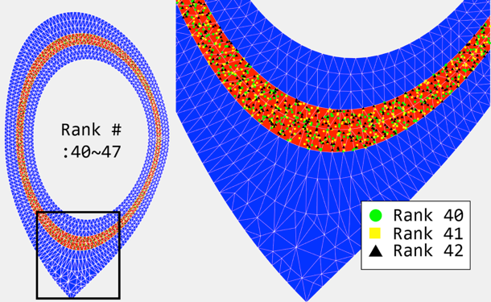
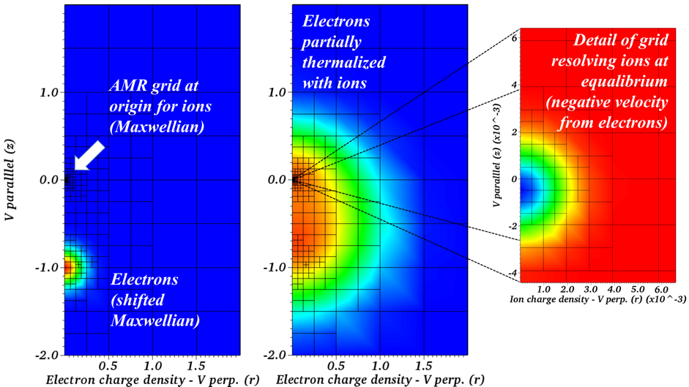
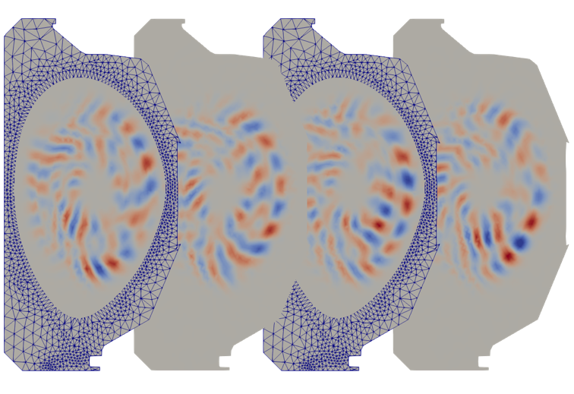
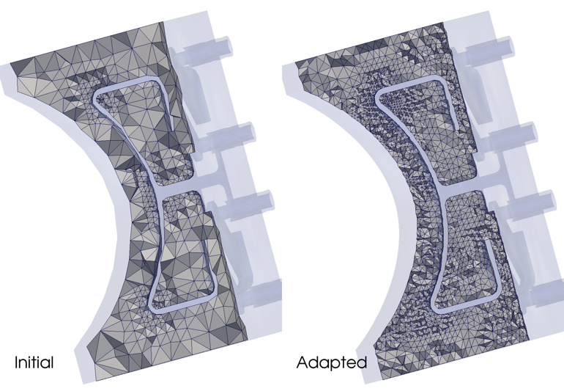
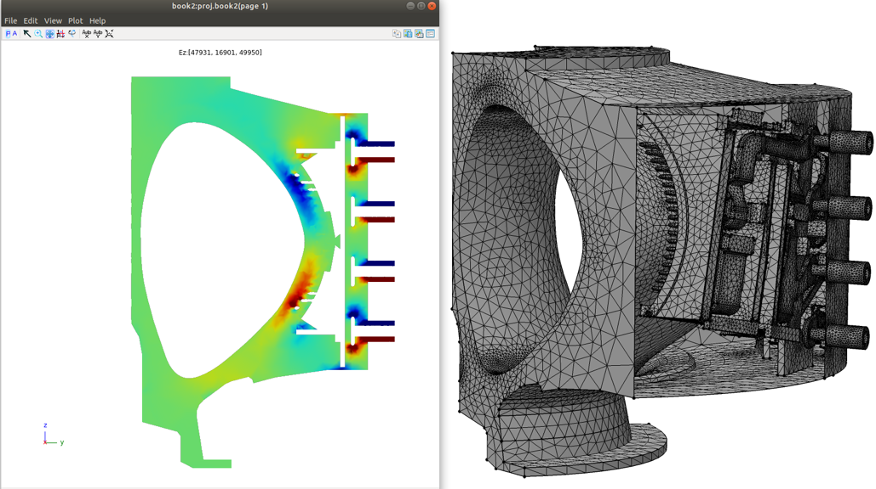
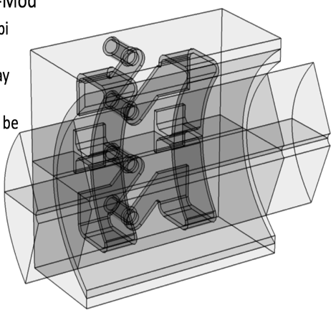
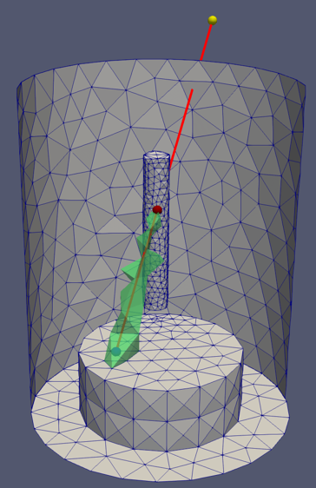
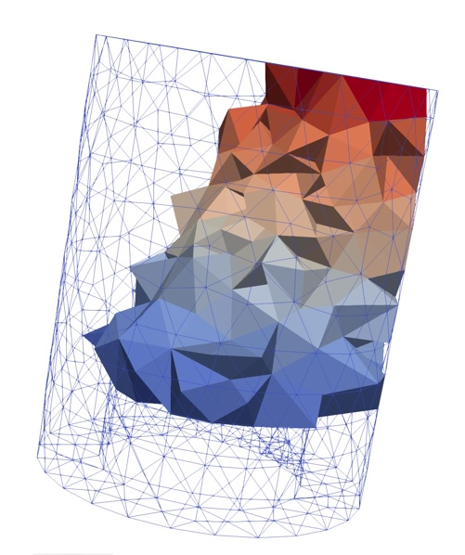
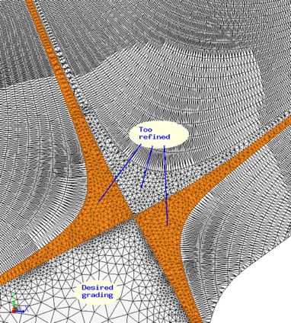
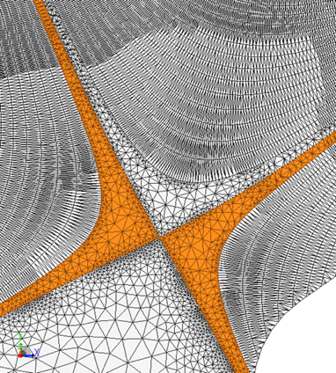
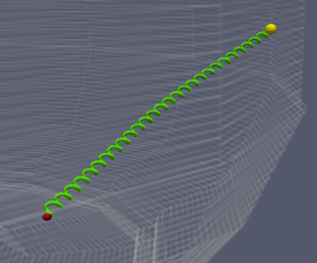
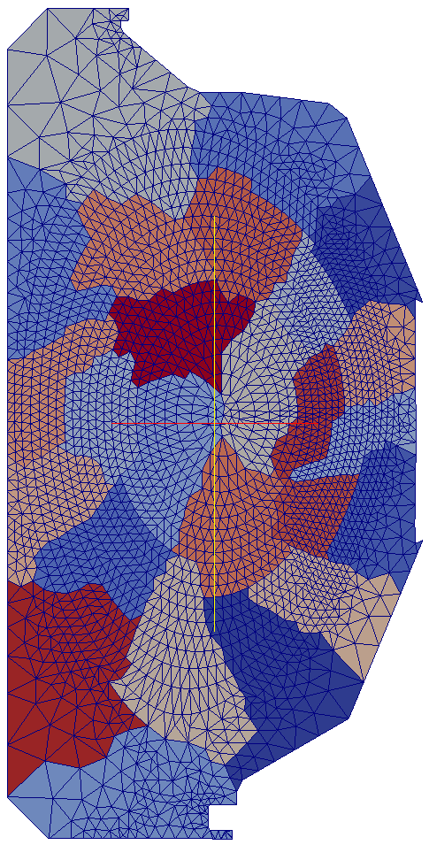
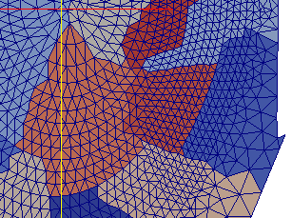
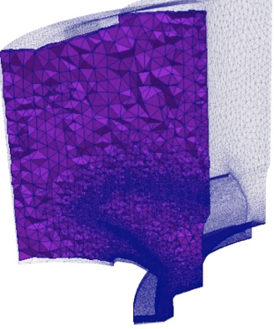
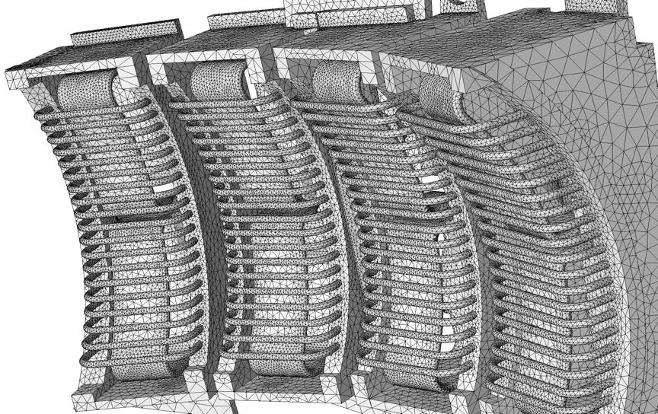
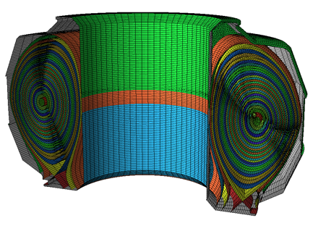
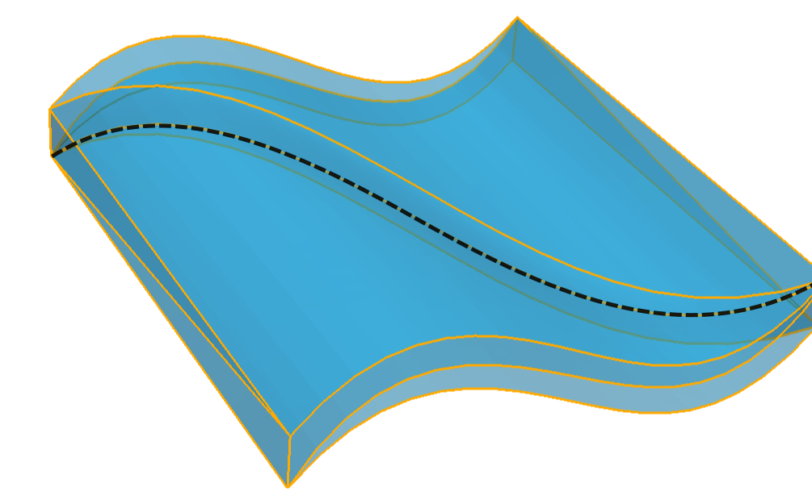
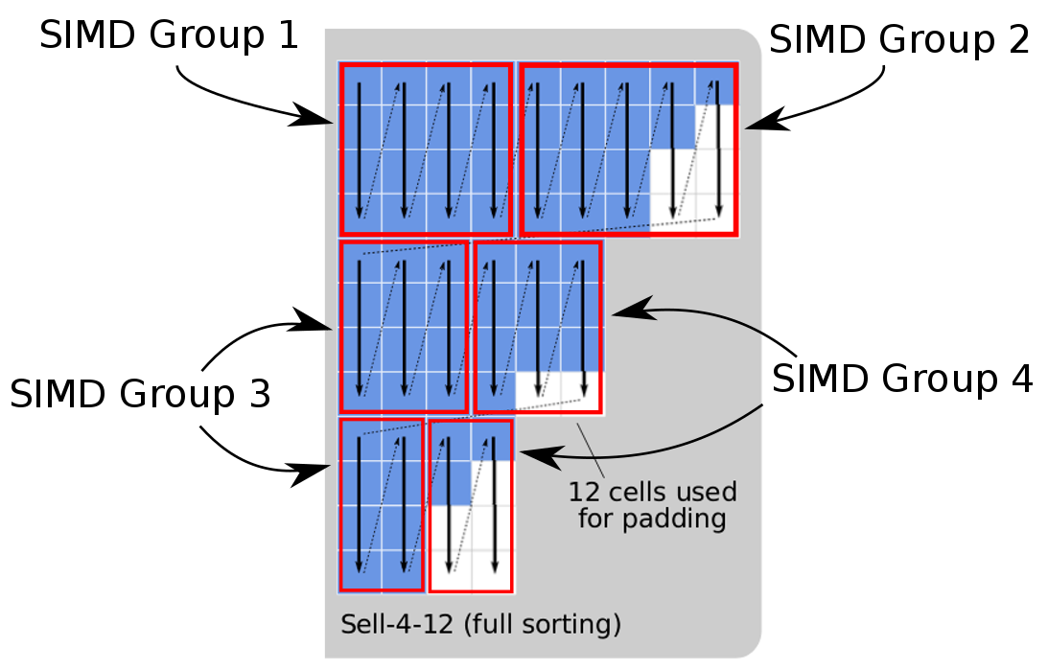
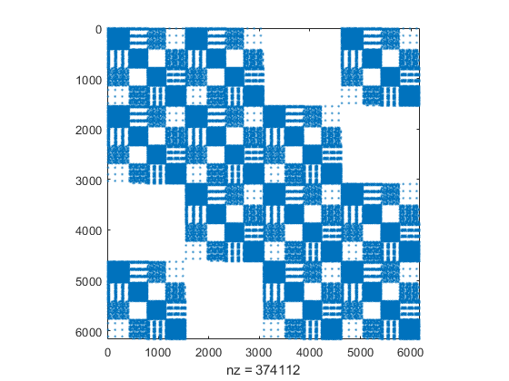
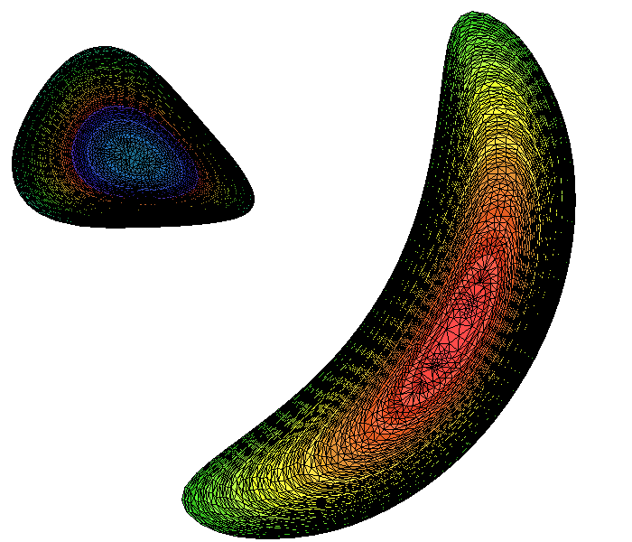
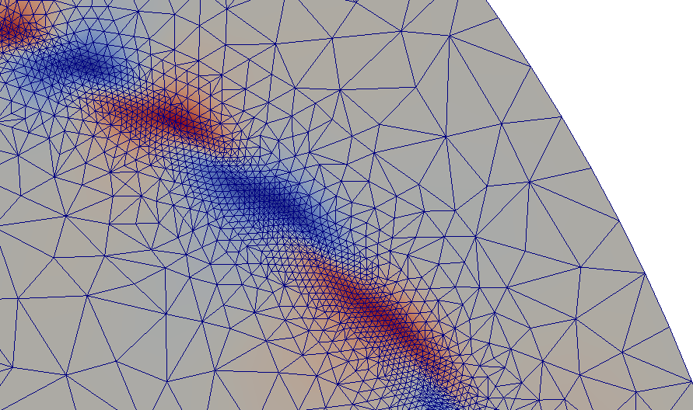
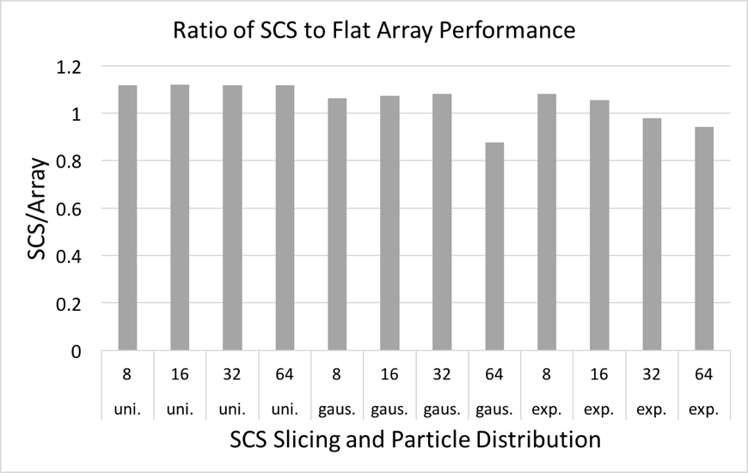
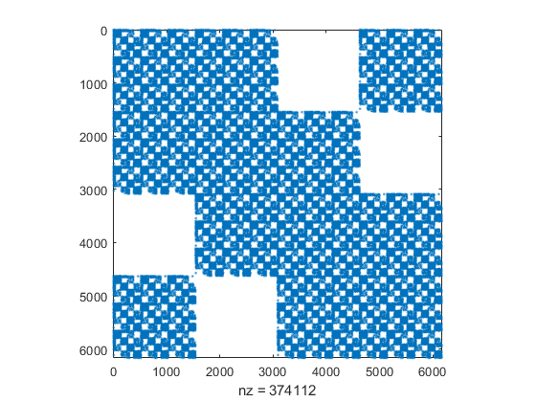
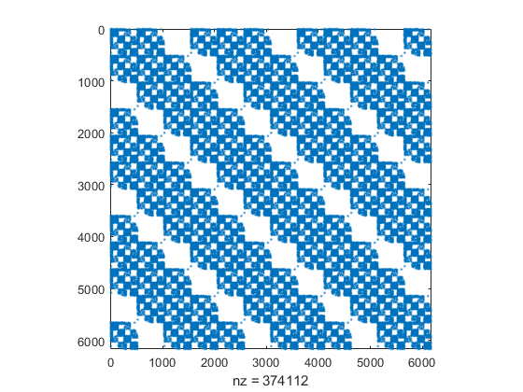

Unstructured Mesh Technologies for Fusion Simulation Codes
FASTMath Team Members: M.F. Adams¹, G. Diamond², V. Dobrev³, M. Hakimi², D. Ibanez⁴, M. Kneplay⁵, T.V. Kolev³, G. Perumpilly², O. Sahni², S. Seol²,
M.S. Shephard², C.W. Smith², M.L. Stowell³, W.R. Tobin², A. Truszkowska², C. Zhang² ¹LBL, ²RPI, ³LLNL, ⁴SNL, ⁵Buffalo
Unstructured meshes are well suited to modeling the complex physics and geometries of fusion reactors. FASTMath and the fusion SciDACs are supporting the development of unstructured mesh technologies needed by the fusion SciDAC Partnerships for their near-exascale simulations.
Areas of Development
Adaptive RF Simulation Workflow
Mesh-Based Edge Plasma PIC Code
Finite Element solvers for runaway electron kinetics and MHD
Mesh generation/adaptation advances for fusion SciDACs
Support of M3D-C1 extended MHD code for core plasma
Adaptive RF simulation workflow
Infrastructure for unstructured mesh PIC simulations
XGCm – mesh-based version of the XGC edge plasma code
GITRm – mesh-based version of the GITR impurity transport code
Workflow steps
Obtain and clean-up antenna CAD models
Combine antenna, reactor and physics geometries
Associate analysis attributes
Automatic mesh generation
MFEM finite element analysis
Estimate errors. If below tolerance terminate
Adapt mesh and return to step 5
Steps 1-3 are carried out interactively
Steps 4-7 are automated and execute in parallel
Tools used
Geometry – Simmetrix SimModeler, CAD systems, EFIT
Mesh generation – Simmetrix MeshSim
Mesh services and curved mesh adaptation – PUMI
High-order finite element analysis – MFEM
RF simulations – PetraM
Error estimator – PUMI
Implementing XGC physics and numerics
  Since data structures are changed code being rewritten in C++
Status
  Based on original PUMI structures – GPU focused structures will be integrated later – will only influence mesh/particle operations
  Mesh/particle interaction operations
  Mesh solve in place (needs optimization)
  Ion and electron push (including subcycling)
  Initial δf simulations
  Performance evaluation and improvement underway
Small δf test case – 6.2K elements, 8 poloidal planes
  300k particles/rank, 64-512 ranks, 1-8 Cori KNL nodes
  Total timings (minus FE solve) equivalent to XGC1
Medium δf test case – 127k elements, 8 poloidal planes
  300k particles/rank, 256-1024 ranks, 4-16 Cori KNL nodes
  Push operation 25% faster than XGC (key and encouraging)
  Total time double XGC – need new structure to optimize
  Buffer zone has substantial influence on timings
Model
Two PICparts
CAD model clean-up
Solver for Runaway Electron Kinetics
***
***
***
****
Conservative solver for runaway electron kinetics
  Discretization of the Landau collision integral
  Conserve mass, momentum and energy, more if desired
  DMSwarm manages parallel particle fields in PETSc
  Symplectic integrators of order 1 to 4 implemented
  Non-conforming mesh adaptation
Scalable MHD solver
  Builds on MFEM high-order finite element solver
  Non-conforming mesh adaptation
  Dynamic mesh adaptation applied to the island
  coalescence problem
Electron beam thermalizing
with ions
Combined geometry
Electrostatic potential fluctuation at four toroidal angles for mesh-based XGC
Island coalescence simulation
Mesh-Based Impurity Transport Code
Example adaptive mesh
MFEM Analysis
Operates in 3D unstructured graded meshes
  3D adjacency search - effective on graded meshes
  Mesh entity classification for efficient operation
  Wall intersection implemented
  Elements where distance tracking
  preprocessed to know when needed
  Boris move implemented
  Omega mesh and new particle data structures
  Initial tests, including GPU execution, underway
  Working with U. Tenn and ORNL to
  define appropriate verification tests
Executed 20 push, search, rebuild iterations on PISCES mesh (~6k tets) on a GPU
  Results comparable to those executed on background grids
Mesh Generation/Adaptation
Infrastructure for Unstructured Mesh PIC
Tokamak geometry and meshing
Reordering mesh for better memory access
ITER, DIII-D, Alcator C-MOD, NSTX, KSTAR, etc.
EFIT physics geometry
Improved mesh quality
Higher order curved mesh generation
Higher order curved mesh adaptation
Special meshing tool for hPIC
Mesh-based particle-in-cell infrastructure
  PIC code specific optimal mesh distribution
  Particles migration and dynamic load balancing
  Fast adjacency searches and wall intersections
  Efficient particle-to-mesh and mesh-to-particle operations
PICpart definition (in more data efficient version)
  PICpart with be a “part” of partitioned mesh
  Plus neighboring and close parts up to the full mesh
  Memory requirements reduced from original approach
Mesh data structure
  Omega - GPU enabled mesh topology data structure
  BFS-like algorithms for effective local performance
  On-node OpenMP or CUDA parallelism using Kokkos
Particles structures critical for GPU performance
  Particles related to elements
  Sell-C-σ defined for particles/element – needed to be more advanced than flat arrays due variable # particles/element
  Coordinating with the COPA ECP particle co-design center
A
B
 | no sorting | full sorting
ptcls (Ki) | time (s) | time (s)
128 | 2.298661 | 3.642041
256 | 2.895464 | 3.415048
512 | 3.79263 | 3.851178
1024 | 4.972283 | 4.090044
2048 | 7.089673 | 4.389198
4096 | 11.578984 | 4.799475
Improved XGC mesh control
Partitioned mesh – PICpart is collection
of partition parts
Sell-C-σ
particle data
structure
Fusion Partnership Interactions
3D mesh for GITRm
High order mesh curving
Curved mesh for complex geometry
***
***
***
****
Support for M3D-C1
  CTTS: M3D-C1 mesh infrastructure and adaptive meshing (PUMI)
  RF Fusion: EM and thermofluids solvers (MFEM),
  RF Fusion: Geometry and meshing (PUMI, Simmetrix)
  HPBS: Parallel mesh version of XGC (PUMIpic, EnGPAR)
  HPBS: Mesh generation tools (PUMI, Simmetrix)
  PSI2: Parallel mesh version of GITR (PUMIpic)
  PSI2: Block structured mesh for specific hPIC version (PUMIpic)
  SCREAM: Conservative solver for runaway electron kinetics (PETSc)
  TDS: Scalable MHD solver (MFEM)
  Support of alternative ordering of unknowns
  By-component DOF ordering
  Implementation supports ordering at process, poloidal plan or globally
  Support of M3D-C1 mesh infrastructure and software
  Initial support of the addition of PIC to M3D-C1
  Plan to integrate our developing GPU mesh/particle structures in future
Particle Push
SCS is within 20% of flat array performance,
faster in many of the non-uniform distributions
Field to
Particle
Field solve with new RHS
Charge Deposition
More Information: http://www.fastmath-scidac.org or contact Mark Shephard, shephard@rpi.edu, 518-276-8044

