Slide 1
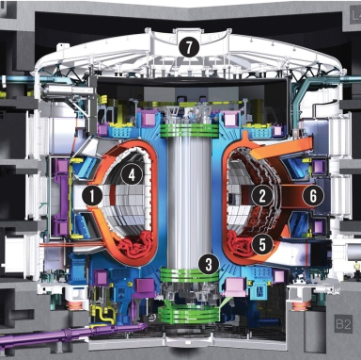
Parallel Particle-in-Cell Simulation on Unstructured Meshes
M.S. Shephard, G. Diamond, G. Perumpilly, O. Sahni, C.W. Smith, A. Truszkowska, E.S. Yoon*, C. Zhang
Rensselaer Polytechnic Institute
In Collaboration with Multiple SciDAC Fusion Partnerships
Why unstructured meshes for fusion simulations?
High fidelity simulations must accurately represent fusion device geometry
Codes have specific meshing requirements
Unstructured meshes deal with any geometry
Outline
Infrastructure for unstructured mesh PIC simulations
XGCm – mesh-based version of XGC edge plasma
GITRm – mesh-based GITR impurity transport
*Now on the faculty of Ulsan National Institute of Science and Technology, Korea

Slide 2
Parallel Unstructured Mesh for Particle in Cell
Multiscale applications combining particle and continuum
DOE fusion SciDACs want this for complex geometries
Approach used in current PIC codes
Entire mesh data on each process
Particles point to mesh – need grid search/sort
Scalable wrt number particles but not wrt mesh
Mesh-based approach being developed
Mesh is key structure – can be distributed
Particles accessed through mesh only
Particle search through mesh adjacencies
Effective coupling to mesh-based PDE solvers
Particle Push
Field to Particle
Charge Deposition
Field solve with new RHS

Slide 3
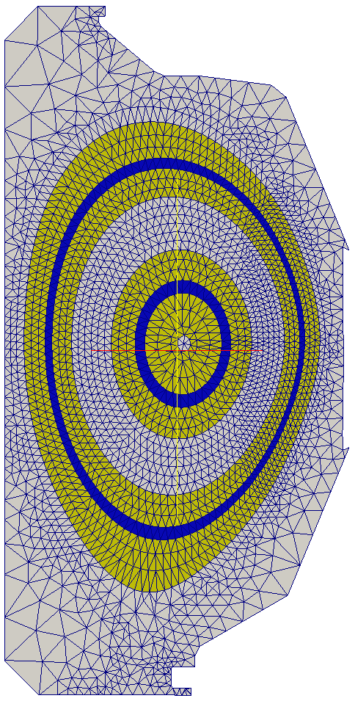
Parallel Unstructured Mesh for Particle in Cell
Mesh distributed in PICparts defined by
Set of non-overlapping parts,
Plus sufficient buffer to keep particles on part in a push
Original version employed element level linked buffer
Substantial memory overhead
Being used in initial version of XGCm edge plasma – to be swapped out for modified one
Modified approach focused on more compact data and GPU execution
PICpart is a “part” and sufficient neighboring parts
Memory requirements reduced
Being used in GITRm impurity transport
Both approaches support
Migration of particles between pushes
Dynamic load balancing
Two PICparts defined in terms of whole parts

Slide 4
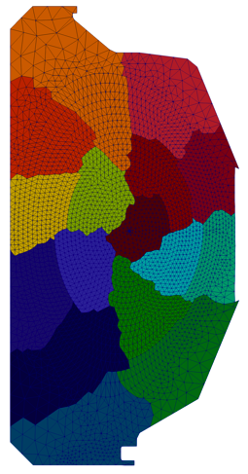
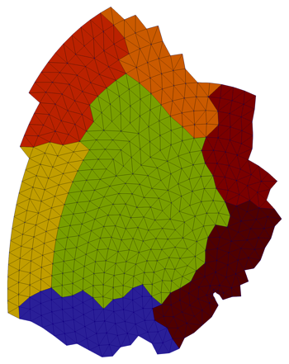
Initial Approach – Directly Use Current PUMI
PUMI originally developed for MPI based parallel mesh adaptation
Devised method using distributed mesh with heavy overlay
Use standard ghosting methods introduces large numbers of “remote copy” pointers
Method being implemented in a version of XGC
Substantial code development since all core data structures are different
Physics/numerics same as XGC – currently targeting only the basic physics modeling capabilities in XGC
Do not expect it to be efficient enough in current form
Next version will use similar structures – effort not wasted
Will gain valuable insights
A PICpart

Slide 5
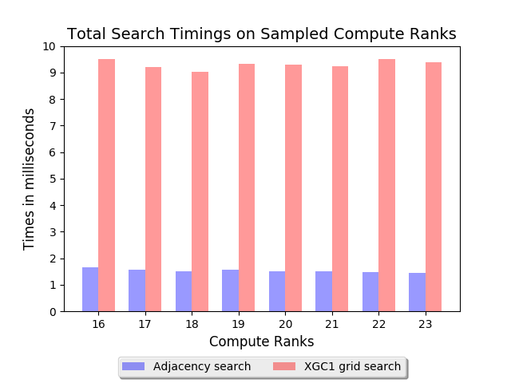
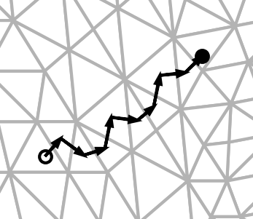
Adjacency-Based Particle Search
Require knowledge of element that particle is in after push
Particle motion small per time step
Using mesh adjacencies on distributed mesh (needed information is local due to large overlaps)
Many particles do not move to new element in a push – optimized parametric inversion for a 2.5 times improvement
Overall >4 times improvement

Slide 6
Refined Approach – Being Defined/Implemented
Defining a refined approach with modified mesh structures more suited to systems with accelerators
Distributed mesh will still be employ large overlap
Changes to gain efficiency for tracking mesh distribution
Overlaps will be complete parts of a partitioned mesh
Use global mesh element labeling (PUMI did not require)
Should allow dramatic reduction in volume of data needed to support particle migration
Devising new data structures to more effectively support GPU based operations on particles
First target is for a version of the GITR impurity transport code
Easier for testing since there is no field solve
Will use the partitioned mesh concept of having a core part, but initial version will have copy of entire mesh on each process (will move to distributed mesh later)

Slide 7
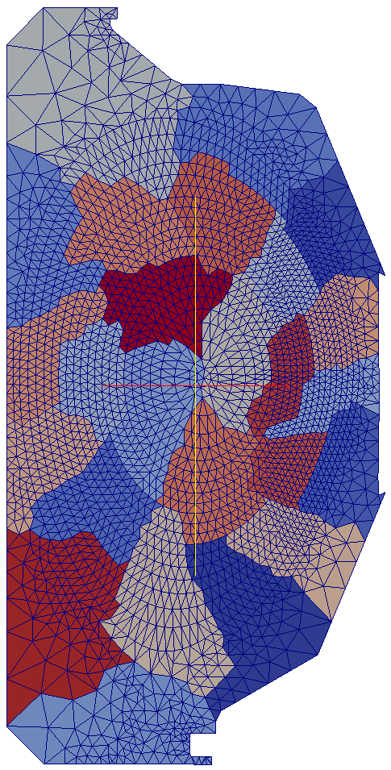
PICpart Construction
A PICpart will be
A part from a partitioned mesh – the core part. Note – there is no concern about “ownership” in the discussion – the core part is simply one that will be surrounded with enough buffer, plus
Surrounding parts such that we have sufficient buffer – In example the part B must be included in PICpart with A as core
For XCG PICpart construction is straight forward
Safe zone construction for more general cases requires more consideration
B
A
Mesh Partition for general mesh

Slide 8
Move to Alternative Mesh Structure
Mesh data structures that support adaptation have evolved
Original structures had object oriented entity level class – bad for GPUs
MDS (current PUMI) stores topology in modifiable, array-based, linked lists – OK for multi-core, managing array ‘holes’ and the ‘free list’ on GPUs during adapt not well suited for GPU execution
Omega_h is a static mesh representation that has been developed for mesh adaptation on GPU’s – simplex topology, linear geometry, structures rebuilt after changes (adaptation, migration/repartitioning)

Slide 9
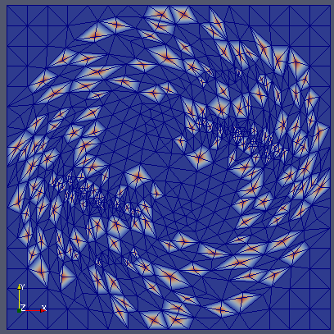
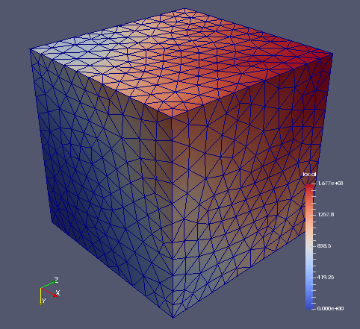
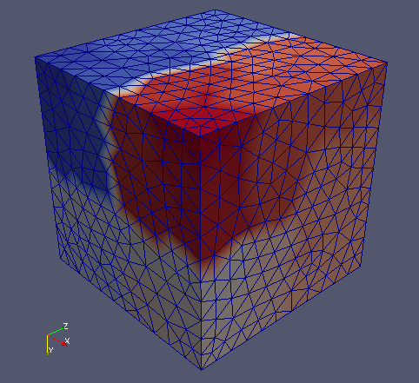
Omega_h
Targeting Omega_h for use with version operating on GPU’s
Omega_h features
Compact arrays ordered so that adjacent entities are aligned
BFS-like algorithms for effective local serial operations
Space filling curves to support parallelization
Independent set construction (currently for mesh adaptation)
On-node OpenMP or CUDA parallelism using Kokkos
github.com/ibaned/omega_h

Slide 10
Particle Data Structures
The layout of particles in memory is critical for high performance push, scatter, and gather operations on GPUs.
Particle data structure requirements:
Optimizes push, scatter, and gather operations
Associates particles with mesh elements
Evenly distributes work with a range of particle distributions e.g.) uniform, Gaussian, exponential, etc.
Stores a lot of particles per GPU – low overhead
Mesh data structure requirements:
Provide required adjacency information on GPU
Reduce irregular memory accesses by building arrays of mesh field information needed for particles.
We are working with the ECP Co-Design Center for Particle Applications (COPA) on the best structures for our application

Slide 11
Particle Data Structures (cont.)
Simple – Flat Arrays
Layout: 1D arrays of particle data
Pros – Simple, Fast push, max concurrency (1 particle/thread)
Cons – High performance of scatter/gather will likely require a lot of memory.
Fancy – Sell-C-σ (SCS)
Layout: rotated and sorted CSR, a row has the particles of an element
Pros – Fast push, lower memory usage for scatter/gather
Cons – Complexity
CSR (top), SCS with vertical slicing (bottom) Besta, Marending, Hoefler, IPDPS 2017

Slide 12
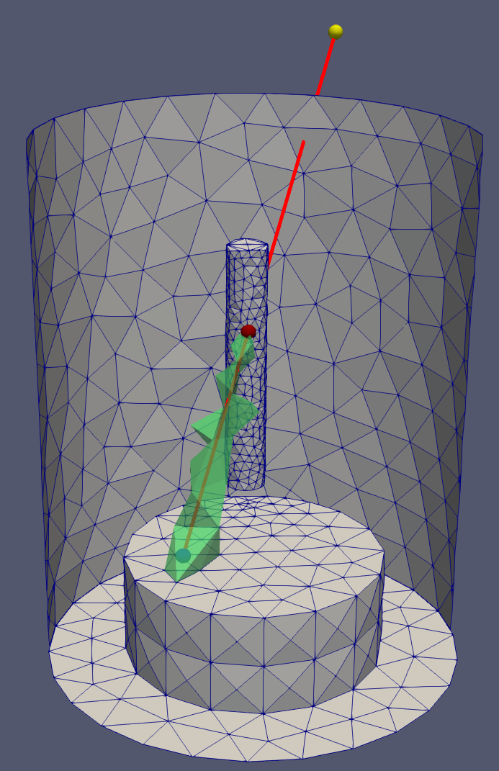
Testing of New Data Structures
Compute random particle position using parent ‘element’ field
Proxy array for scalar element field
134M particles and 131,072 elements
SCS is within 20% of flat array performance, faster with exp. dist.
Basic PIC push test
Executed 20 push, search, rebuild iterations in PISCES mesh (~6k tets) on a GPU
Particles initialized off of bottom inset face
One process and one GPU on RPI DCS System – node P9 (x2) and V100 (x4)
(lower is better)
GPU: GTX 1080ti Code: C++ and Kokkos
 | no sorting | full sorting
ptcls (Ki) | time (s) | time (s)
128 | 2.298661 | 3.642041
256 | 2.895464 | 3.415048
512 | 3.79263 | 3.851178
1024 | 4.972283 | 4.090044
2048 | 7.089673 | 4.389198
4096 | 11.578984 | 4.799475
(left) Timing results. (center) Path of a particle through mesh. (right) Elements colored by iteration when particles enter; 0=blue, 20=red.

Slide 13
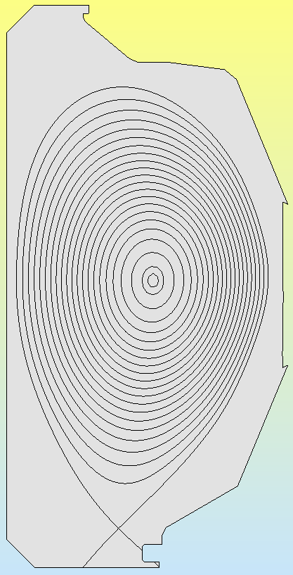
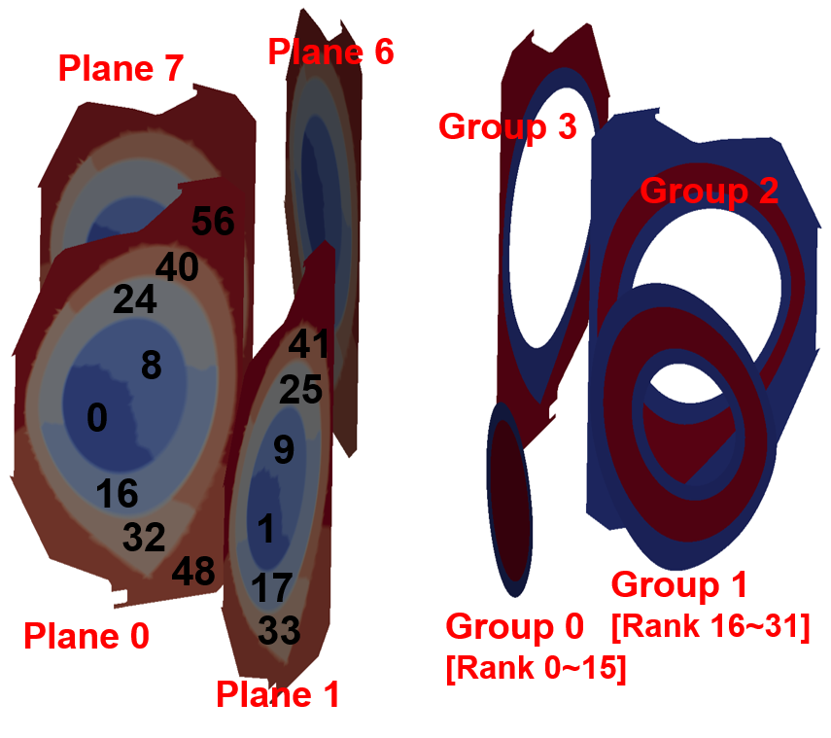
PUMIpic for XGCm Gyrokinetic Code
XGC uses a 2D poloidal plane mesh considering particle paths
Mesh distribution takes advantage of physics defined model/mesh
Separate parallel field solve on each poloidal plane
Current implementation based on original PICpart definition
Mesh distribution, adjacency search, particle migration, field transfers and parallel field solve implemented
Dynamic load balancing approach defined
Grouping structure introduced for effective parallel distribution of particles over repeated PICparts
Mesh Distribution
Model
Two-level partition for solver (left) and particle push (right)

Slide 14
Example XGCm Operation: Field Transfers
XGC gyro-average scheme for Charge-to-Mesh
Pre-computed gyro-ring weight functions
Scattering marker particle weights to vertices (left figure) → scattering gyro-ring samples of each “vertex” to vertices of element that contain the sample (right figure)
Scattering factors in the latter process pre-calculated once at setup phase with uniform gyro-radius grid
Must do communication for sums
Particle values depend on fields on bounding poloidal planes
XGCm safe zone needed to be set so gyro-ring with max. radius is on process
Charge-to-Mesh

Slide 15
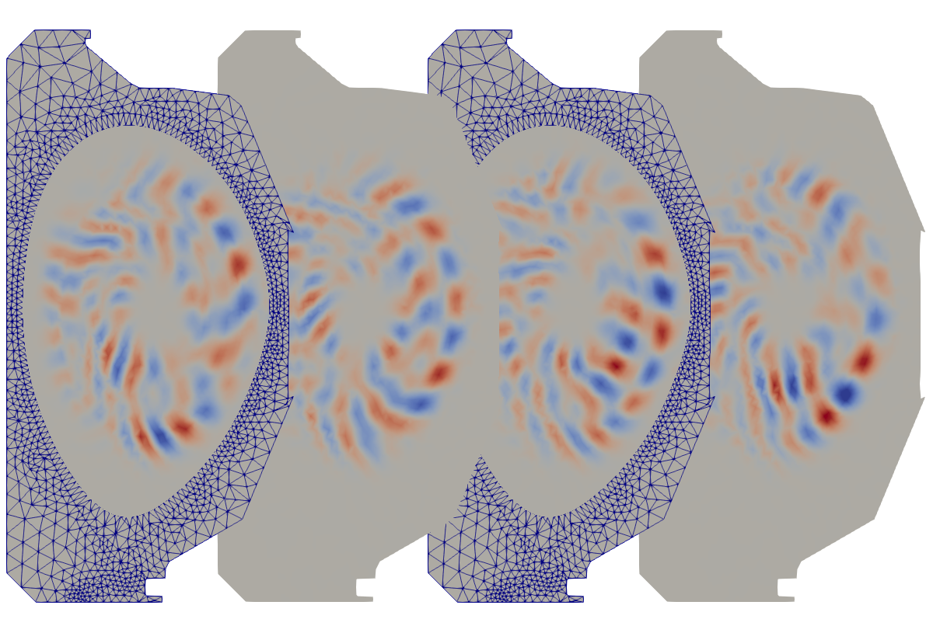
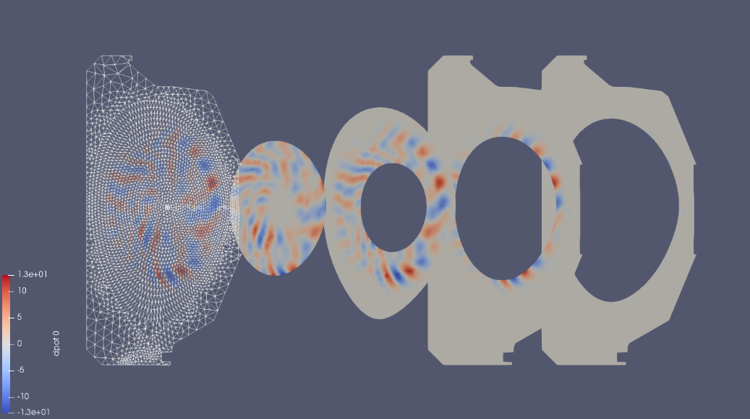
XGCm Edge Plasma Code based on PUMIpic
Implementing XGC physics and numerics
Since data structures are changed code being rewritten in C++
Status
Based on original PUMI structures – GPU focused structures will be integrated later
Mesh/particle interaction operations
Mesh solve
Ion and electron push (including subcycling)
Initial δf simulations
Performance evaluation and improvement underway
Snapshot of electrostatic potential fluctuation (a) at toroidal angle ζ=0,π/2,π,3π/2 from left to right and (b) in local domain of each group at ζ=0

Slide 16
Initial XGCm Test Problem Results
Small δf test case – 6.2K elements, 8 poloidal planes
6201 mesh elements (triangles)
300k particles/rank, 64-512 ranks, 1-8 Cori KNL nodes
Total timings (minus FE solve) equivalent to XGC1
Medium δf test case – 127K elements, 8 poloidal planes
300k particles/rank, 256-1024 ranks, 4-16 Cori KNL nodes
Push operation 25% faster than XGC (key and encouraging)
Currently total time greater than XGC – need new mesh/particle structures to eliminate slow steps

Slide 17
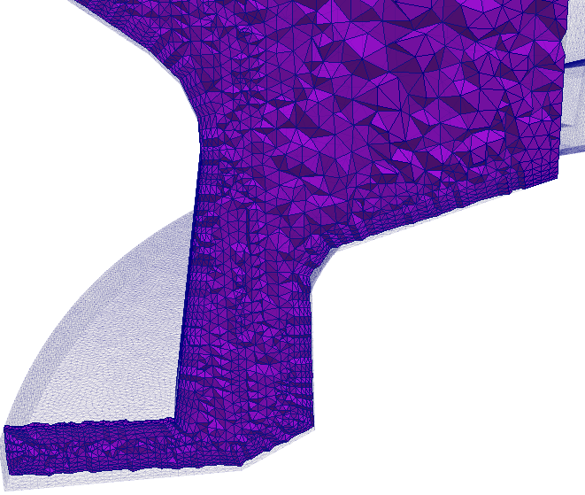
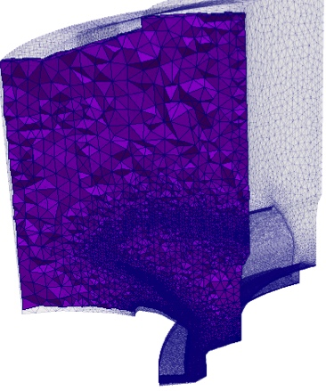
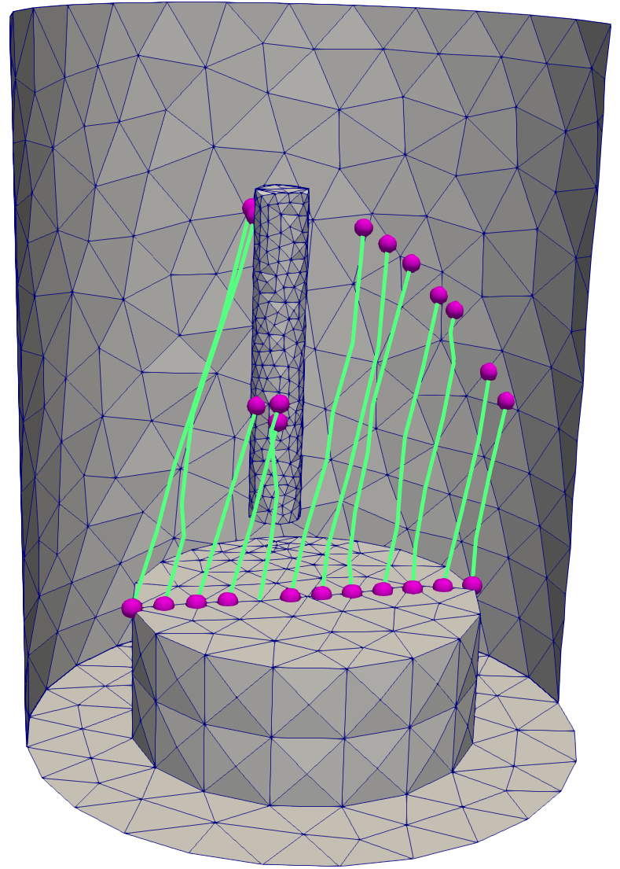
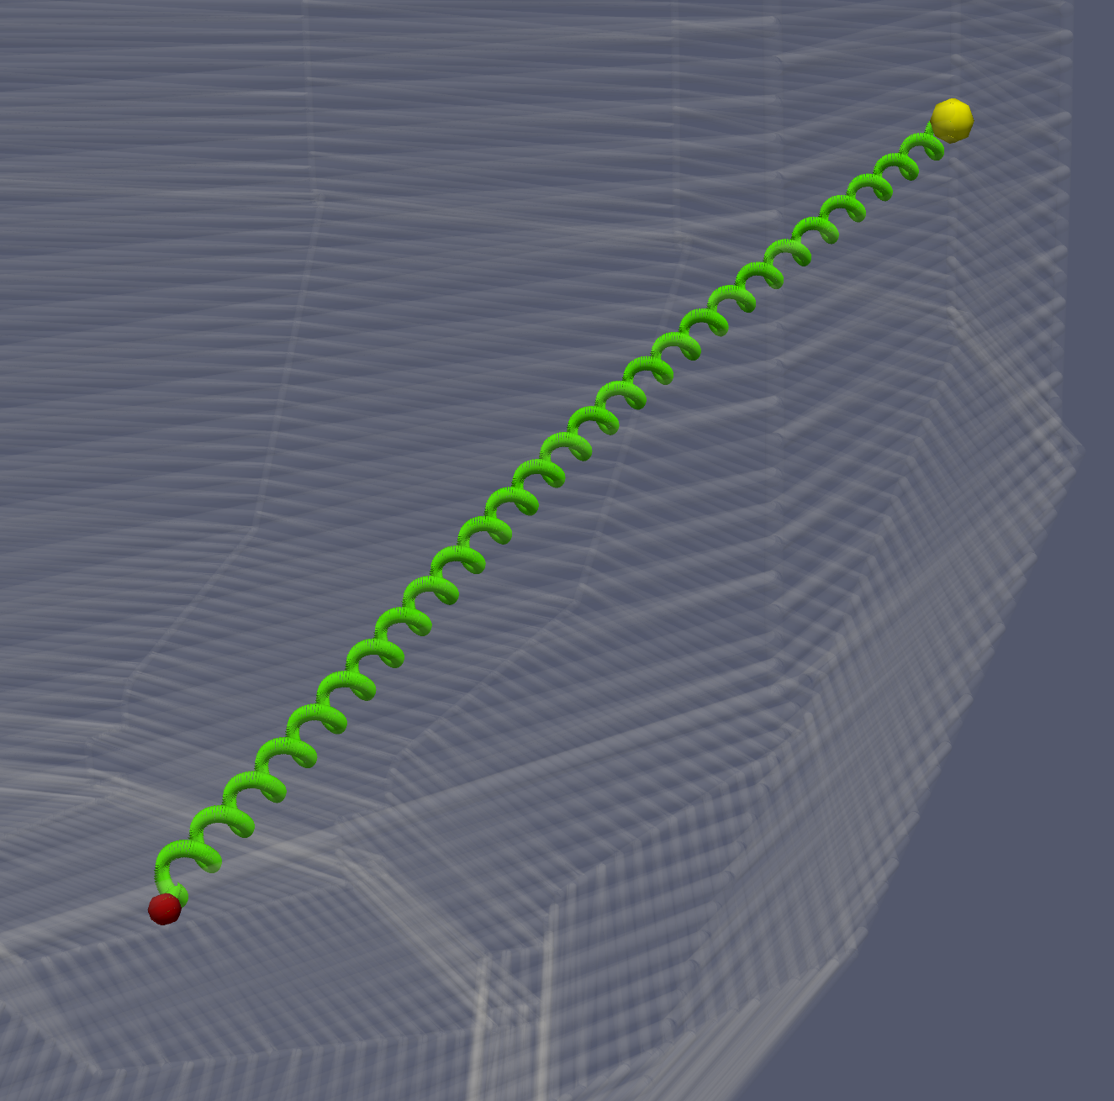
Mesh Based GITR: GITRm
Operates of 3D graded meshes
3D adjacency search
Effective on graded meshes
Wall intersection implemented
Employ mesh entity classification for efficient operation
Elements where distance tracking preprocessed to know when needed
GITR Boris move implemented
Omega mesh and new particle data structures
Initial tests, including GPU execution, underway
Working with U. Tenn and ORNL on to define appropriate verification tests

Slide 18
Mesh-based GITR: GITRm – Preliminary Tests
Executed 20 push, search, rebuild iterations on PISCES mesh (~6k tets) on a GPU
Results comparable to those executed on background grids
Developments for larger particle counts and multiple processes:
Bulk communication layer w/MPI wrapper for MPI, CUDA aware MPI, and possibly NCCL (initial version in testing)
Remaining and new physics
Parallel PICpart creation (done)
 | no sorting | full sorting
ptcls (Ki) | time (s) | time (s)
128 | 2.298661 | 3.642041
256 | 2.895464 | 3.415048
512 | 3.79263 | 3.851178
1024 | 4.972283 | 4.090044
2048 | 7.089673 | 4.389198
4096 | 11.578984 | 4.799475
(left) Path of a particle through mesh. (center) Elements colored by iteration when particles enter; 0=blue, 20=red. (right) Timing results

Slide 19
Closing Remarks
Key changes/developments
An element centric view – particles associated with elements
A distributed mesh, but one that can avoid communication during the push step
Replaced spatial search with adjacency search
Structures and methods suited for executing mesh-based PIC on accelerators.
Development being integrated into PIC codes
XGCM: core components in place basic set of physics operations implemented – have verified basic test cases
GITR: Fully 3D mesh, current emphasis is to prototype the improved structures and methods
Acknowledgement:
This work is supported by the US Department of Energy under grants # DE-SC0018275 and DE-AC52-07-NA27344

