Slide 1
Unstructured Mesh Methods for
Particle in Cell Simulations
M. Adams¹, D. Ibanez², M. Kneplay³, G. Perumpilly⁴, O. Sahni⁴,
M.S. Shephard⁴, C.W. Smith⁴, C. Zhang⁴
¹Lawrence Berkeley National Laboratory
²Sandia National Labs
³Uinversity at Buffalo
³Rensselaer Polytechnic Institute

Slide 2

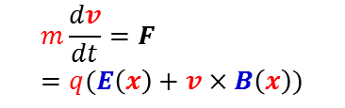




Unstructured Mesh Methods for Particle In Cell Simulations
Particle In Cell (PIC) represents an important class of multiscale method used in several areas of science
Particular emphasis is fusion plasma physics
FASTMath unstructured mesh PIC developments
  Fully conservative coupled particle/FEM method for the Vlassov-Maxwell-Laundau system
  Parallel unstructured mesh management procedures for PIC simulation codes
Fusion energy SciDACs
  Core plasma
  Edge plasma
  Wall impurities
Particle Push
Field to
Particle
Charge Deposition
Field solve with new RHS
Notes:
Current SOA before PISCEES: A structured grid finite difference code (1) without the ability to refine or adapt the mesh to where it is needed, such as runoff glaciers and (2) with robustness issues.
Performance is always a concern as well.
These are being solved by the bullets at the bottom (AMR or unstructured gird, improved nonlinear and linear solvers, improved use of new architectures).
What work this will enable that current State of Art does not:
Improved grid and discretization enables us to resolve the dynamics much better, including runoff glaciers and the grounding line (Ice/Ocean/Land triple point).
Robustness is critical for releasing the code to a broad community, and evn more, to release it as a subcomponent of an full Earth System Model coupled to ocean and land models.
Engagement with linear solvers experts (Adams, Tuminaro) critical for achieving speed and scalability of the major linear solver cost.
------------------------------
The colors are ice flow – red is fast and needs refinement, blue is slow and can use coarser grids
Structured grid – aimed at getting the grounding line very accurate (where ice goes from touching land to going over the ocean) – when on the bedrock a very large friction coefficient and goes to almost no friction 0 this impacts the rate of the formation ice break/ice bergs
Finite element trilinos code – static refinement – no dynamic adaptivity. Aiming for callibration and parameter inversion problem. A lot of data and coefficients in the models – want to create a self consistent initial condition and then propagate into the future so we can do better predictions. The initialization of the model is the bulk of the work – if we can’t calibrate the model so that today looks like today, there is very little hope of getting tomorrow correct.
In the first year, have written the solvers. Now can co the callibration with uncertainty – will involve quest as well.
Second part for fastmath work – implicit solvers. Nonlinear methods and Homotopy and FAS multigrid; majority of the time is in the iterative solves so have been spending a lot of time. Spans the FASTMath topic areas very well.

Slide 3
Particle-Grid Interaction Support in PETSc
Develop particle-grid interaction methods in PETSc
  New DMTelescope object
  Map (particle) charge to unstructured grid
  Map weights back to particles from grid
  Conserve mass, momentum and energy
    Even higher moments if desired
Develop particle interface for existing Landau Collision Integral solver
  Deploy as 3rd party library for particle-in-cell (PIC) Vlasov codes
3

Slide 4
Landau Collision Integral Solver
Magnetized plasmas Vlasov-Maxwell-Landau
  For each species α:
  Distribution function f in phase space
Landau collision operator C_{α} gold standard for fusion plasmas
  Plasmas dominated by small-angle Coulomb collisions
  Transitions many-body dynamics single particle statistics
Develop mass, momentum and energy preserving particle-grid transfer operators
  Preserve all moments up to order accuracy of the finite element space in solver
4

Slide 5
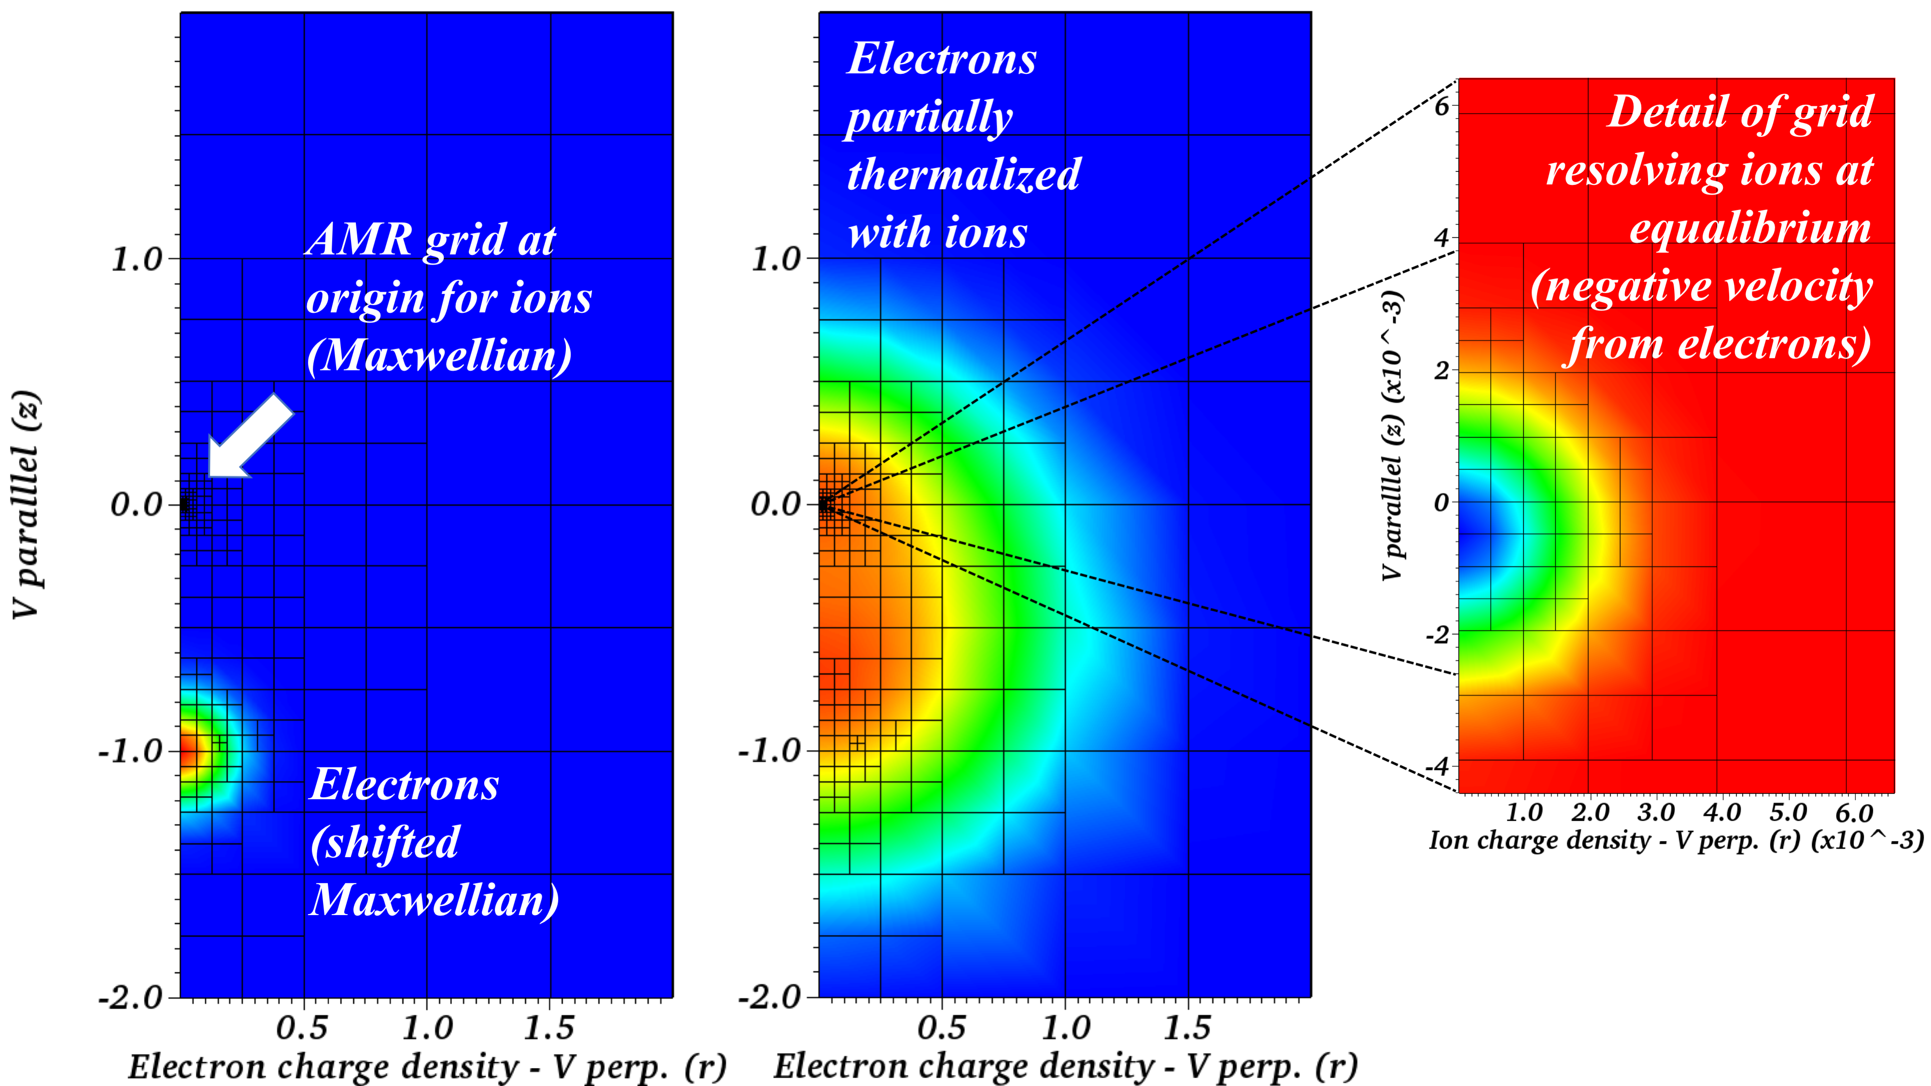
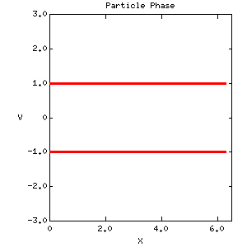
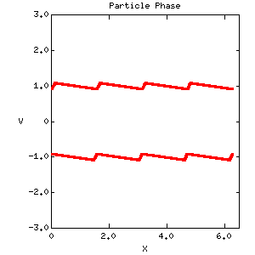
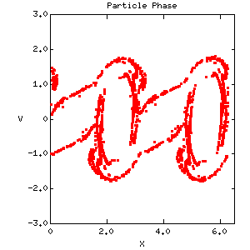
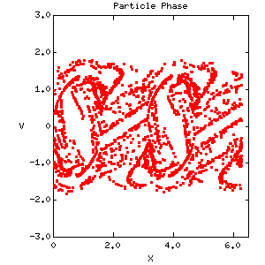
Landau Collision Integral Solver – Results
Fully conservative coupling of particle and adaptive mesh FEM discretizations¹
New DMSwarm manages
parallel particle fields in PETSc
Symplectic integrators of order 1, 2, 3, and 4 implemented
Eventually enable full GEMPIC² algorithm
Particle-grid interaction:
Electron beam thermalizing with ions
¹M. F. Adams, et. al., SIAM J. Sci.
Comp., 2017
²M. Kraus, et. al., Journal of Plasma
Physics., 2017
Two stream instability test, initial conditions (left), with roll up (right) using initial PETSc implementation of GEMPIC
5

Slide 6

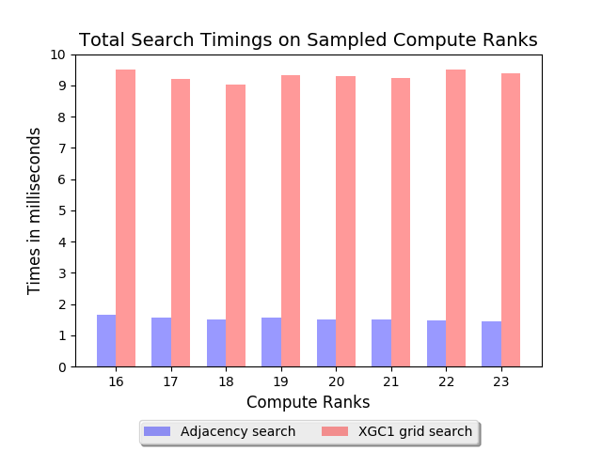
Parallel Unstructured Mesh for Particle in Cell
Multiscale applications combining particle and continuum
  Fusion SciDACs want this for complex geometries
Current approaches being used
  Copy of entire mesh and fields on each process
  Particles point to mesh – need grid search
  Scalable wrt number particles but not wrt mesh
Mesh-based approach being developed
  Key structure is the mesh
  Particles accessed through distributed
  mesh – with appropriate overlap
  Particle search through mesh adjacencies
  Effective coupling to mesh-based PDE solvers
  Generalization for other fusion codes under
  development

Slide 7
Parallel Unstructured Mesh for Particle in Cell
Initial XGCm implementation based on PUMI
  Distributed mesh with overlap – more pointers than desired
  Physics/numerics same as XGC
  Optimizing current version on first level physics (delta-f)
Modified approach focused on more compact data distribution and GPU execution
  Omega_h for the mesh data structure
  New element based particle structures – interactions with the COPA ECP project
  Alternative distribution based on complete parts to reduce all the copies associated with entity level read only copies
  Using Kokkos for performance portability
  Being used in new version of GITR impurity transport code

Slide 8
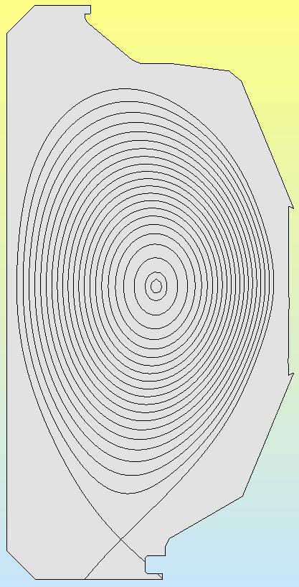
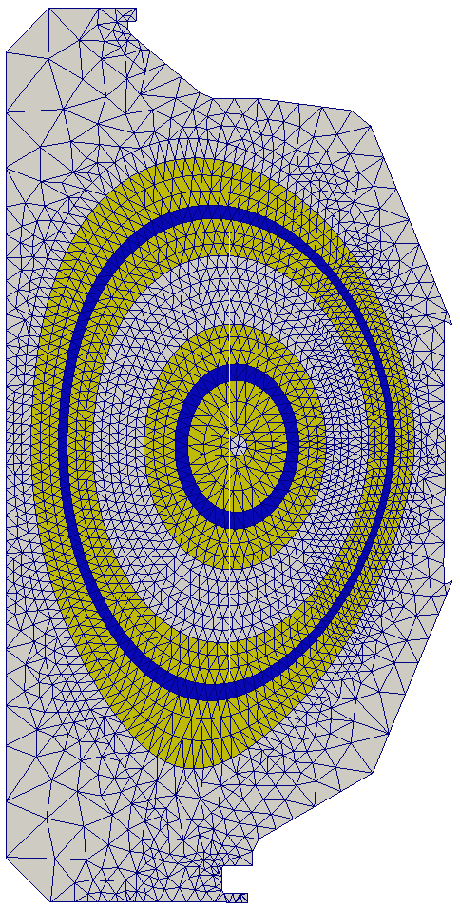
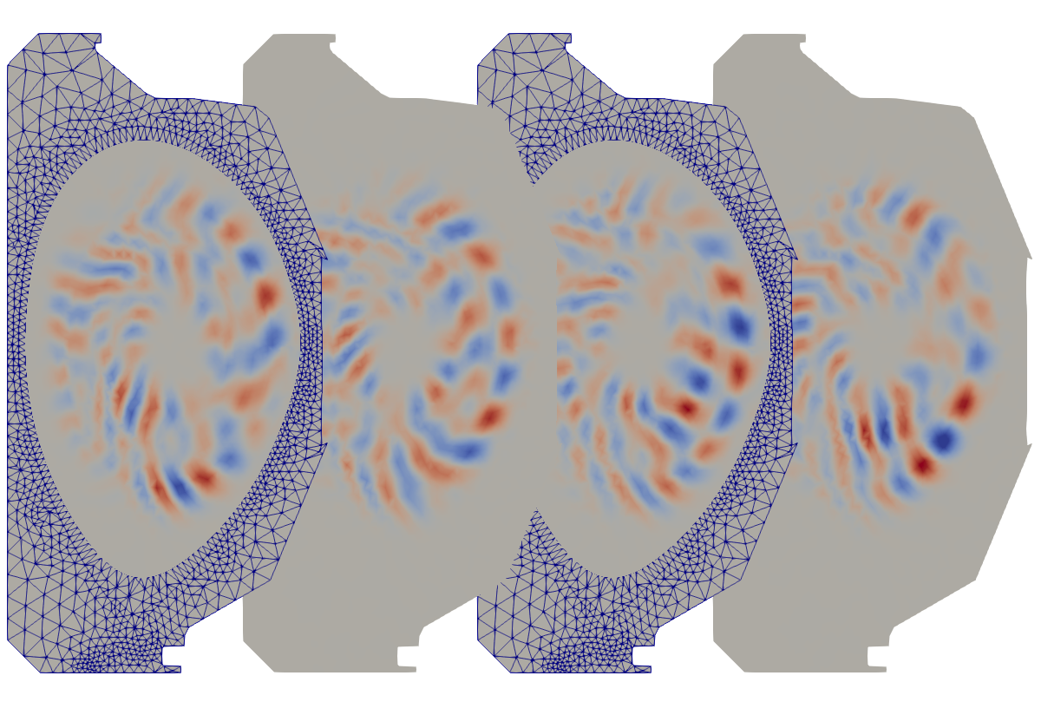
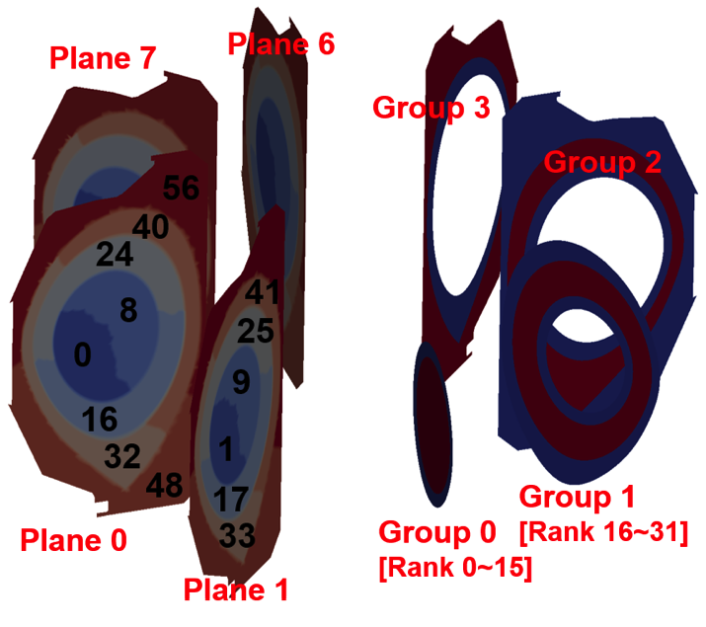
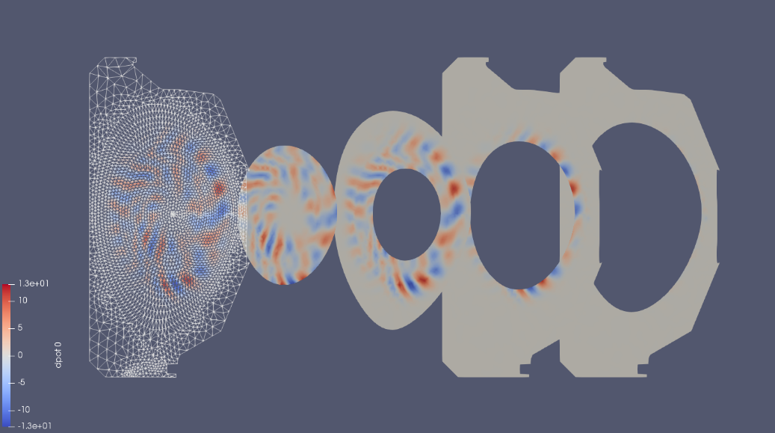
XGCm Implementation Status
Status of development
  C++ code supporting ion and electron push for δf simulations
  Currently
    optimizing key
    steps
    Evaluating more
    scalable procedures
    Starting to plan
    to move to new
    structures
Model
Distributed mesh
Snapshot of electrostatic potential fluctuation (a) at toroidal angle ζ=0,π/2,π,3π/2 from left to right and (b) in local domain of each group at ζ=0
Two-level partition for solver (left) and particle push (right)

Slide 9
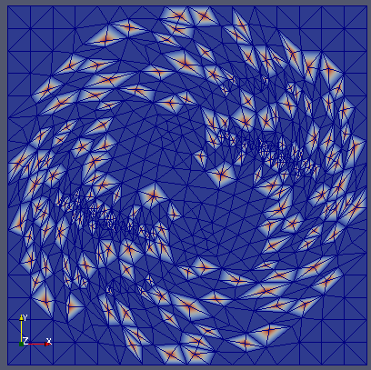

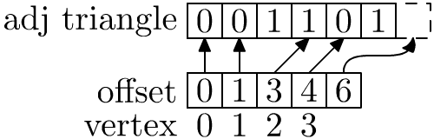
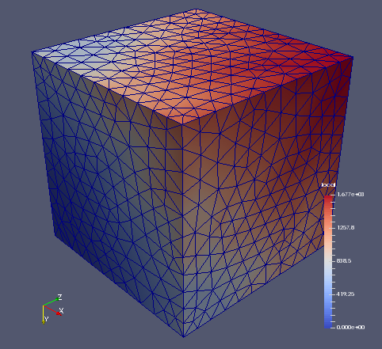
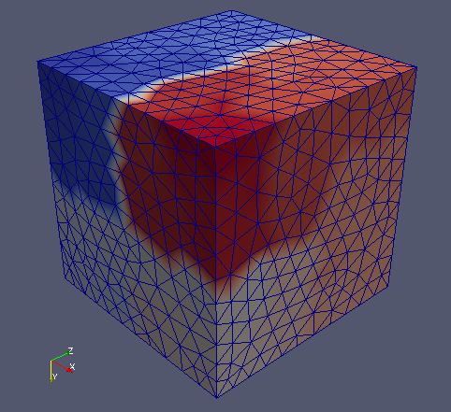
Mesh Data – Omega_h
Omega_h features
  Compact arrays ordered so that adjacent
  entities are aligned
  BFS-like algorithms for effective local serial
  Space filling curves to support parallelization
  Independent set construction
  (currently for mesh adaptation)
  On-node OpenMP or CUDA
  parallelism using Kokkos
github.com/ibaned/omega_h

Slide 10
Particle Data Structures
The layout of particles in memory is critical for high performance push, scatter, and gather operations on GPUs.
Particle data structure requirements:
  Optimizes push, scatter, and gather operations
  Associates particles with mesh elements
  Changes in the number of particles per element
  Evenly distributes work with a range of particle distributions (e.g. uniform, Gaussian, exponential, etc.)
  Stores a lot of particles per GPU – low overhead
Mesh data structure requirements:
  Provide required adjacency information on GPU
  Reduce irregular memory accesses by building arrays of mesh field information needed for particles.

Slide 11
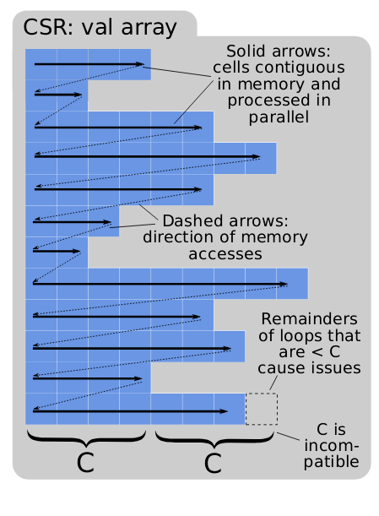
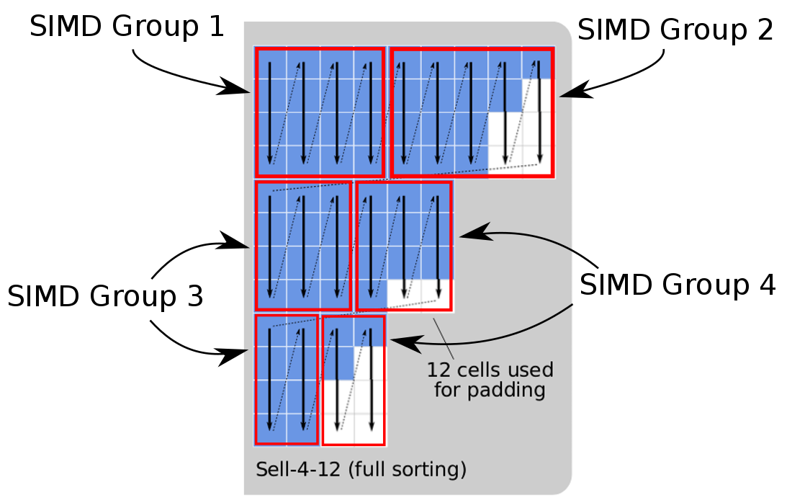
Particle Data Structures (cont.)
Simple – Flat Arrays
  Layout: 1D arrays of particle data
  Pros – Simple, Fast push, max
  concurrency (1 particle/thread)
  Cons – High performance of
  scatter/gather will likely require
  a lot of memory
Fancy – Sell-C-σ (SCS)
  Layout: rotated and sorted CSR,
  a row has the particles of an element
  Pros – Fast push, lower memory
  usage for scatter/gather
  Cons – Complexity
CSR (top), SCS with vertical slicing (bottom)
Besta, Marending, Hoefler, IPDPS 2017

Slide 12
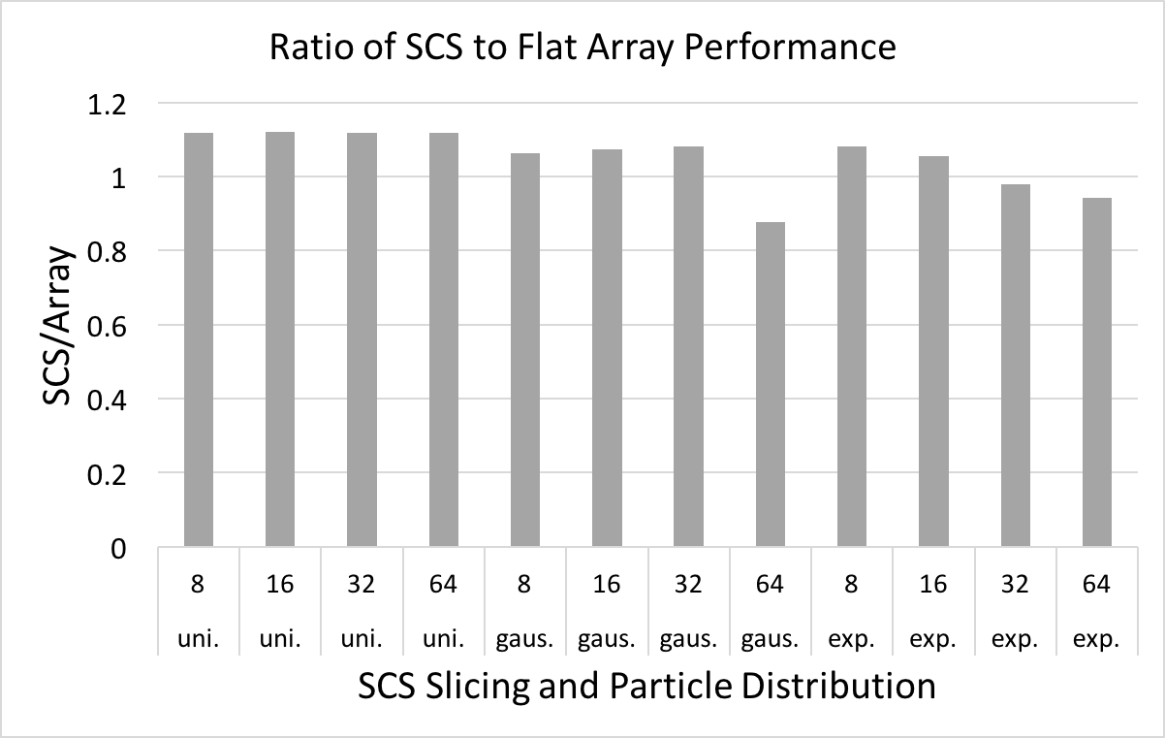
Pseudo Push Experiment
Compute random particle position using parent ‘element’ field
  Proxy array for scalar element field associated with verts
  134M particles and 131,072 elements
SCS is within 20% of flat array performance, faster with exp. dist.
(lower is better)
  GPU: GTX 1080ti
  Code: C++ and Kokkos

Slide 13
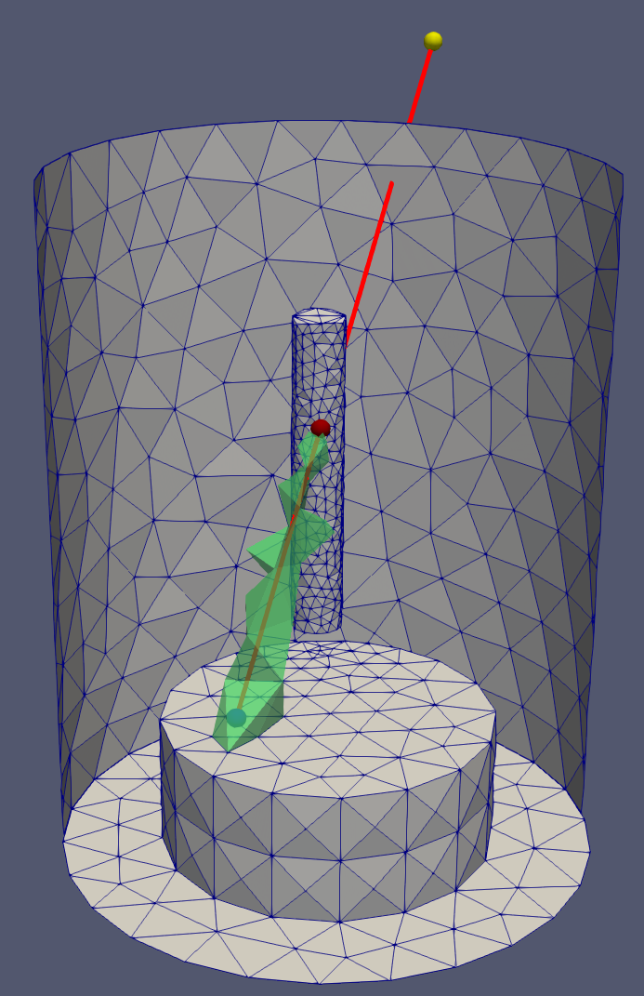
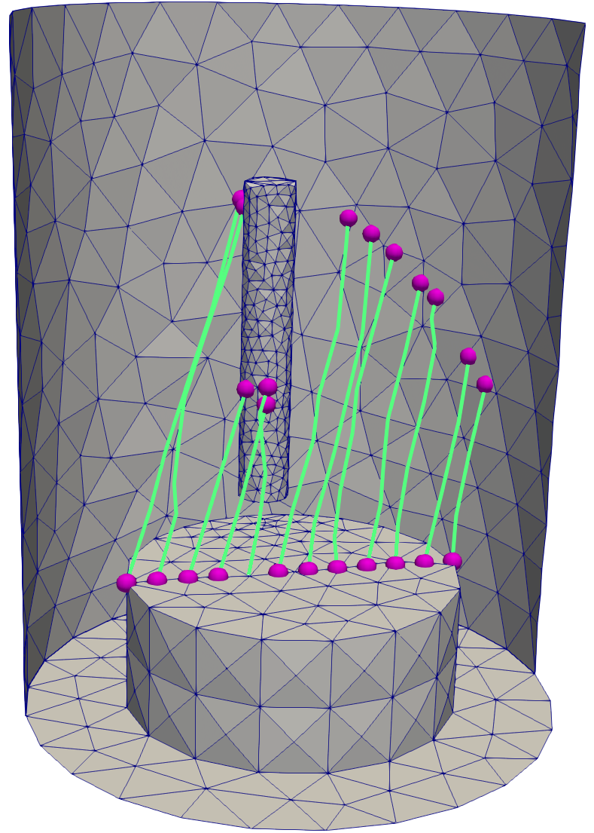
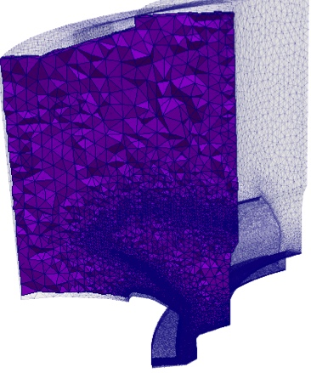
Mesh Based GITR
PUMIpic capabilities needed for GITR
  Fully 3D graded/adapted meshes
  based on particle distribution
  Wall interactions
  Plan on supporting the future
  case where the fields evolve
  based on particle position
Development of 3D mesh
version of GITR initiated
  Based on new approach
  Initial efforts focused on the
  on-node operations and GPU’s
  Key steps implemented to work
  on 3D meshes
Particle traces from original GITR
Possible graded mesh

Slide 14
Parallel Unstructured Mesh for Particle in Cell: Application Interactions
Three fusion SciDACs need unstructured mesh/particle
  Center for Tokamak Transient Simulations, Steve Jardin, PPPL
  High-fidelity Boundary Plasma Simulation, C.S. Chang
  Plasma Surface Interactions, Brian Wirth, ORNL
Working toward a general ability to be used in new versions of:
  M3DC1 – core plasma
  XGC – edge plasma
  hPIC – Sheath model (near wall interactions)
  GITR – Impurity generation and transport (wall interactions)
14

