Slide 1







Unstructured Mesh Technologies for
Fusion Simulation Codes
M.S. Shephard, G. Diamond, M. Hakimi, G. Perumpilly, O. Sahni, E.S. Seol, C.W. Smith, W.R. Tobin, A. Truszkowska, E.S. Yoon*, C. Zhang
Rensselaer Polytechnic Institute
In Collaboration with
M.W. Beall, B.R. Downie, R. Nastasia and S. Tendulkar
Simmetrix Inc.
V. Dobrev, T. Kolov, M.L. Stowell
Lawrence Livermore National Laboratory
D. Ibanez
Sandia National Laboratories
And with Multiple SciDAC Fusion Partnerships
*Now on the faculty of Ulsan National Institute of Science and Technology, Korea

Slide 2
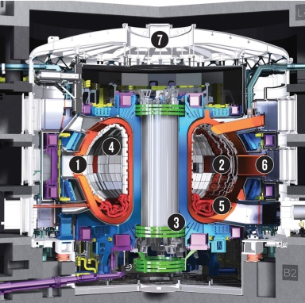
Background / Selected Developments
Why unstructured meshes for fusion simulations?
  High fidelity simulations must accurately
  represent fusion device geometry
  Codes have specific meshing requirements
  Unstructured meshes deal with any geometry
Areas of Developments
  Mesh generation/adaptation advances for fusion SciDACs
  Support of M3D-C1 extended MHD code for core plasma
  Adaptive RF simulation workflows
  Infrastructure for unstructured mesh PIC simulations
  Status of XGCm – mesh-based version of XGC edge plasma
  Status of GITRm – mesh-based GITR impurity transport
  Last year overviewed technologies, this year focus on advances

Slide 3
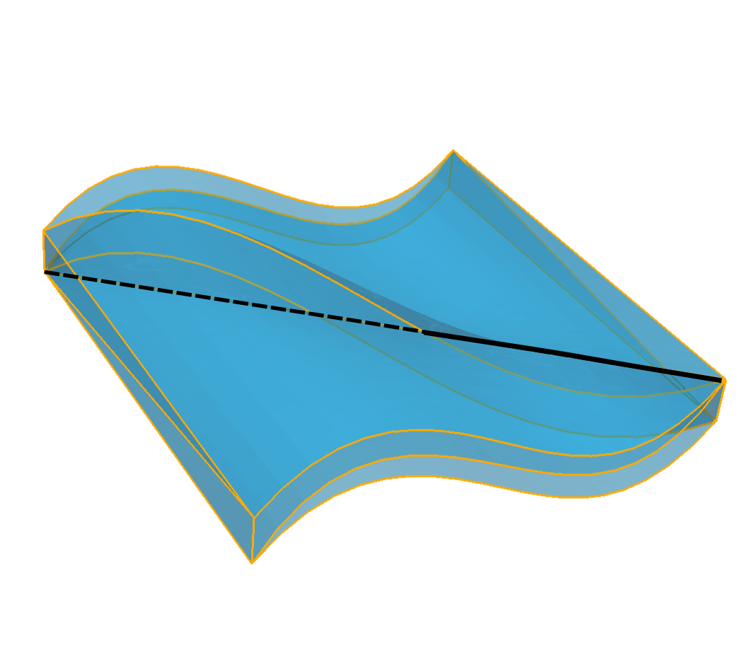
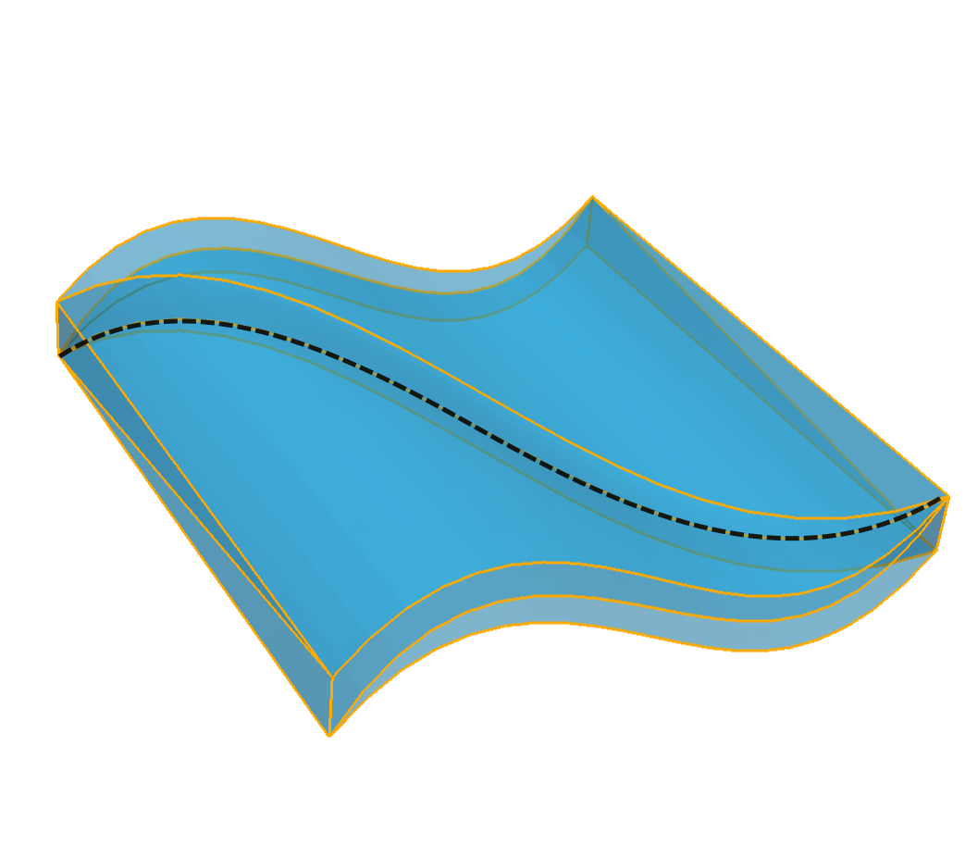
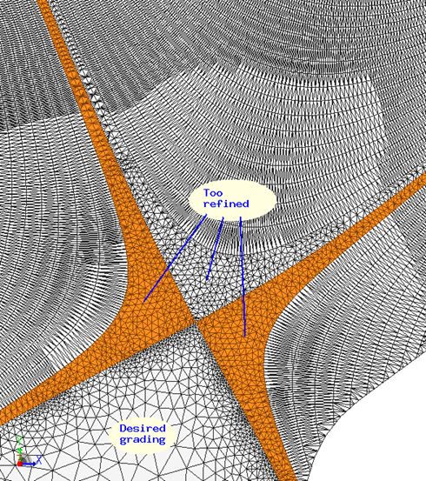
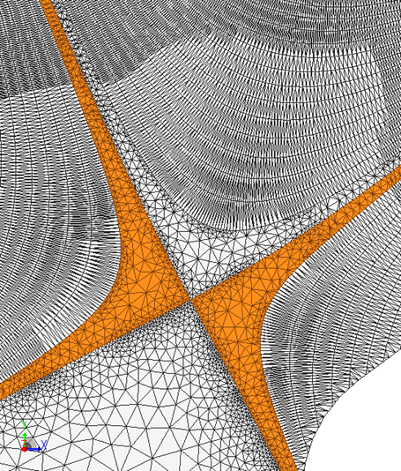
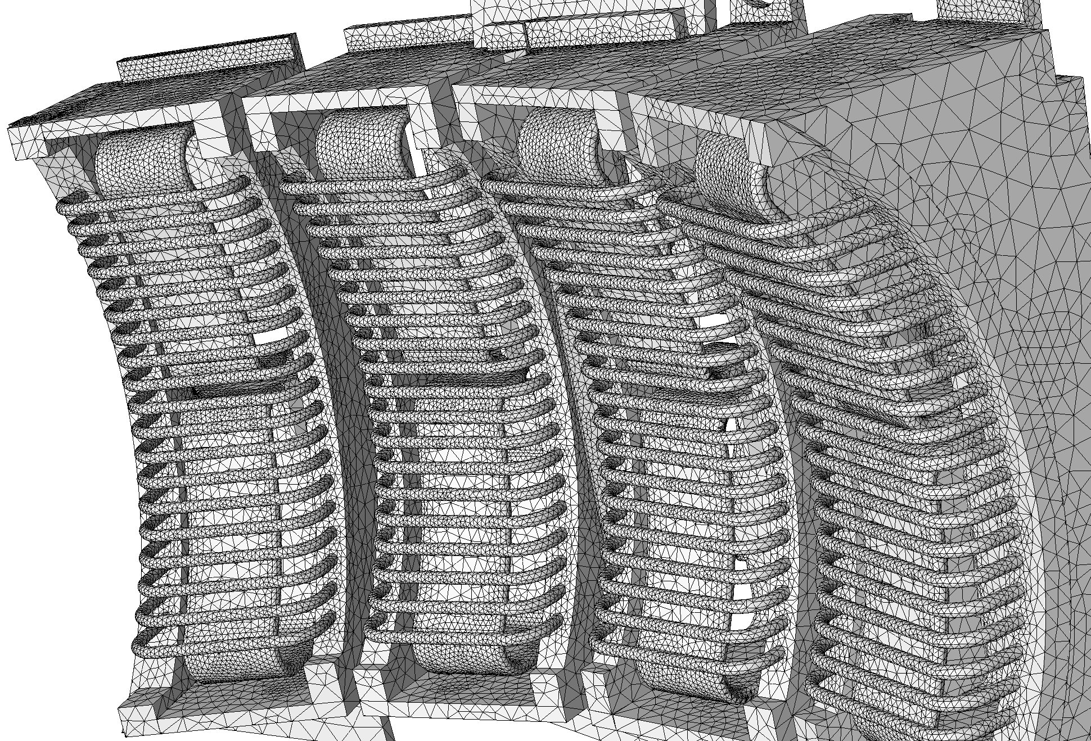
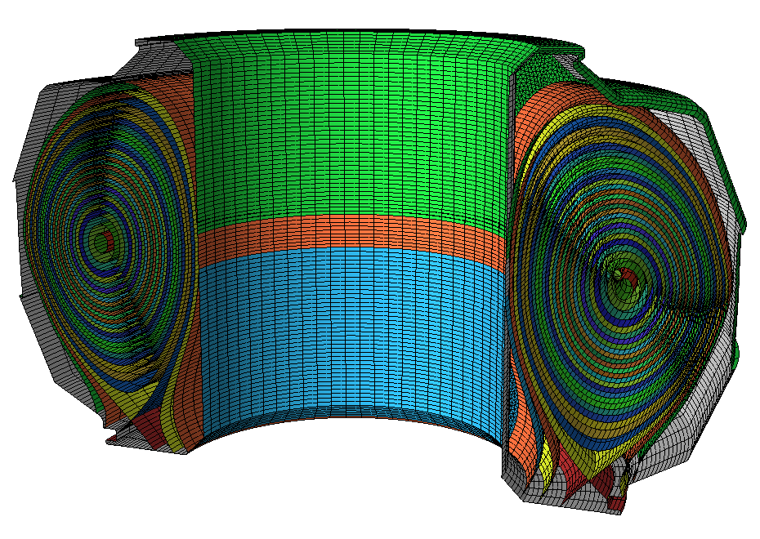
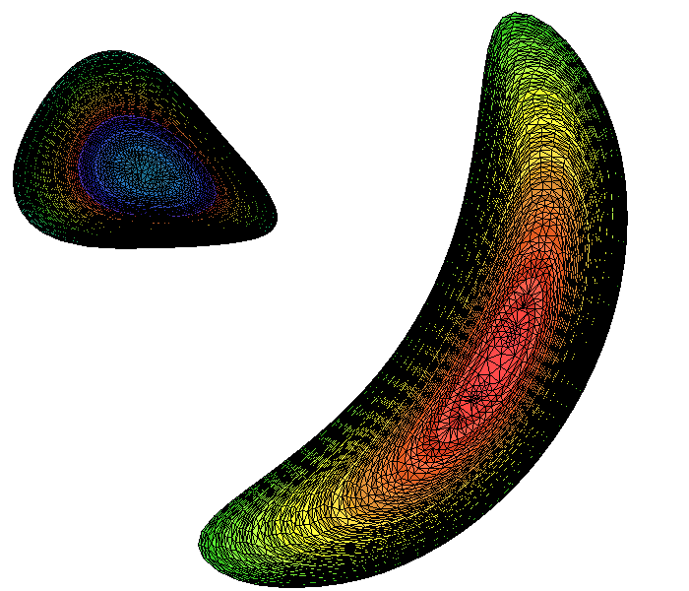
  Fusion Geometry and Meshing Developments
Working directly with Simmetrix
  Tokamak geometry and meshing
    Reordering mesh for better memory access
    ITER, DIII-D, Alcator C-MOD, NSTX, KSTAR, etc.
    EFIT physics geometry
    Improved mesh quality at x-point and
    at wall/flux curve interactions
  Graphical user interface enhanced,
  user documentation being written
  Curved mesh generation
  Higher order curved mesh adaptation
  Investigation of stellalator meshing
Notes:
The basic Tokamak is a torus.
r starts from the axis point (the center of each cross section)

Slide 4
Adaptive RF Simulation Workflow
  Workflow steps
  Obtain and clean-up antenna CAD models
  Combine antenna, reactor and physics geometries
  Associate analysis attributes
  Automatic mesh generation
  MFEM finite element analysis
  Estimate discretization errors. If below tolerance terminate
  Adapt mesh and return to step 5
Tools used
  Geometry – Simmetrix SimModeler, CAD systems, EFIT
  Mesh generation – Simmetrix MeshSim
  Mesh services and curved mesh adaptation – PUMI
  High-order finite element analysis – MFEM
  RF simulations – PetraM
  Error estimator – PUMI
Steps 1-3 are interactive
Steps 4-7 are automated

Slide 5
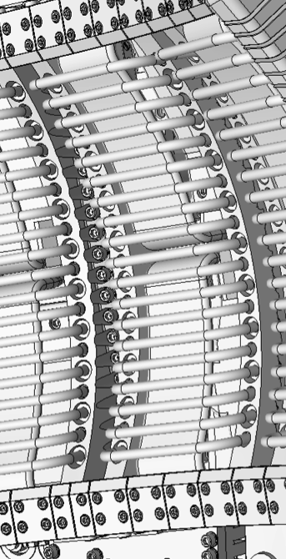
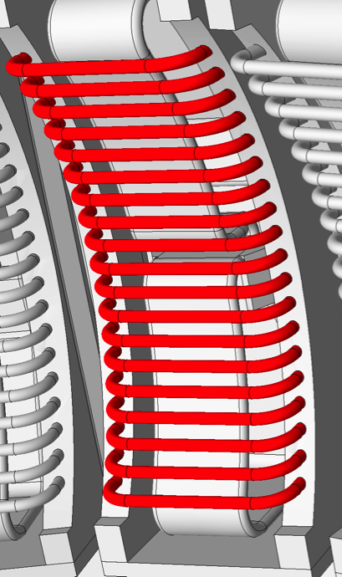
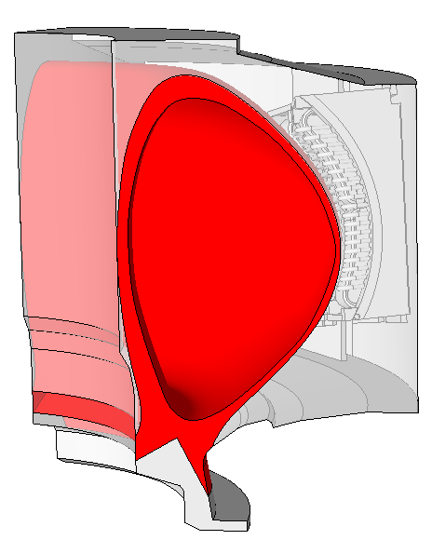
Defeaturing CAD Models and Combining Geometry
Tools used: CAD systems, SimModeler
  Antenna defeatured using functions in the SimModeler GUI
    Fast elimination of large numbers of small features
    Simplified geometry can be added
  Reactor cross section extruded
  EFIT data used to construct flux surface
  Model components combined in SimModeler
    Region identification
    Preparation of analysis geometry
5

Slide 6
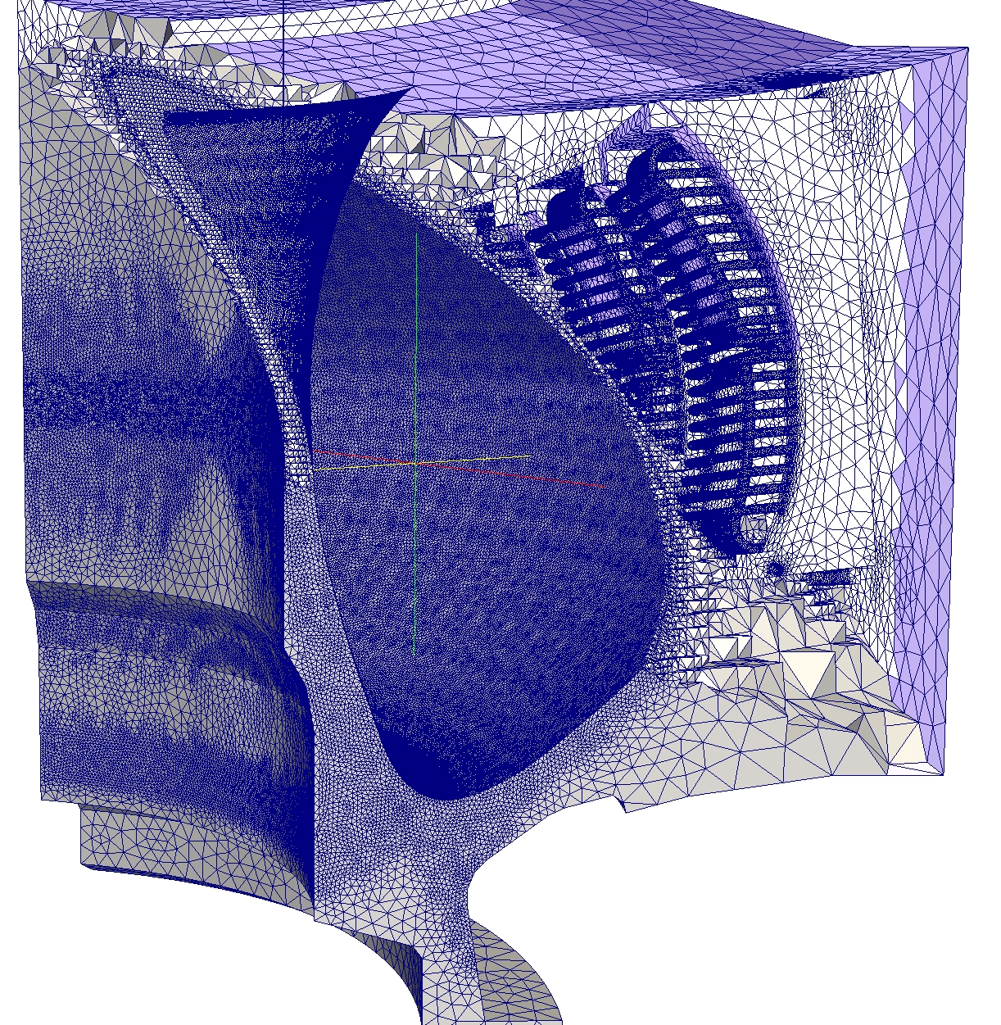
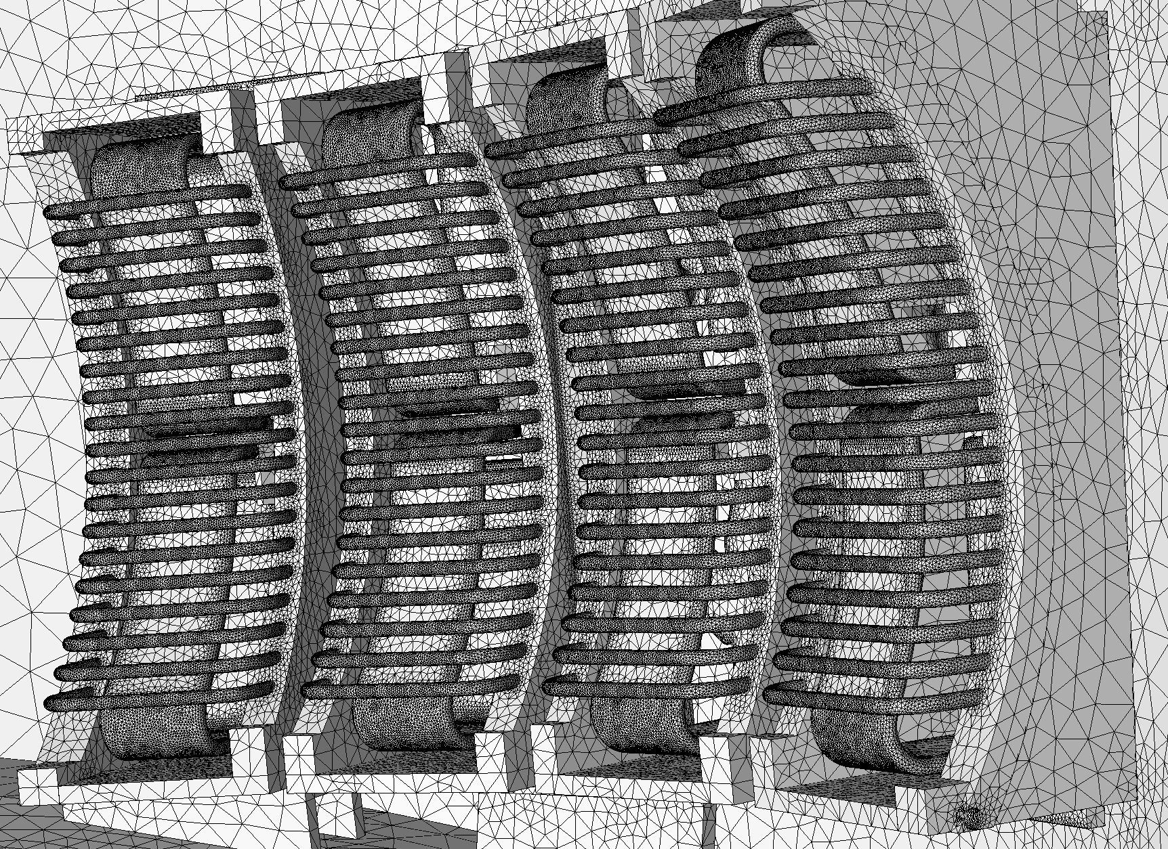
Curved Mesh Generation
Tools used: MeshSim, GeomSim, Adapt
Functionalities needed
  Mesh controls on analysis geometry
  Automatic mesh generation
  Linear or quadratic geometry mesh
  Curved mesh entity inflation (initial
  version – further efforts required)
8M element mesh with refined SOL
8M element linear mesh
2.5M element quadratic mesh
6

Slide 7
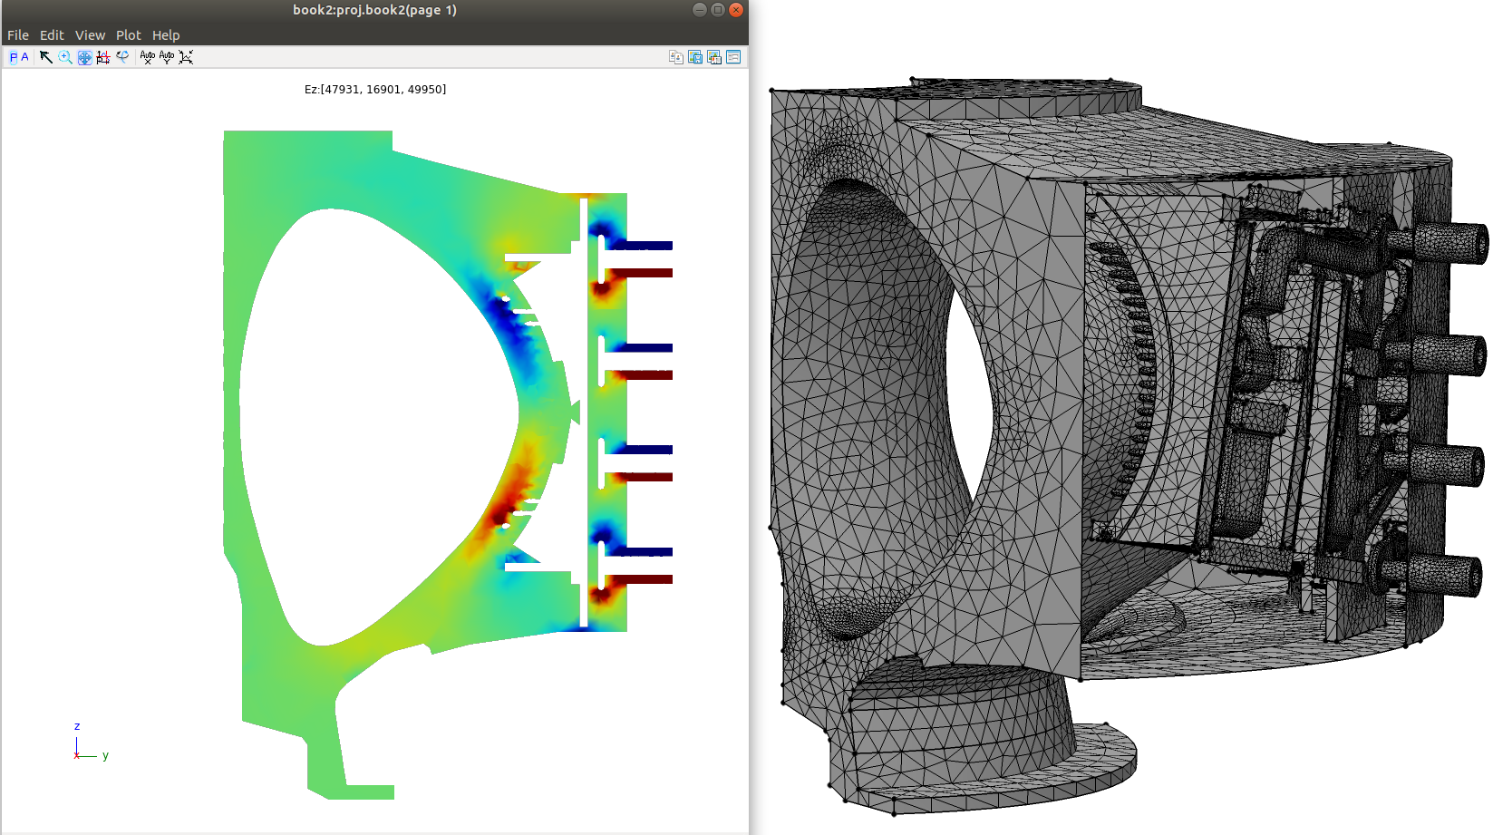
Integration of PUMI with MFEM
Tools used: PUMI, PetraM, MFEM
Functionalities needed
  Parallel meshes into MFEM
  Link with PetraM
Current Status:
  In-memory integration of parallel PUMI with MFEM
  Integration with PetraM (some file transfer –
  in-memory underway)
7

Slide 8
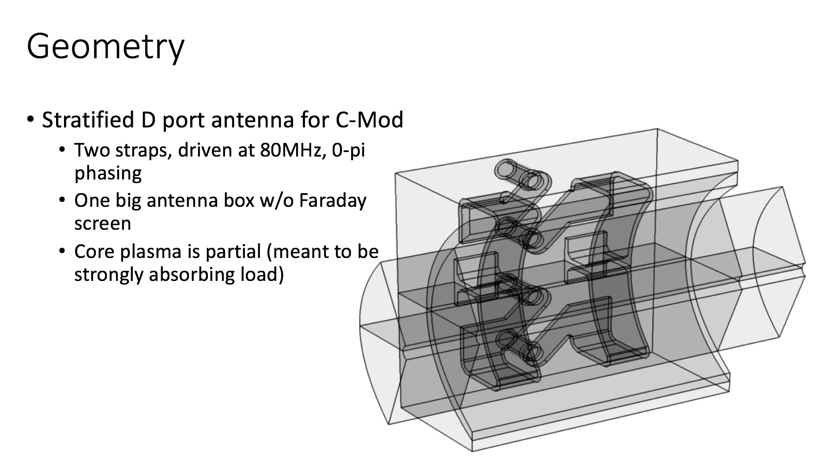
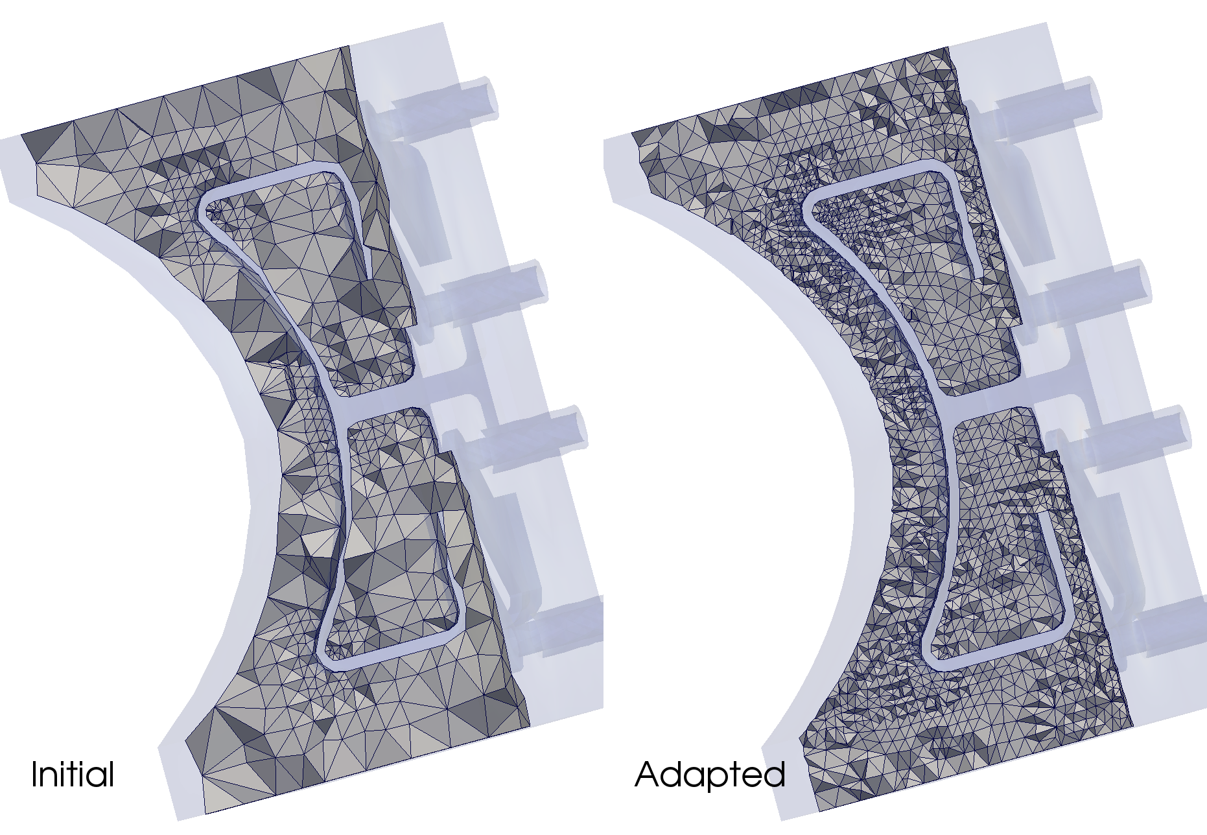
Adaptive Mesh Control
Tools used: PetraM, MFEM, PUMI/MeshAdapt, GeomSim
  Patch recovery error indicator
    A version specific to Nedelec elements is under development
  Integrated with the PetraM/MFEM/PUMI/MeshAdapt
  Example: D-Port Antenna for C-MOD
    2-straps, driven and 80MHz
    Core plasma is partial
8

Slide 9
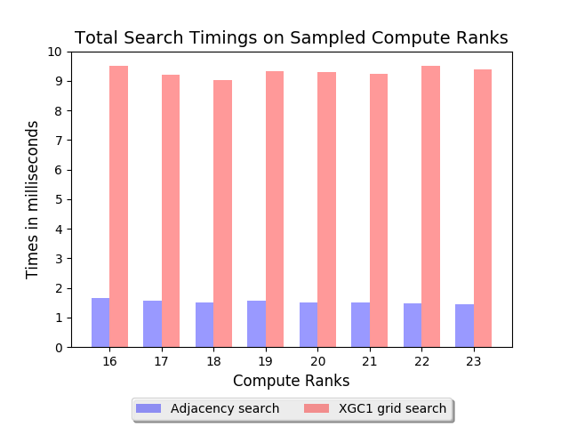


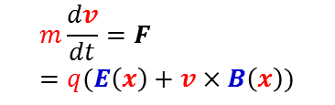




Parallel Unstructured Mesh for Particle in Cell
Multiscale applications combining particle and continuum
  Fusion SciDACs want this for complex geometries
Approach used in current PIC codes
  Entire mesh data on each process
  Particles point to mesh – need grid search/sort
  Scalable wrt number particles but not wrt mesh
Mesh-based approach being developed
  Mesh is key structure – can be distributed
  Particles accessed through mesh only
  Particle search through mesh adjacencies
  Effective coupling to
  mesh-based PDE solvers
Particle Push
Field to
Particle
Charge Deposition
Field solve with new RHS

Slide 10
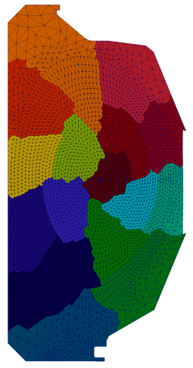
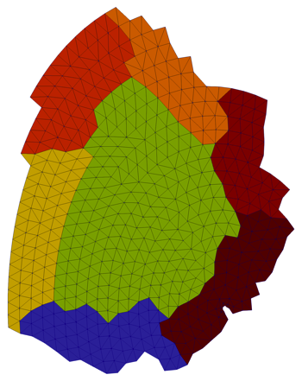
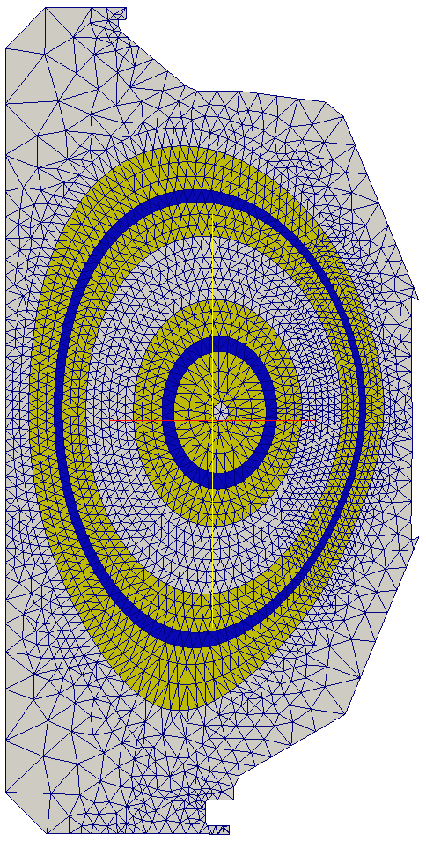
Parallel Unstructured Mesh for Particle in Cell
Mesh distributed in PICparts defined by
  Set of non-overlapping parts
  Plus sufficient buffer to keep particles on part in a push
Original version employed element level linked buffer
  Substantial memory overhead
  Being used in initial version of XGCm edge
  plasma – to be swapped out for modified one
Modified approach focused on more compact
data and GPU execution
  PICpart is a “part” and sufficient
  neighboring parts
  Memory requirements reduced
  Being used in GITRm impurity transport
  Both approaches support
  Migration of particles between pushes
  Dynamic load balancing
A PICpart
Two PICparts defined in terms of whole parts

Slide 11
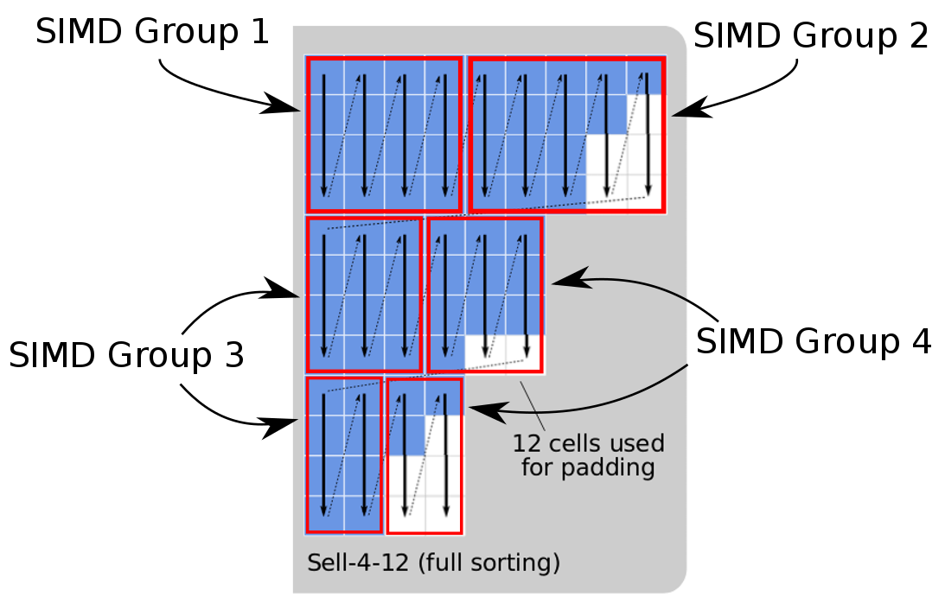
Mesh and Particle Data Structures
Mesh data structure: Omega
  GPU enabled mesh topology data structure
  BFS-like algorithms for effective local serial performance
  Space filling curves to support parallelization
  On-node OpenMP or CUDA parallelism using Kokkos
Particles structures critical for GPU performance
  Particles related to elements
    Flat arrays use excessive memory
    due to variable numbers of
    particles/element
  Sell-C-σ defined for particles/element
  Coordinating with the COPA ECP
  particle co-design center

Slide 12
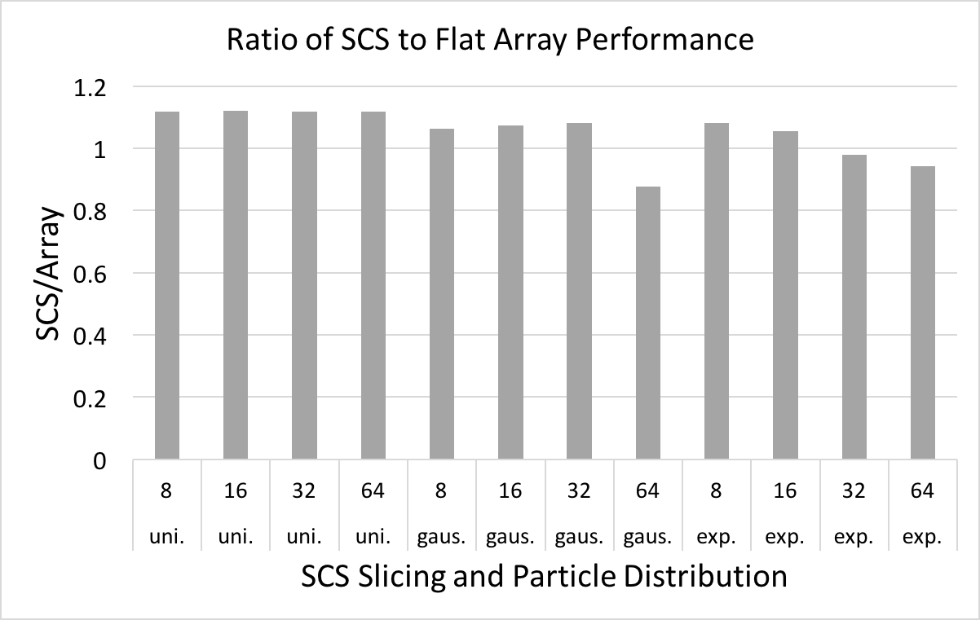
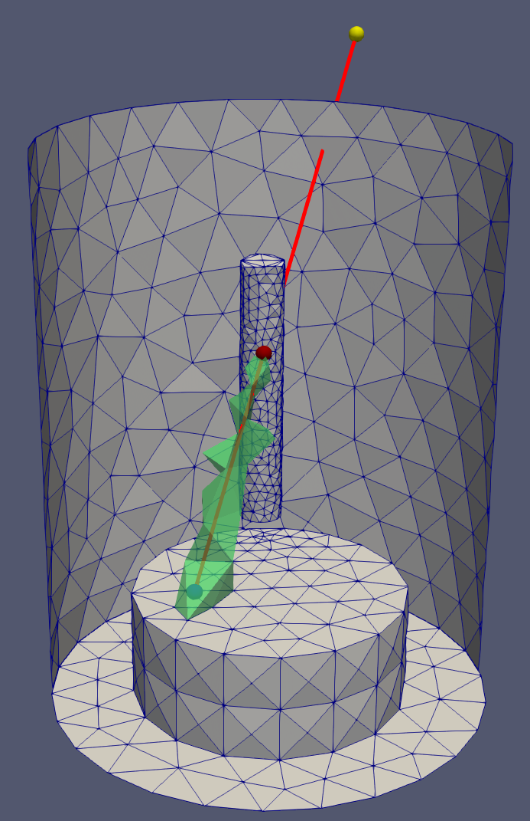
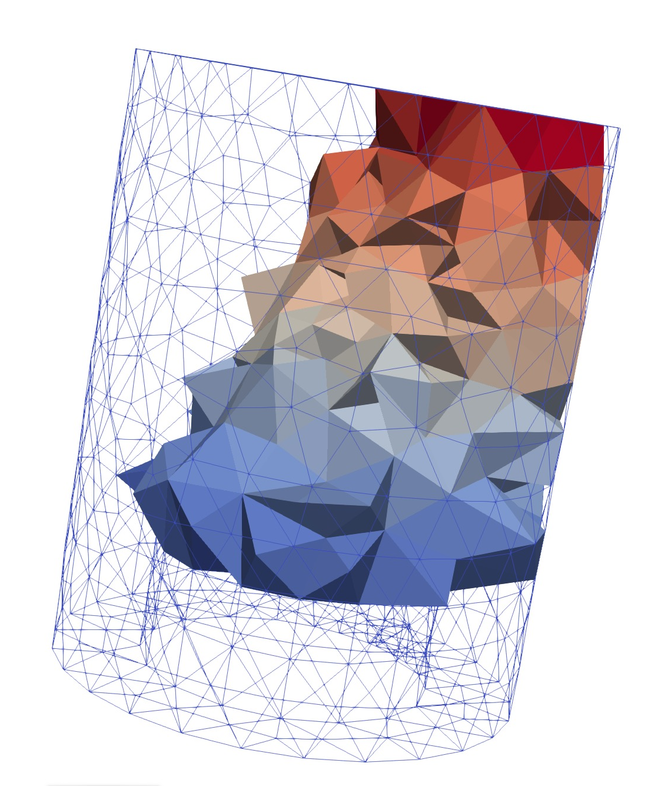
Testing of New Data Structures
Compute random particle position using parent ‘element’ field
  Proxy array for scalar element field
  134M particles and 131,072 elements
  SCS is within 20% of flat array
  performance, faster with exp. dist.
Basic PIC test
  Executed 20 push, search, rebuild
  iterations in PISCES mesh (~6k tets)
  on a GPU
  Particles initialized off of
  bottom inset face
  One process and one
  GPU on RPI DCS
  System – node P9 (x2)
  and V100 (x4)
(lower is better)
  GPU: GTX 1080ti Code: C++ and Kokkos
 | no sorting | full sorting
ptcls (Ki) | time (s) | time (s)
128 | 2.298661 | 3.642041
256 | 2.895464 | 3.415048
512 | 3.79263 | 3.851178
1024 | 4.972283 | 4.090044
2048 | 7.089673 | 4.389198
4096 | 11.578984 | 4.799475
(left) Timing results. (center) Path of a particle through mesh. (right) Elements colored by iteration when particles enter; 0=blue, 20=red.

Slide 13
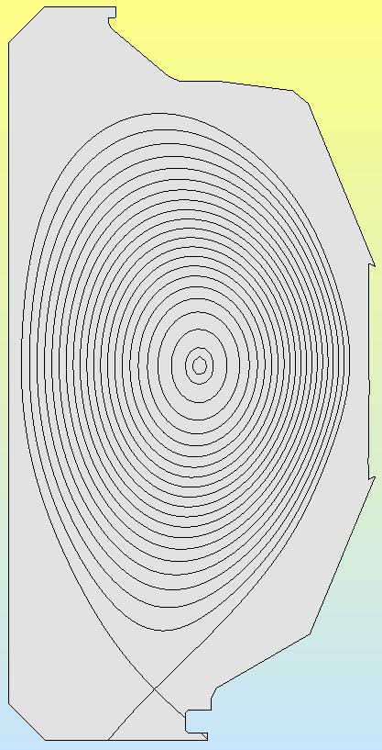
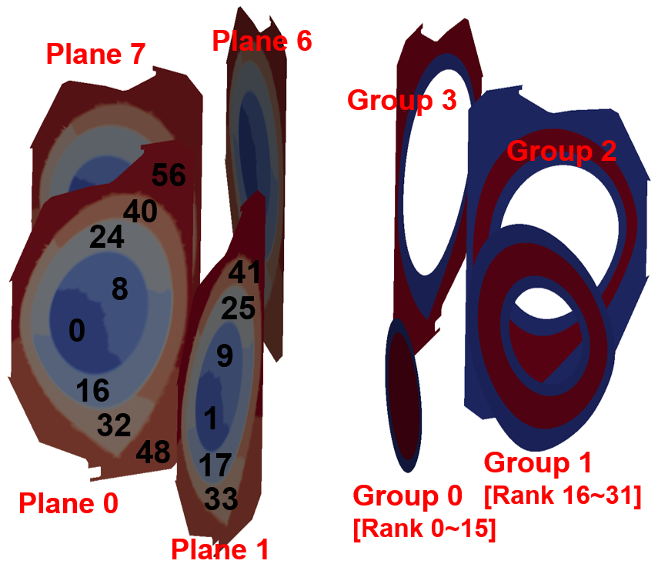
PUMIpic for XGCm Gyrokinetic Code
XGC uses a 2D poloidal plane mesh considering particle paths
  Mesh distribution takes advantage
  of physics defined model/mesh
  Separate parallel field solve on
  each poloidal plane
Current implementation based on
original PICpart definition
  Mesh distribution, adjacency search,
  particle migration, field transfers and
  parallel field solve implemented
  Dynamic load balancing
  approach defined
  Grouping structure introduced for
  effective parallel distribution of particles
  over repeated PICparts
Mesh Distribution
Model
Two-level partition for solver (left) and particle push (right)

Slide 14
Example XGCm Operation: Field Transfers
  XGC gyro-average scheme for Charge-to-Mesh
    Pre-computed gyro-ring weight functions
    Scattering marker particle weights to vertices (left figure) → scattering gyro-ring samples of each “vertex” to vertices of element that contain the sample (right figure)
    Scattering factors in the latter process pre-calculated once at setup phase with uniform gyro-radius grid
  Must do communication for sums
  Particle values depend on fields on bounding poloidal planes
  Mesh level reductions and field
  association use PUMI
  XGCm safe zone needed to
  be set so gyro-ring with max.
  radius is on process
Charge-to-Mesh

Slide 15
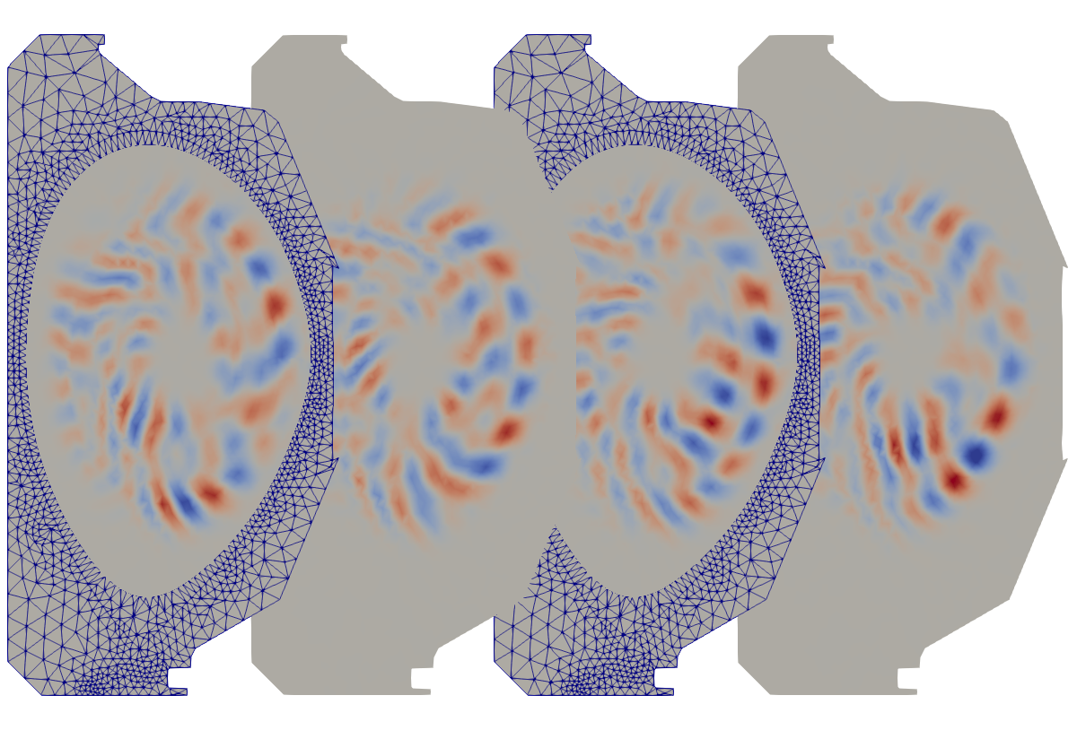
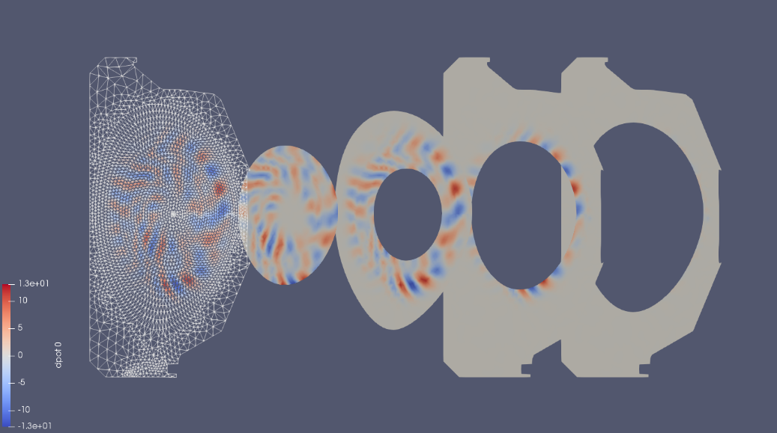
XGCm Edge Plasma Code based on PUMIpic
Implementing XGC physics and numerics
  Since data structures are changed code being rewritten in C++
Status
  Based on original PUMI structures – GPU focused structures will be integrated later
  Mesh/particle interaction operations
  Mesh solve
  Ion and electron push (including subcycling)
  Initial δf simulations
  Performance evaluation and improvement underway
Snapshot of electrostatic potential fluctuation (a) at toroidal angle ζ=0,π/2,π,3π/2 from left to right and (b) in local domain of each group at ζ=0

Slide 16
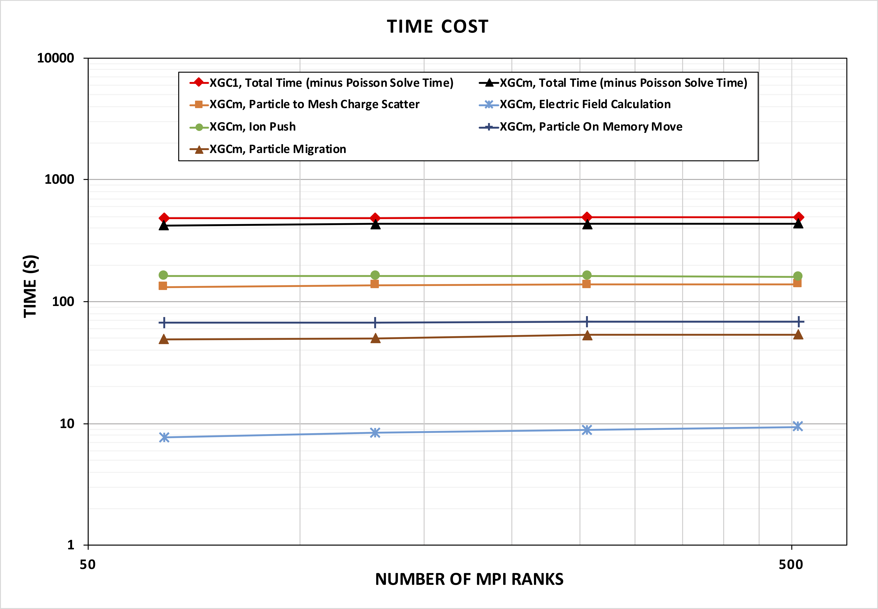
Initial XGCm Test Problem Results
Small δf test case – 6.2K
elements, 8 poloidal planes
  6201 mesh elements (triangles)
  300k particles/rank, 64-512 ranks, 1-8 Cori KNL nodes
  Total timings (minus FE solve)
  equivalent to XGC1
Medium δf test case – 127K
elements, 8 poloidal planes
  300k particles/rank, 256-1024
  ranks, 4-16 Cori KNL nodes
  Push operation 25% faster than
  XGC (key and encouraging)
  Currently total time greater than XGC – need new mesh/particle structures to eliminate slow steps

Slide 17
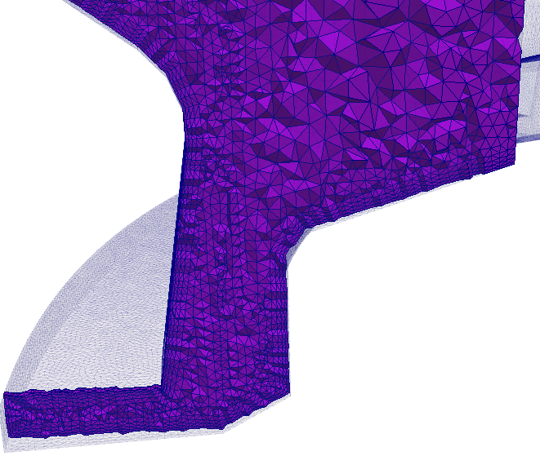
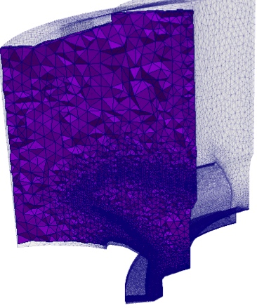
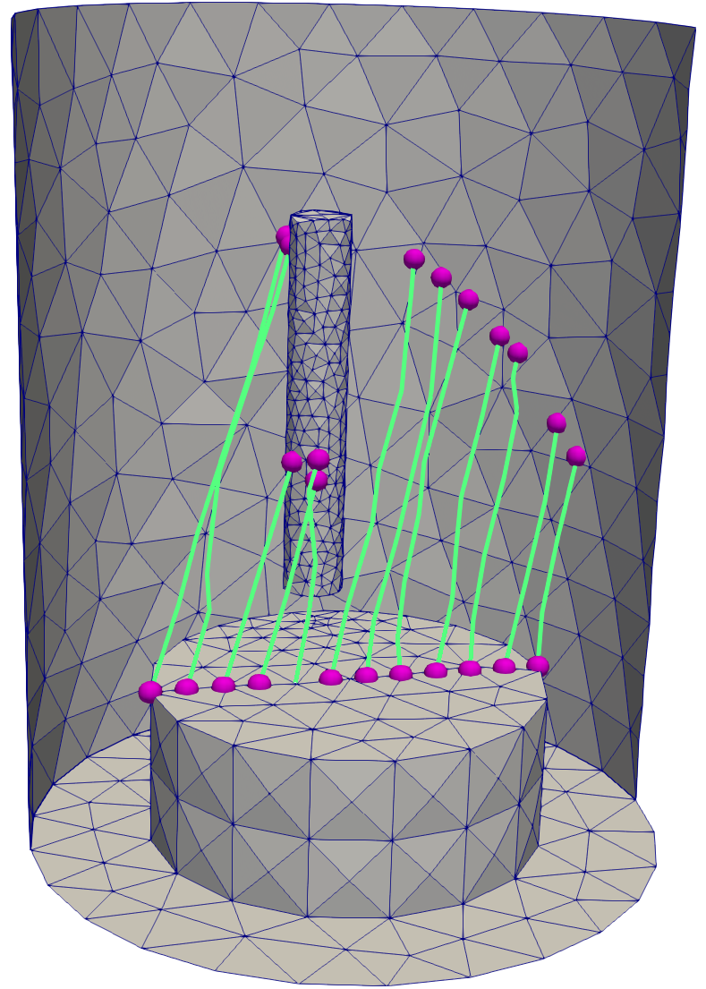
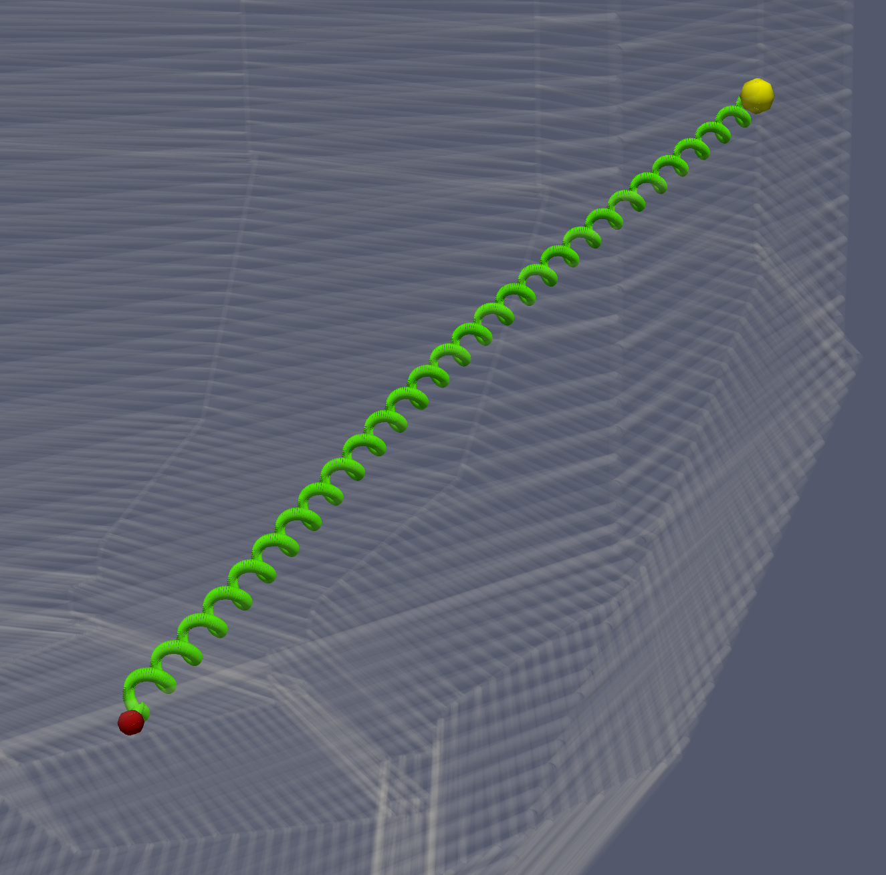
Mesh Based GITR: GITRm
Operates of 3D graded meshes
  3D adjacency search
    Effective on graded meshes
  Wall intersection implemented
    Employ mesh entity classification
    for efficient operation
    Elements where distance tracking
    preprocessed to know when needed
  GITR Boris move implemented
  Omega mesh and new
  particle data structures
  Initial tests, including GPU
  execution, underway
  Working with U. Tenn and ORNL on
  to define appropriate verification tests

Slide 18
Mesh-based GITR: GITRm – Preliminary Tests
Executed 20 push, search, rebuild iterations on PISCES mesh
(~6k tets) on a GPU
  Results comparable to those executed on background grids
Developments for larger particle counts and multiple processes:
  Bulk communication layer w/MPI wrapper for MPI, CUDA aware MPI, and possibly NCCL (initial version in testing)
  Remaining and new physics
  Parallel PICpart creation (done)
 | no sorting | full sorting
ptcls (Ki) | time (s) | time (s)
128 | 2.298661 | 3.642041
256 | 2.895464 | 3.415048
512 | 3.79263 | 3.851178
1024 | 4.972283 | 4.090044
2048 | 7.089673 | 4.389198
4096 | 11.578984 | 4.799475
(left) Path of a particle through mesh. (center) Elements colored by iteration when particles enter; 0=blue, 20=red. (right) Timing results

Slide 19
Closing Remarks
  Key advances in the last year:
    Simulation workflow for RF simulations with full geometric complexity
    Unstructured mesh infrastructure for PIC calculations – emphasis on structures suitable for GPUs
    XGCm edge plasma code timings are encouraging
    GITRm code uses new GPU ready mesh and particle structures
    Initial computations being produced
  We are interested in helping additional fusion, and other, SciDACs on unstructured mesh related needs
    Working on specific meshing tool for hPIC code to support sheath/presheath simulations
    Very preliminary discussions of alternative FE technologies for core plasma disruption simulations
  Additional FASTMath Fusion Partnership activities
    Conservative solver for runaway electron kinetics (SCREAM)
    Scalable MHD solver (TDS)
Poster on FASTMath activities with SciDAC Fusion Partnerships on Thursday

Slide 20
Support Acknowledgements
  “Unstructured Mesh Technologies for Fusion Simulation Codes”, contract # DE-SC0018275, to support fusion SciDACs including:
    Center for Tokamak Transient Simulations, Steve Jardin, PPPL
    Partnership Center for High-fidelity Boundary Plasma Simulation,
    C.S. Chang, PPPL
    Center for Integrated Simulation of Fusion Relevant RF Actuators,
    Paul Bonoli, MIT
    Plasma Surface Interactions: Predicting the Performance and Impact of Dynamic PFC Surfaces, Brian Wirth, ORNL
  Subcontract from LLNL as part of “Frameworks, Algorithms and Scalable Technologies for Mathematics (FASTMath) SciDAC Institute”,
  contract # DE-AC52-07-NA27344
  Subcontract from Simmetrix on their DOE SBIR “Unstructured Mesh Technologies for Massively Parallel Simulation and Data Analysis of Magnetically Confined Plasmas”, Phase IIb SBIR contract # DE-SC0013919
20

