Slide 1
Curved Conforming Mesh Adaptation
Mark S. Shephard, Cameron W. Smith, Morteza H. Siboni, Samiullah Malik, and Aditya Joshi
Scientific Computation Research Center
Rensselaer Polytechnic Institute
Activities
Curved mesh adaptation
Implicit error estimator for Maxwell’s equations solved with Nedelec elements
MFEM based adaptive RF Simulation workflows
Automatic mixed and hex meshing (Simmetrix)
Mesh adaptation on GPUs

Slide 2
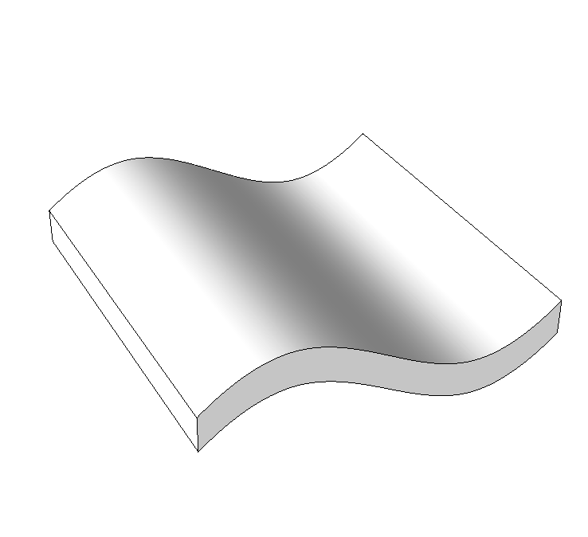
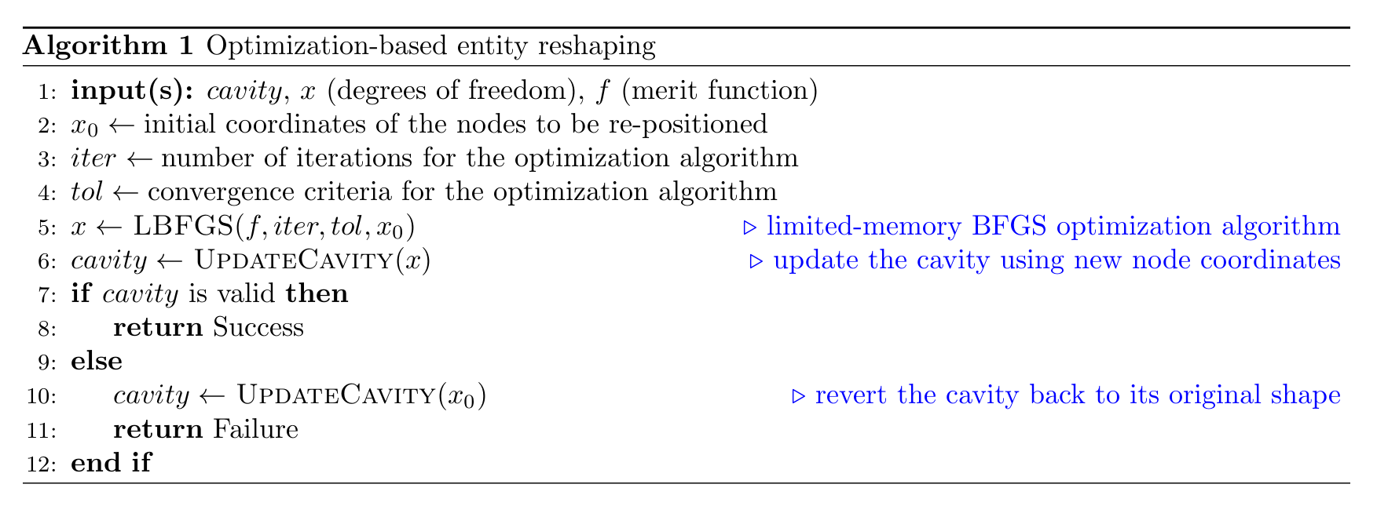
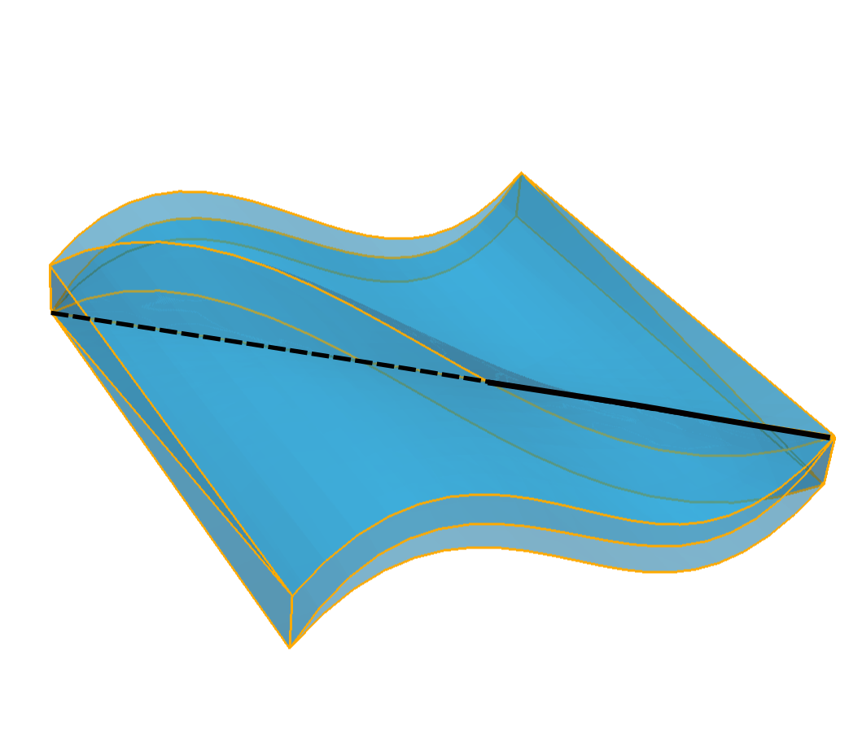
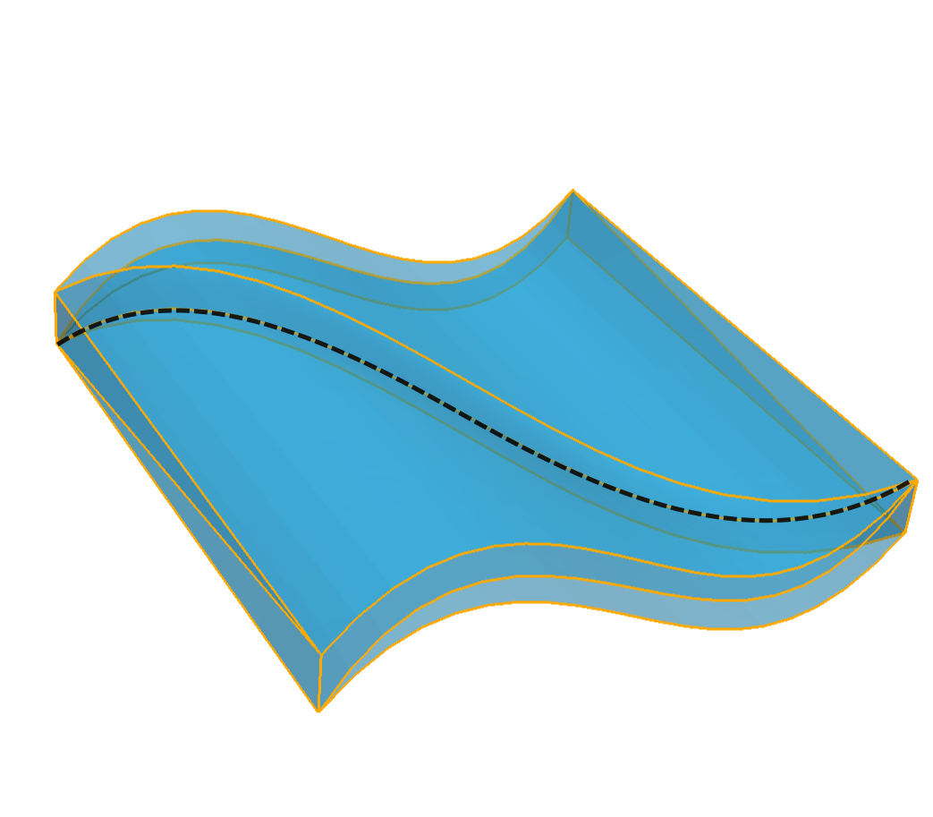
Higher than Quadratic Curved Mesh Adaptation
Optimization-based entity reshaping operator
model
inflated cubic mesh with an invalid internal edge
Various options are available for the merit function. Two most relevant options are (a) minimizing Jacobian variations and (b) improving the worst Jacobian
Emphasis on on cavity-based application to allow inclusion in cavity based mesh adaptation
cubic mesh after reshaping is applied
2

Slide 3
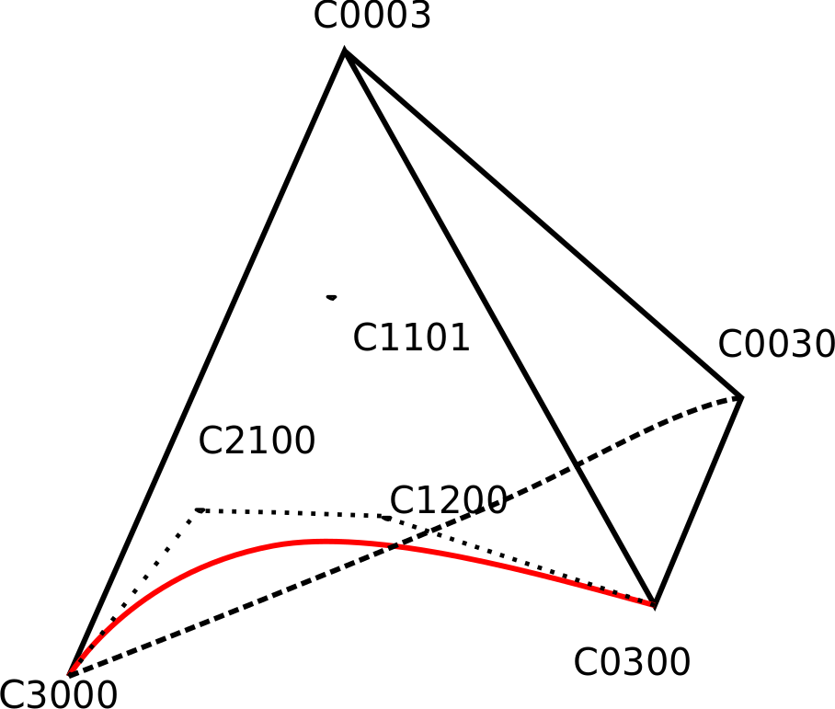
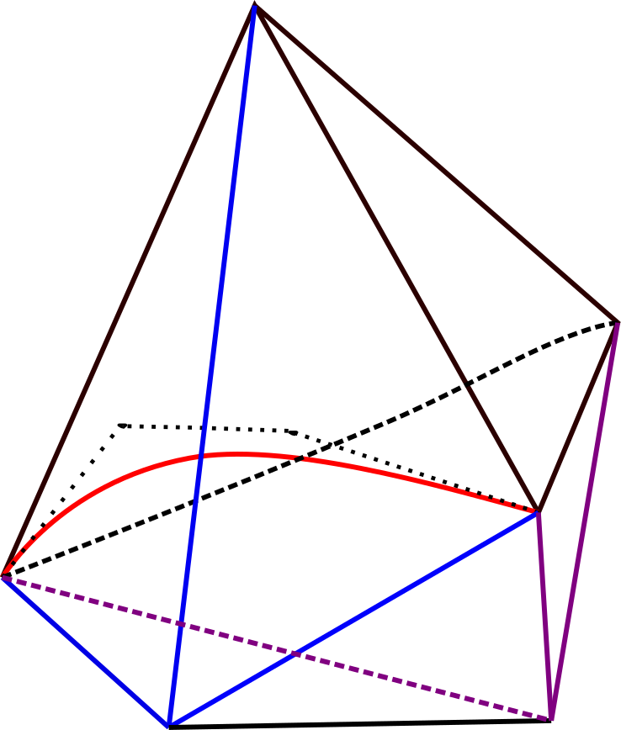
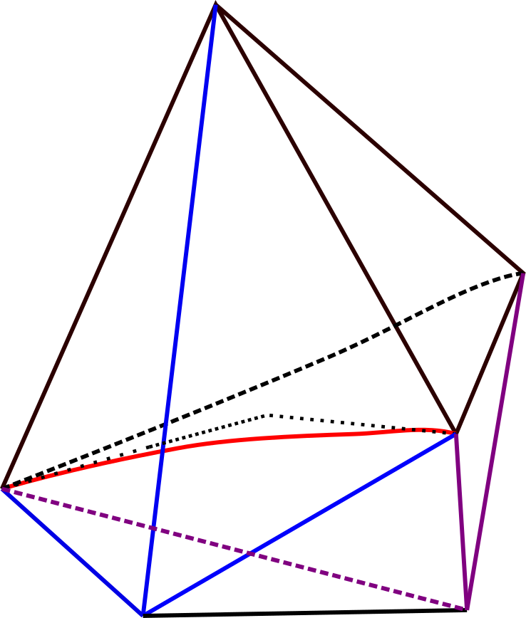
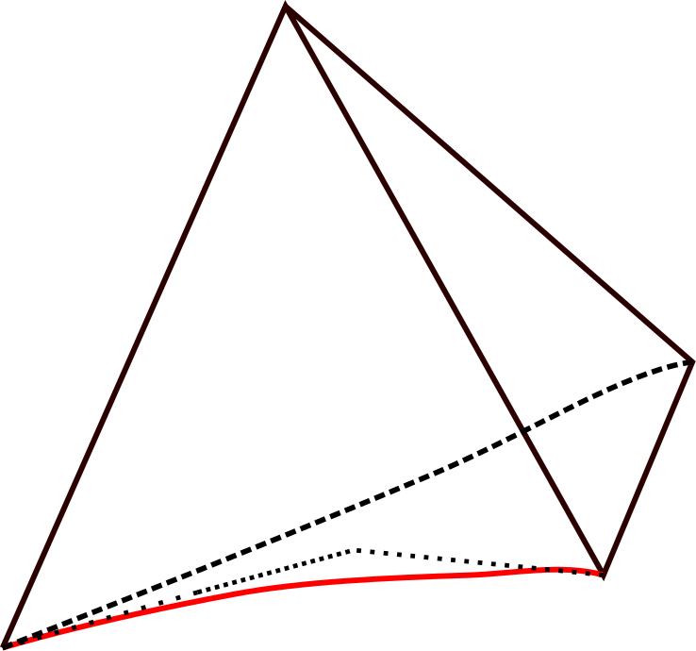
Higher than Quadratic Curved Mesh Adaptation
First step is ability to fix invalid elements caused when inflating geometry
Using Optimization based on entities interior of mesh cavities – focused on cubic entities initially – cost increases quickly with order
Invalid Element
Local Cavity of the edge
Edge Reshape
Valid Element
- Choose the adjacent face to this vertex with the least value of the Jacobian determinant.
- Choose the edge of this face adjacent to the invalid vertex based on the decreasing dimension of the model classification for the edge.
- The DOF vector (x) is the set of all node coordinates of the adjacent entities to this edge.
- x₀ = {X_{e0}, X_{e1}, X_{f0}, X_{f1}, X_{f2}, X_{f3}}
where, X_{e0} , X_{e1} , X_{f0} ,.. are the physical coordinates of C₂₁₀₀, C₁₂₀₀, C₁₁₀₁ and so on..
- The vector x₀ is the input to the optimizer.
- Optimizer returns x_{new}
which is the set of new coordinates of all adjacent entities to this edge.
- Accept x_{new} only if all elements constituting the cavity are valid.

Slide 4
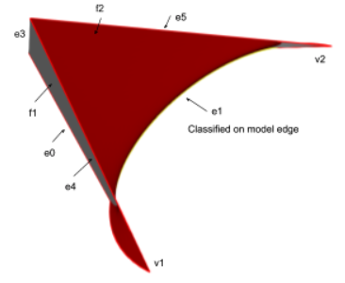
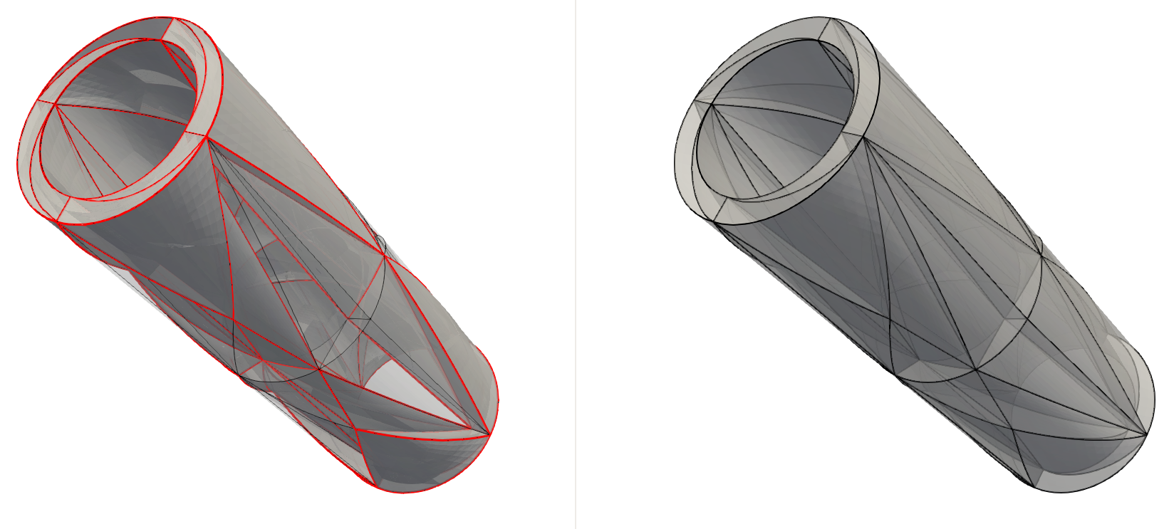
Higher than Quadratic Curved Mesh Adaptation
First step is ability to fix invalid elements caused when inflating geometry
Optimization based reshape routines that penalizes small values of Jacobian determinant with order
Face Reshape: computationally cheaper than other reshape routines.
Edge Reshape
Given an invalid mesh, an ordered list of face and edge entities is generated such that the reshape operators are tried in the most efficient manner (i.e. in terms of success rate and avoiding redundant reshapes).
An invalid Element after inflation | Invalidity and Fix
 | Invalid entities: 2 faces (top and bottom) + All adjacent edges to e1 + both bounding vertices of e1 Fix: Entity list for reshape { f2, e0, e4, e5, e2}
Cubic Mesh after inflation (left); after fixing invalidities(right); highlighted elements are invalid.

Slide 5
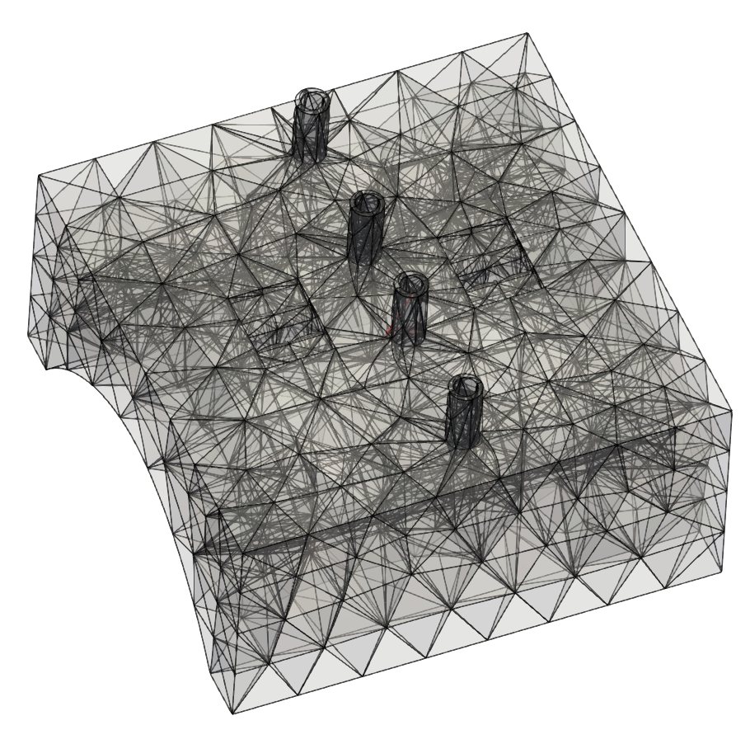
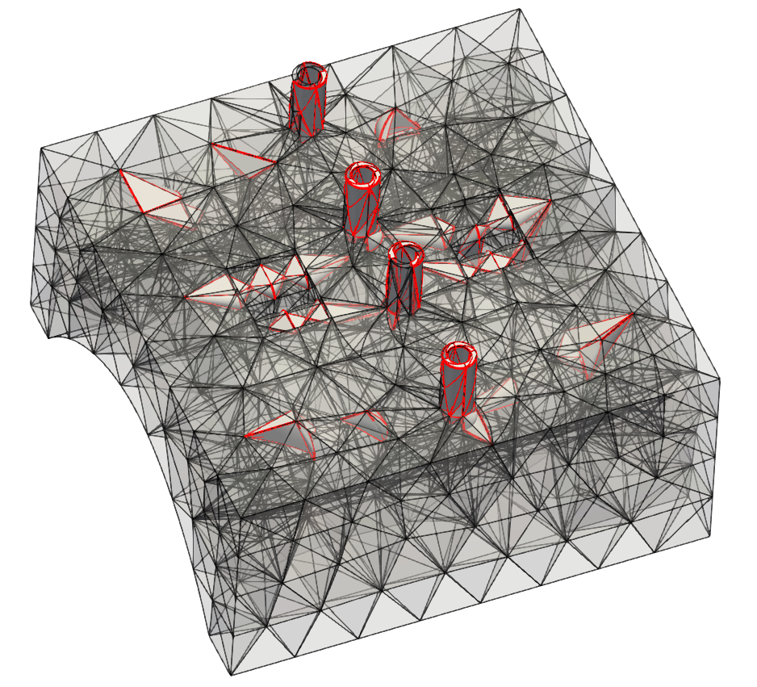
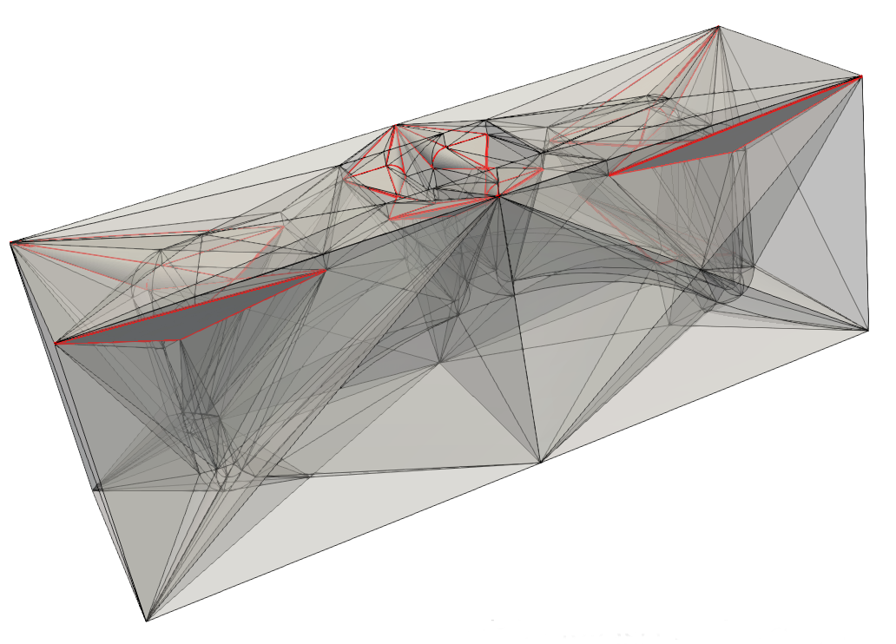
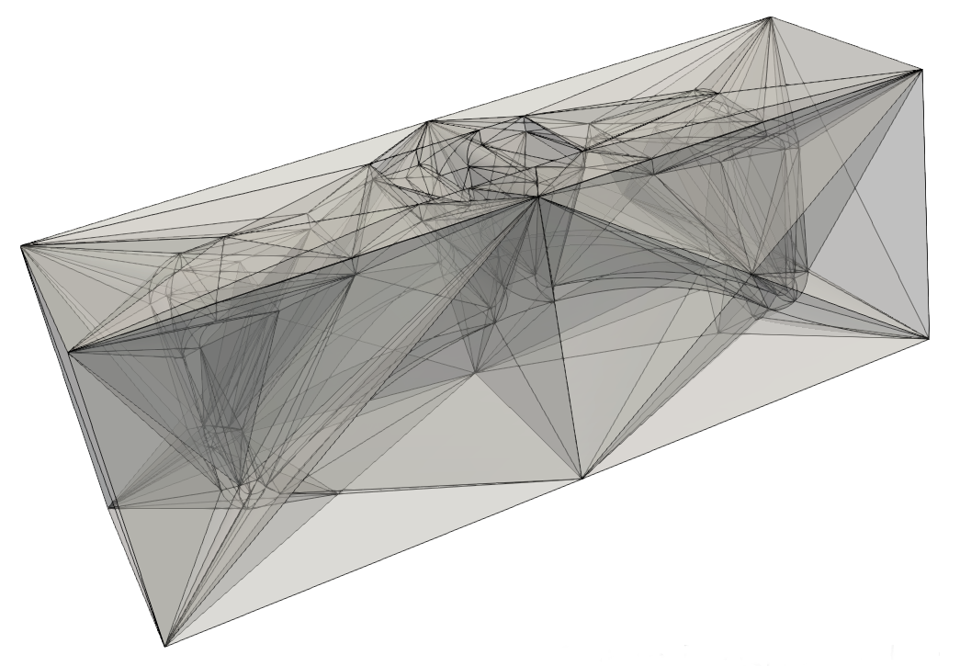
Higher than Quadratic Curved Mesh Adaptation
RF antenna case
Cubic Mesh:
Highlighted elements are invalid.
Left: Mesh after inflation, but before reshaping of interior entities (still 1 invalid element in upper example – working on that)
Right: Mesh after interior entity reshape
Fig. 1
Fig. 2

Slide 6
Error Estimation For Time Harmonic Maxwell’s Equations
Estimation of the Discretization Error:
Explicit Methods: these are more efficient computationally, and they are known to result in less accurate estimates for the error
Implicit Methods: these are less efficient computationally since they require a secondary solve, however they are known to result in more accurate estimates for the error
Implicit Error Estimation:
Form the residual weak form for the domain
Get the residual weak form for each element, this would correspond to a local BVP for each element with Neumann boundary conditions
Since the fluxes are not exact at element boundaries we need to perform self-equilibration of fluxes
Solve the local BVP for each element to get the element error indicator function
Use the L2 norm of element error indicator function to compute the to compute the per element error

Slide 7
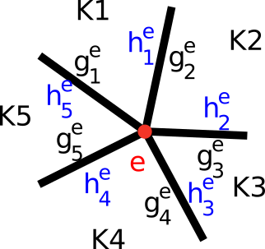
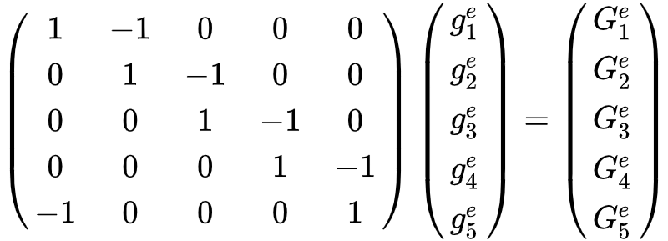
Error Estimation For Time Harmonic Maxwell’s Equations
Self-Equilibration of Fluxes:
There will be mismatch between fluxes at element boundaries (since the FEM solution is not exact)
The fluxes are self-equilibrated by introducing a “correction” term
The correction terms are obtained by making sure each individual element is in equilibrium
This guarantees that the local BVPs for each element have well-defined solutions
Application to Nedelec Edge Elements:
The flux correction to a given face “f” (in our case a triangle) can be represented as follows:
The coefficient gs associated with edge “e” can be obtained by looking at the edge patches:
Here Gs are the weak residuals computed for each element in the patch (note that the weak form also includes the boundary integrals including the un-equilibrated fluxes)
The system of equation shown above is singular & special consideration must be taken for its solution (see [2])
[1]Demkowicz, Leszek. Computing with hp-adaptive finite elements: volume 1 one and two dimensional elliptic and Maxwell problems. Chapman and Hall/CRC, 2006.
[2]Ainsworth, Mark, and J. Tinsley Oden. "A posteriori error estimators for second order elliptic systems part 2. An optimal order process for calculating self-equilibrating fluxes." Computers & Mathematics with Applications 26.9 (1993): 75-87.
7

Slide 8
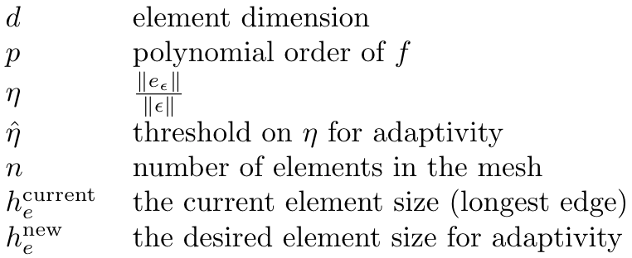
Error Estimation For Time Harmonic Maxwell’s Equations
Size Field Computation
Element scalar size factor is computed as:
where
8

Slide 9
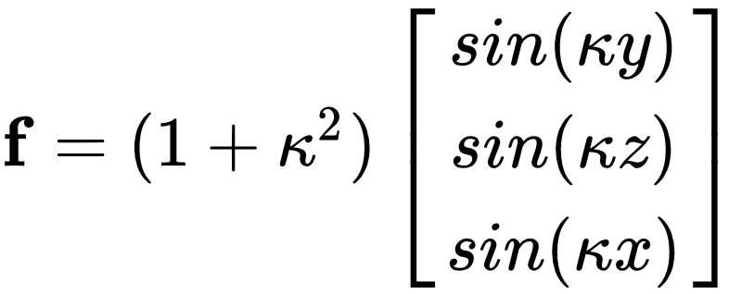
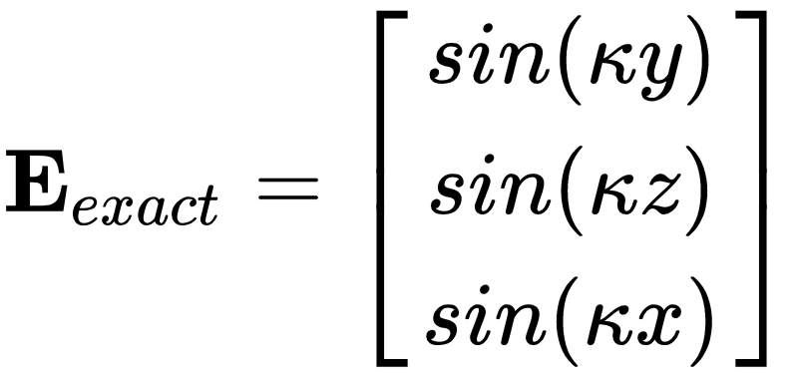
Error Estimation For Time Harmonic Maxwell’s Equations
Verification Using A Sample Problem With Known Solution:
FEM Solution
Solution Field
Computed Error
9

Slide 10
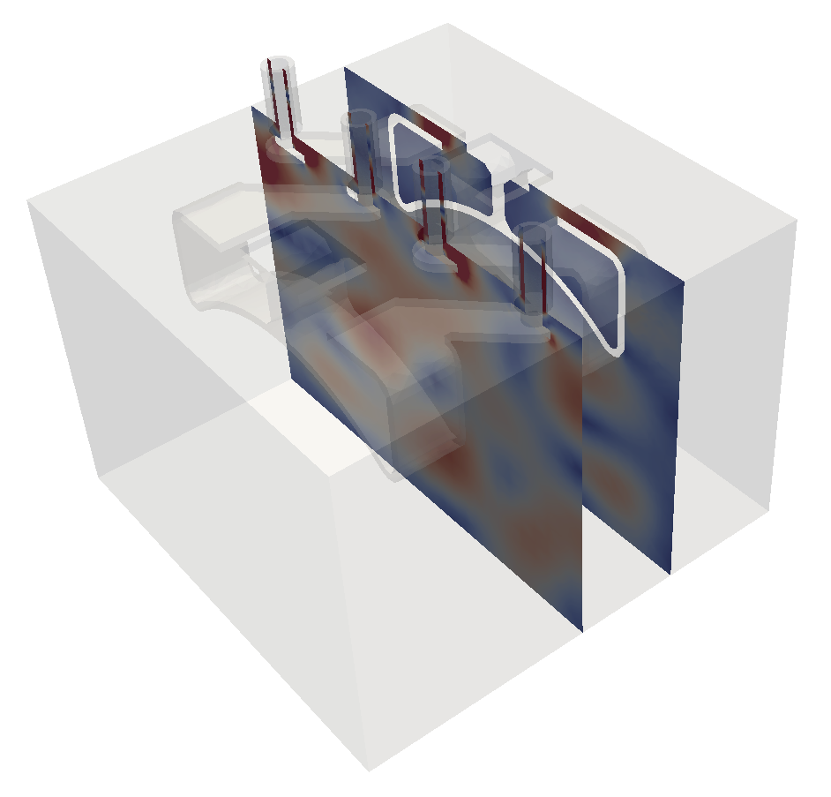
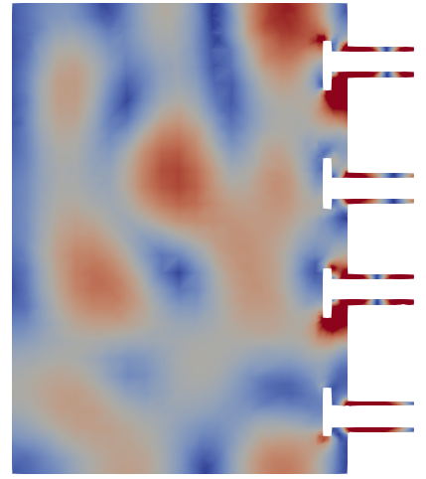
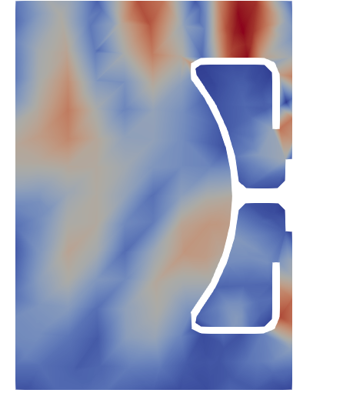
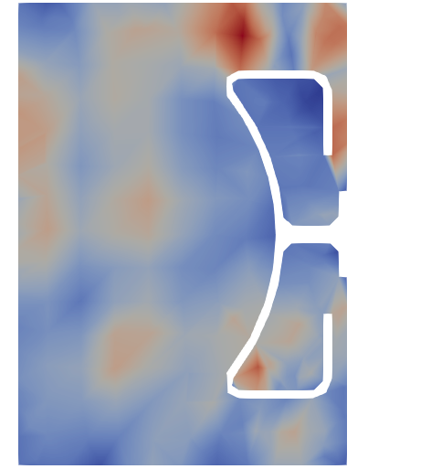
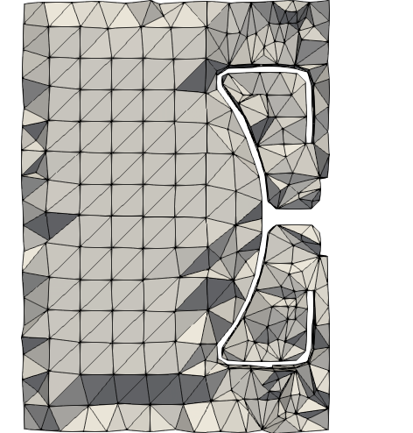
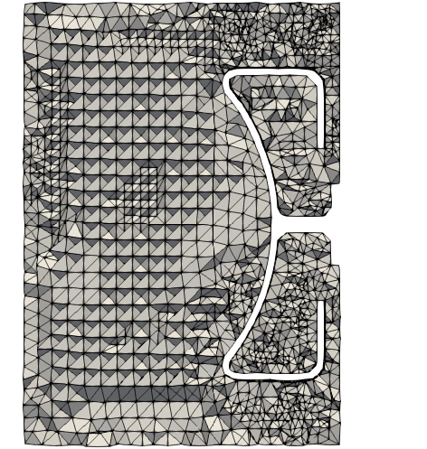
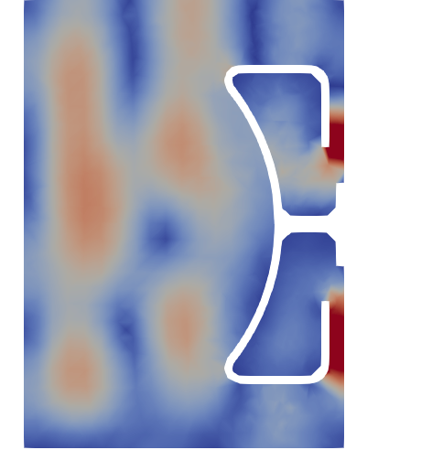
Error Estimation For Time Harmonic Maxwell’s Equations
Application to RF Antenna:
Two antenna RF heater with 4 ports with input phases equal 0, 90, 180 and 270 degrees.
A frequency domain Maxwell’s Equation for the Electric Field
∇ × 1/μ ∇ × E - ω (ε ω - j σ) = -j ω J
solution-initial mesh
error-initial mesh
initial mesh
adapted mesh
solution-adapted mesh
10

Slide 11
Adaptive RF Simulation Workflow
Workflow Steps (as indicated last year):
Obtain and clean-up antenna CAD models
Combine antenna, reactor and physics geometries
Associate analysis attributes
Automatic mesh generation
MFEM finite element analysis
Estimate discretization errors. If below tolerance terminate
Adapt mesh and return to step 5
Efforts for last year:
Full integration with Petra-M preprocessor and MFEM extensions to support the RF SciDAC applications
Moving to regular use of high-order elements – important to go to high order for effective solution to wave problems
11

Slide 12
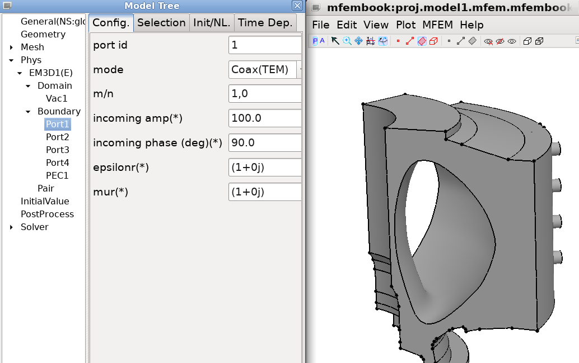
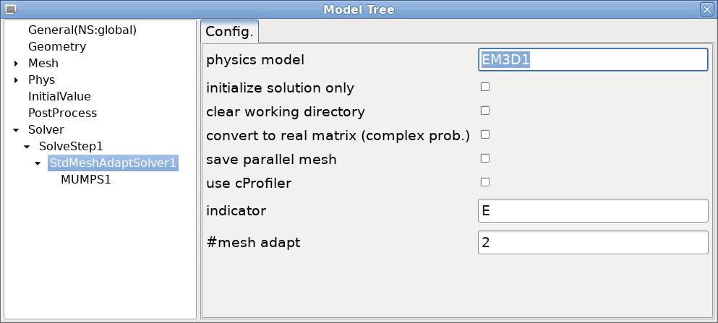
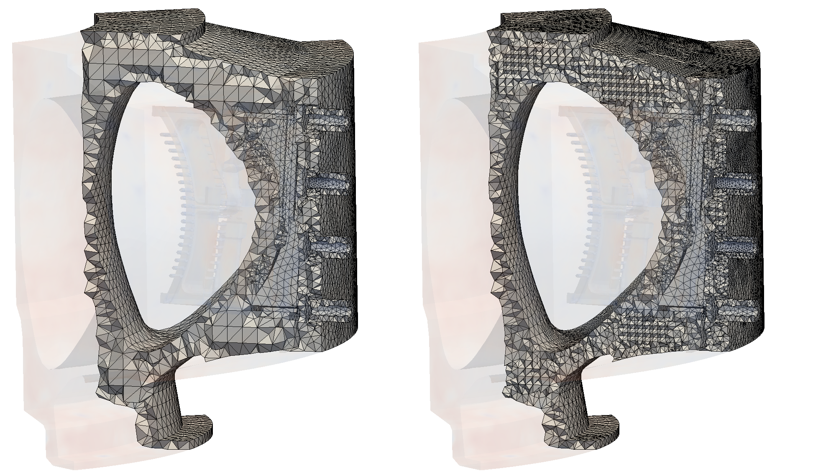
Integration of Adaptive Workflow and PetraM
Adaptive Workflow & PetraM:
Development of python wrappers for PUMI “MeshAdapt” tools
Integration of the “MeshAdapt” into PetraM using the python wrappers
Collaboration with MIT to perform full adaptive RF simulations in PetraM starting from a realistic engineering CAD
Physics Setup in PetraM
Adaptive Setup in PetraM
Before/After Adapt Meshes for RF Antenna
Adapt Parameters
Input Model & Mesh
12

Slide 13
Adaptive RF Simulation Workflow
Model Preparation and Mesh Generation:
Problem Setup:
Adaptive Solve:
13

Slide 14
Adaptive RF Simulation Workflow
More on Model Clean-up/Modification Using Simmetrix Tools
Tools used: CAD systems, SimModeler
Antenna defeatured using functions in the SimModeler GUI
Fast elimination of large numbers of small features
Simplified geometry can be added
Reactor cross section extruded
EFIT data used to construct flux surface
Model components combined in SimModeler
Region identification
Preparation of analysis geometry
14

Slide 15
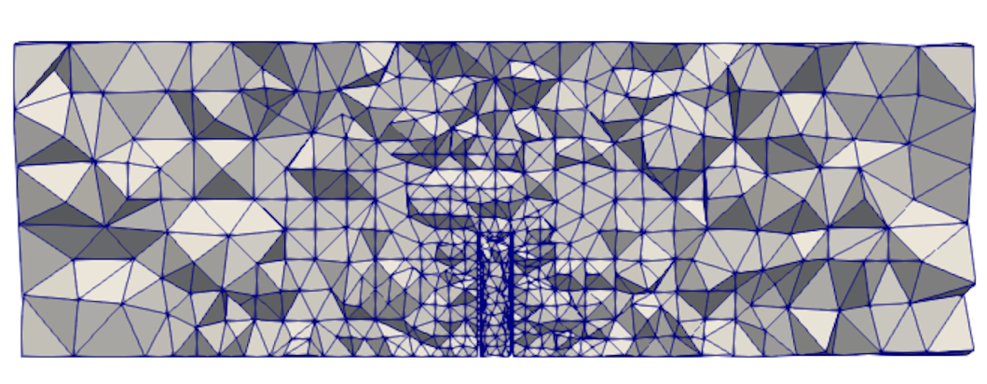
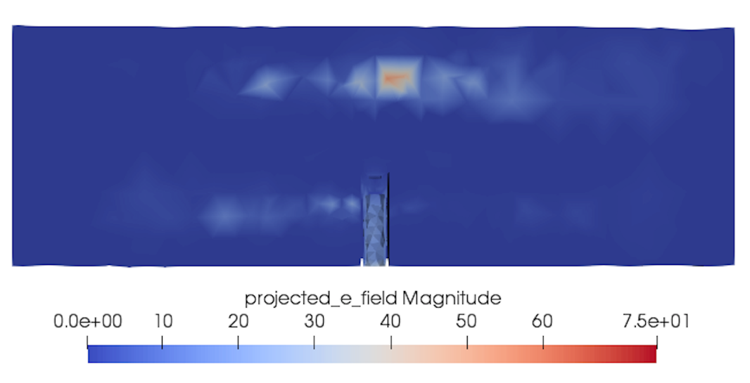
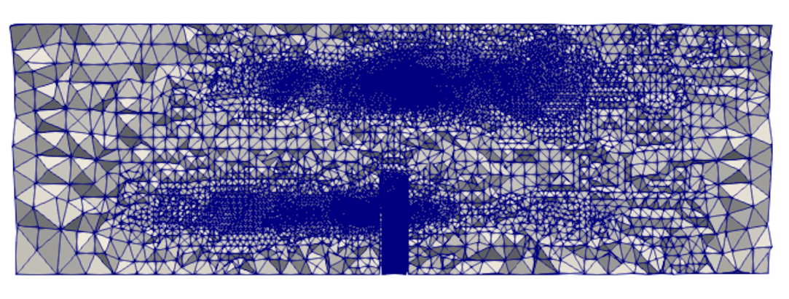
Adaptive RF Simulation Workflow
*****
Figure 7 – Simmetrix mesh (37k edges)
Figure 8 – Simmetrix mesh solution (order = 2)
Figure 9 – Simmetrix Adapted mesh (3M edges)
15

Slide 16
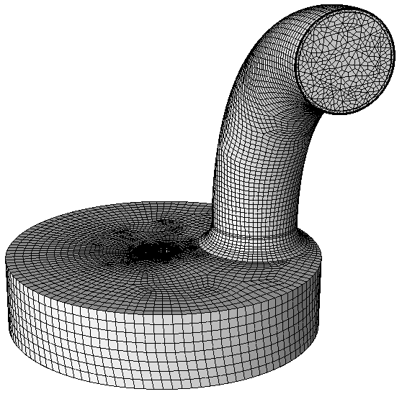
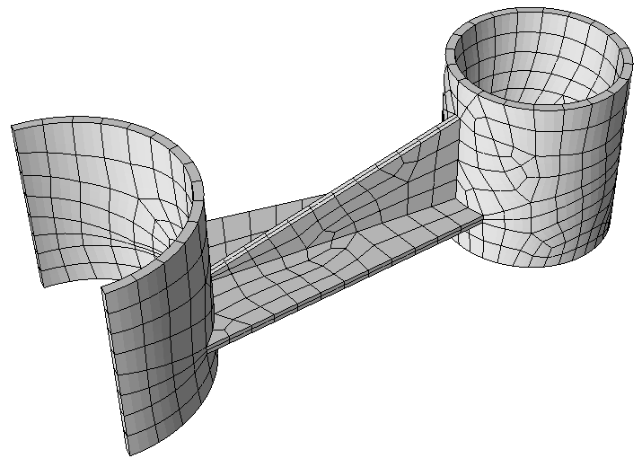
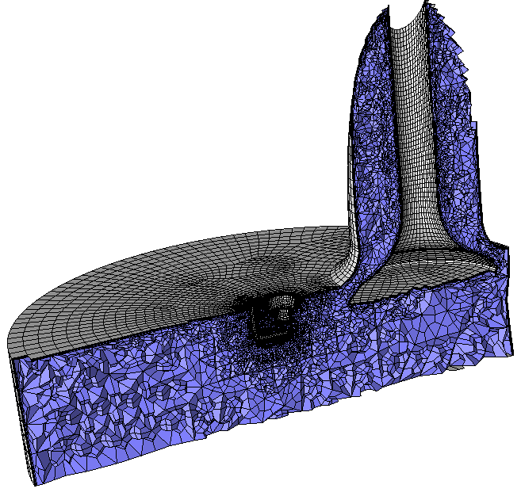
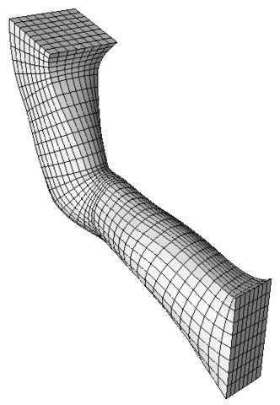
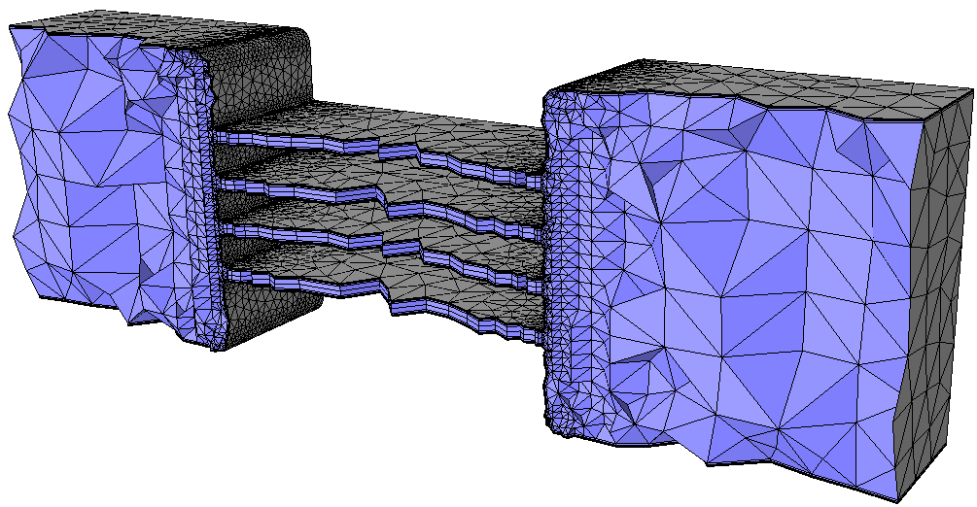
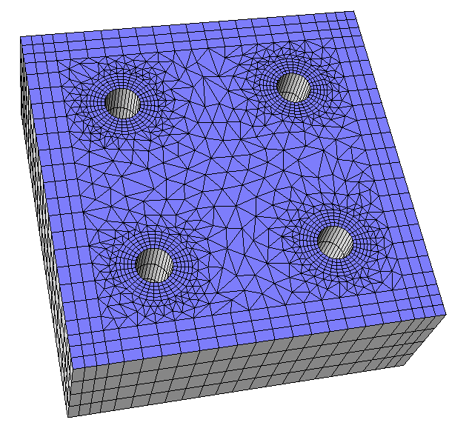
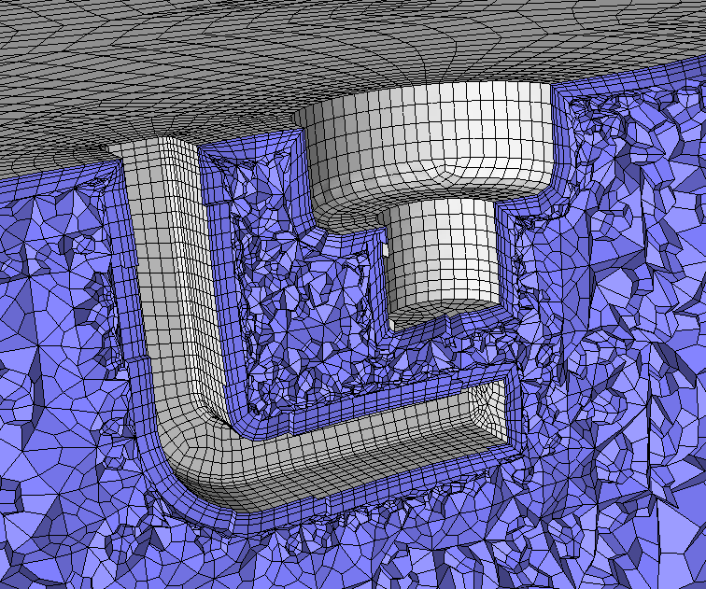
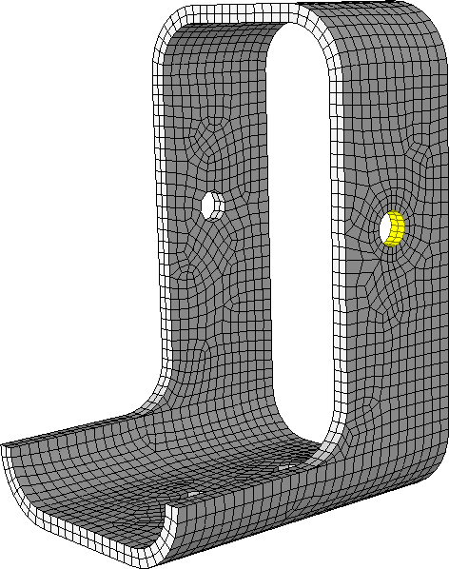
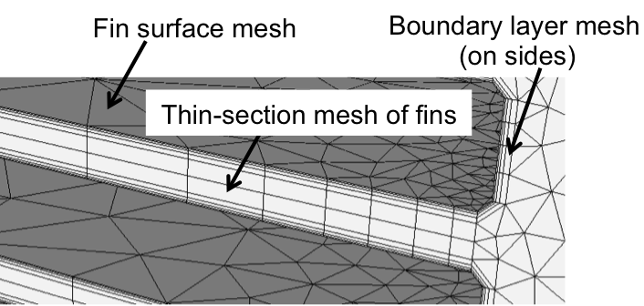
Toward Automatic Mixed and Hex Meshing
Recently Simmetrix has increased their activities on mixed and all hex meshes (full automation emphasized)
For fully automatic all hex have determined new operators to allowing for much better quality overall meshes
Interacting with an ANL NEK5000 group on this activity
Both mixed mesh and all hex activities include efforts on curved high-order meshes
16

Slide 17
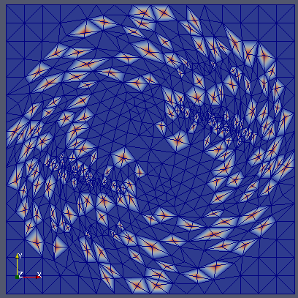
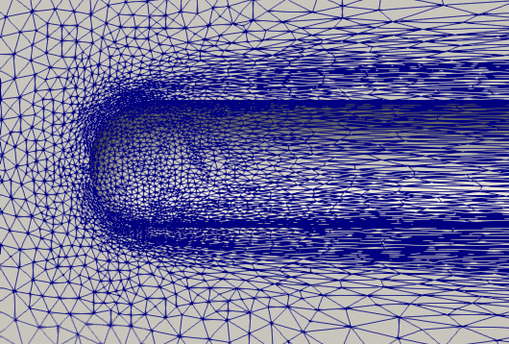
Omega_h: Mesh Adaptation on GPUs
GPU adaptation of conforming 3D simplex (tri & tet)
Refinement and coarsening beyond initial mesh
On-node parallelism using either CUDA or Kokkos
Source: github.com/SNLcomputation/omega_h
Examples of common uses: github.com/SCOREC/omegah_examples
Developments needed to extend support for Laghos and RF simulations of fusion tokamak reactors
mixed topology meshes
high-order Bezier elements
Porting to AMD and Intel GPUs for El-Capitan/Frontier and Aurora
Graduate student – Aditya Joshi

Slide 18
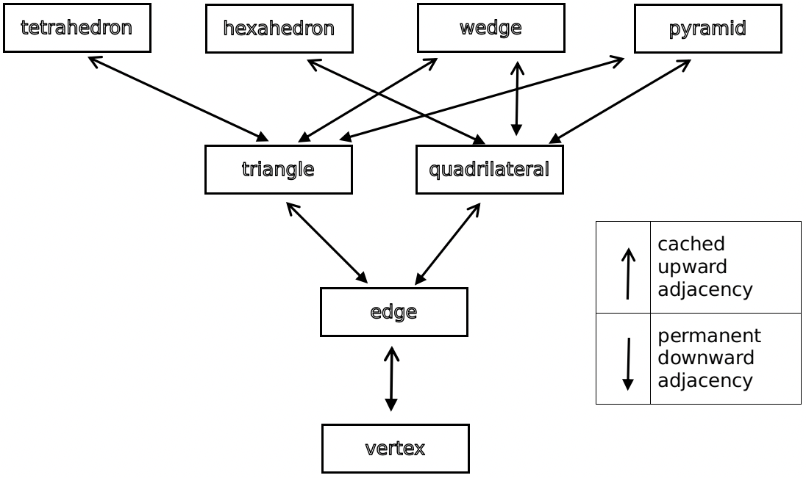
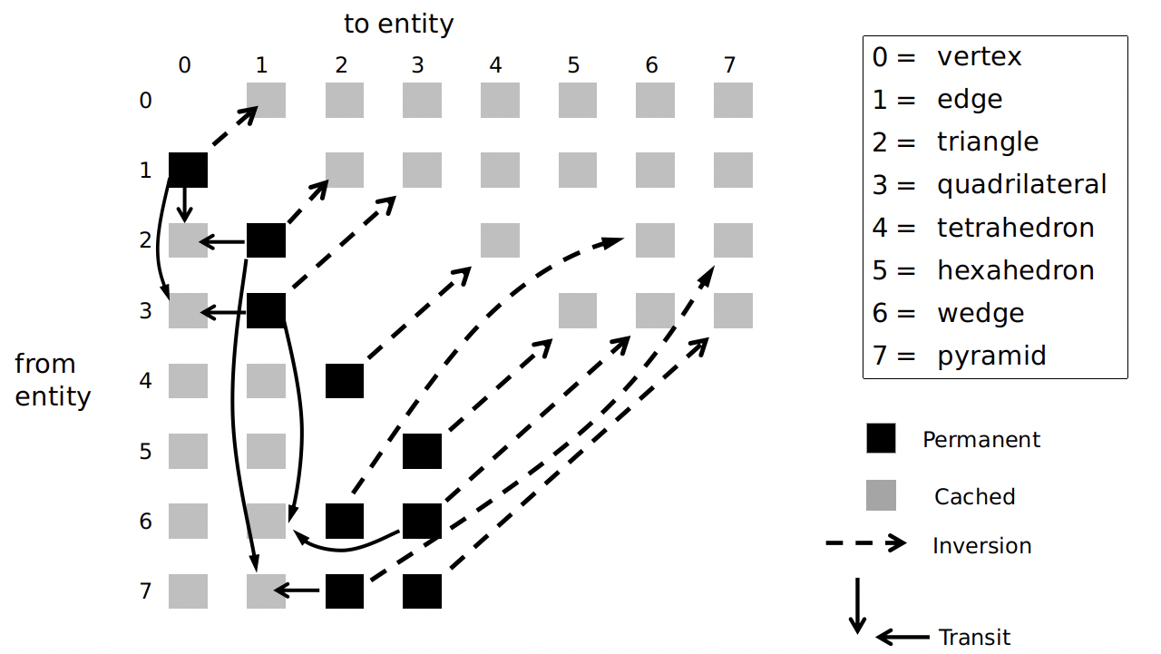
Omega_h: Mixed Mesh Support
Full representation – all entities stored
Complete representation
Amortized constant time adjacency queries on GPU
Critical for adaptation
Key operations
Graph Inversion – construct upward adj. from downward adj.
Graph transit – construct second order adjacencies
Extended Adjacency Table – no overhead for monotopology
Conversion from Simmetrix SimModSuite via APIs
One level representation of a mixed mesh
Monotopology mesh adjacency storage
Mixed mesh adjacency storage

Slide 19
Omega_h: High Order Bezier Elements
Steps: (1) representation and elevation (2) refinement, then (3) coarsening
Adaptation for tets in a mixed mesh
Conversion from Simmetrix Lagrangian quadratic tets
Calling SimModSuite APIs ttach edge nodes to Omega
Defining matrices for conversion
Considering MAGMA for batched small matrix operations
Representation – Tag attached data storage for associating nodes with entities
Elevation – targeting up to sixth order, batched operations
Refinement and Coarsening
Iterations based on independent set/coloring
Store sufficient topology and shape change plans
Build new mesh using original mesh + plans, destroy original mesh
Must at least have equal performance and quality as CPU version
Algorithmic challenges – current CPU procedures are the starting point

Slide 20
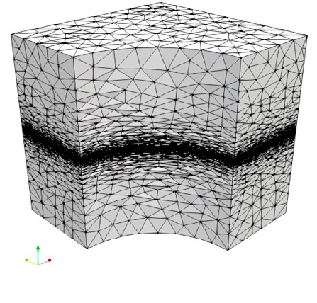
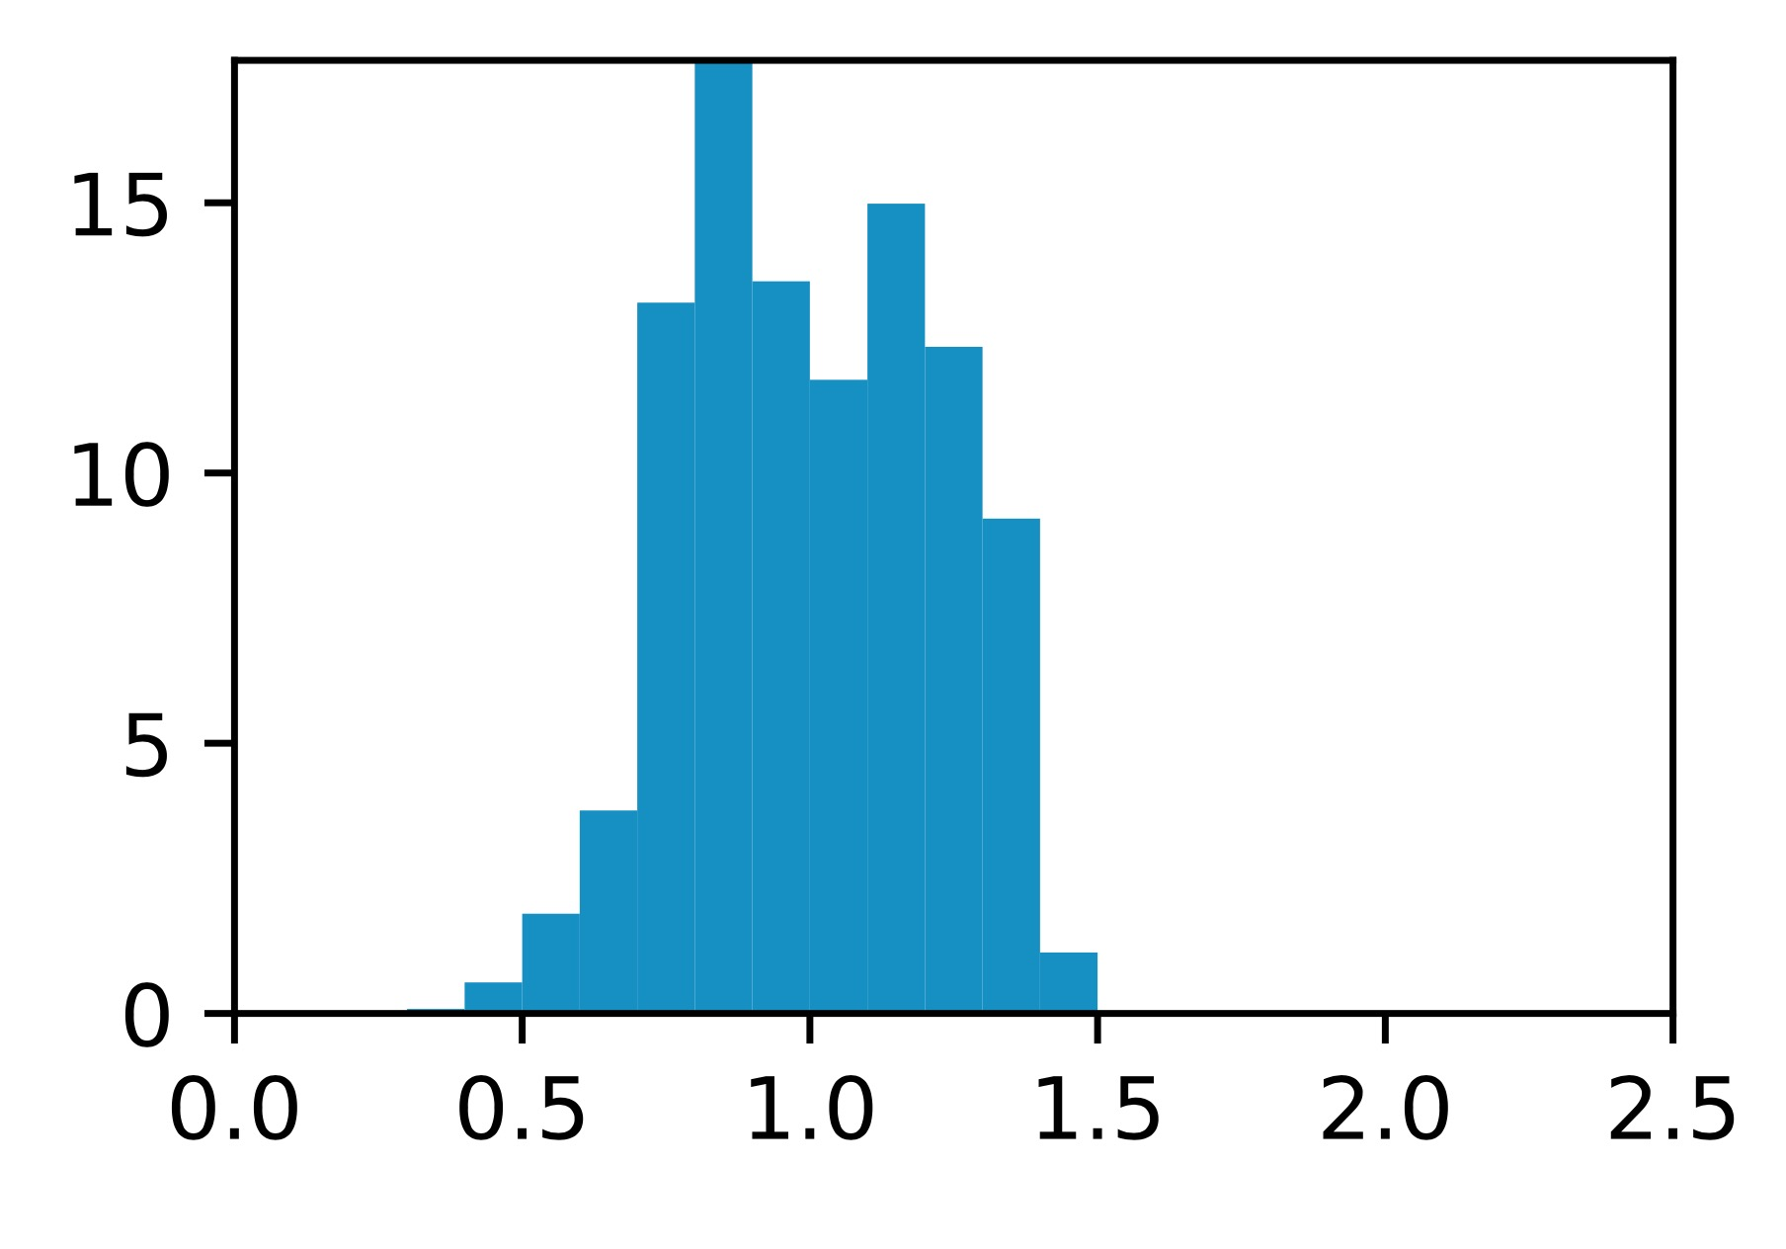
Omega_h: AMD HIP Port
Hipify’d – no problems, 20mins
Cmake – bugs, documentation lacking, 4 hrs
bug in 3.5.1, switched to module mode in 3.6.0
Public system install on Summit is version 2.6
Build failures – ongoing, > 4 hrs
Must pass –amd-gpu=<identifier> to run
Conditional compilation directives for Kokkos, CUDA, and OpenMP
Performance Testing
Corona AMD MI50, Corona AMD MI60, AiMOS NVIDIA V100
Running cases from Unstructured Grid Adaptation Working Group (ugawg.github.io/) – Ibanez, Barral, Krakos, Loseille, Michal, Park
Omega_h adapted mesh (top) and corresponding edge length histogram (bottom) for the linear cube metric. [2017, Ibanez]

