Slide 1
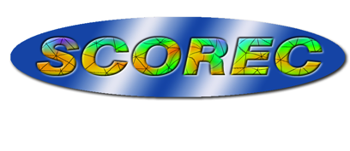
Adaptive Workflow for RF Simulations: Geometry and Meshing
M. H. Siboni, A. Moharana, S. Malik, U. Riaz and M. S. Shephard
Scientific Computation Research Center, RPI
B.R. Downie, R. Nastasia, S. Tendulkar and M.W. Beall Simmetrix Inc. (Supported through a DOE SBIR project)
Outline
Why the focus on geometry?
Boundary representation for Analysis Geometry
Construction of complete workflow including analysis geometry preparation
Tools used
Example usage

Slide 2
Why the Focus on Geometry?
At one level the answer is obvious:
We want mesh of the given domain – need domain defined
However,
Analysis code people think only in terms of the mesh
Mesh generation people have most often only think in terms of a “mesh geometry”
An approach without a proper high-level domain definition is not satisfactory when dealing with complex geometry (from multiple sources), nor is it best for dealing with multi-physics problems. One needs:
A high-level and robust description of the “analysis domain”
Problem physics input defined in terms the analysis domain
Robust meshing that will create valid meshes that are consistent with the analysis domain and provide the desired mesh control.
Notes:
The basic Tokamak is a torus.
r starts from the axis point (the center of each cross section)

Slide 3
Analysis Geometry
For solving RF problems in tokamaks the pieces of analysis geometry comes from multiple sources:
Antenna CAD model(s) – often simplified
Tokamak models (CAD or faceted)
Flux surfaces (typically in terms of information on a background grid)
Need to combine all the pieces of geometry into a single model that must:
Is a complete and unique representation
Support specification of analysis attributes (loads, material properties, boundary conditions)
Supports fully automatic mesh generation (meaning a valid mesh the model is generated at the push a button with, or without, setting meshing parameters
Notes:
The basic Tokamak is a torus.
r starts from the axis point (the center of each cross section)

Slide 4
Analysis Geometry
Options for defining the analysis geometry
Boundary representation – what the CAD systems use and what robust automatic mesh generators rely on
CSG tree – original CAD approach, neutronics people use it because of historic code, relies on point classification – difficult to make robust WRT being ability to ensure mesh validity
Mesh representation – only a geometric approximation, have to generate it from something (often not watertight)!
Hybrid – various options – difficult to develop clean APIs to interact with.
Notes:
The basic Tokamak is a torus.
r starts from the axis point (the center of each cross section)

Slide 5
Analysis Geometry
Analysis geometry based on a proper boundary representation
Able to take advantage of the capabilities of CAD systems
Complete and unique model
Can use CAD tool for geometry interaction
“Dirty Geometry” is not an issue – CAD systems understand the geometry so long as you have access to the needed information and use meshing procedures that know how to use the information. Note – some of the standard file transfers do loose key tolerance information – this can be an issue
Procedures to construct geometric boundary entities from background grids and watertight mesh representations exist (we use them on a regular basis)
Is natural for use in specifying analysis attributes – after all we are solving boundary value problems
Notes:
The basic Tokamak is a torus.
r starts from the axis point (the center of each cross section)

Slide 6
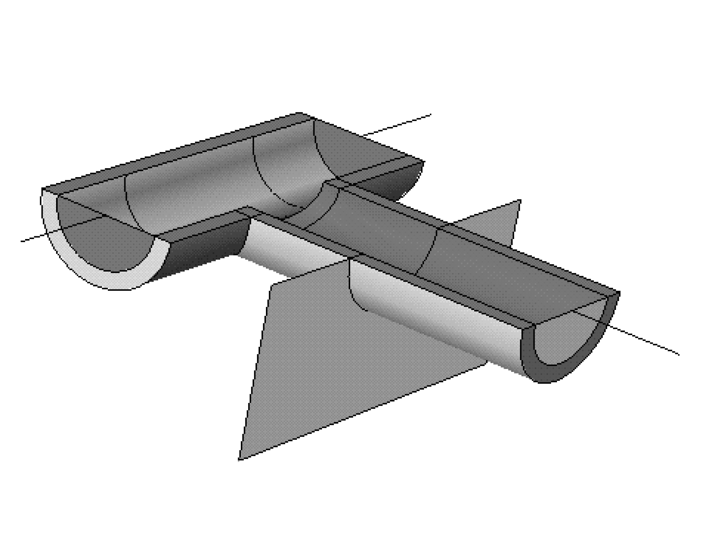
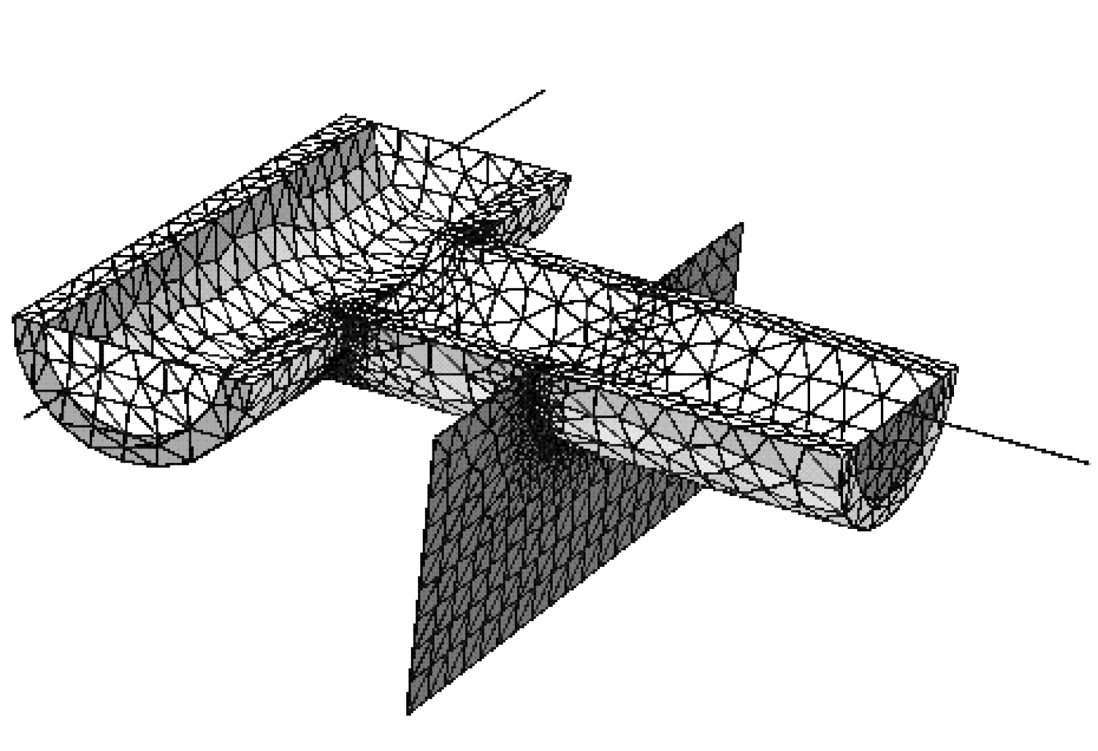
Non-Manifold Boundary Representation
Non-manifold geometric model - general combination of volumes, surfaces and curves with no fixed requirements on numbers of entities interacting at a b’dry
Non-manifold representations important to effective simulation processes
Topology of geometric model provides ideal abstraction for interacting with analysis geometry
6

Slide 7
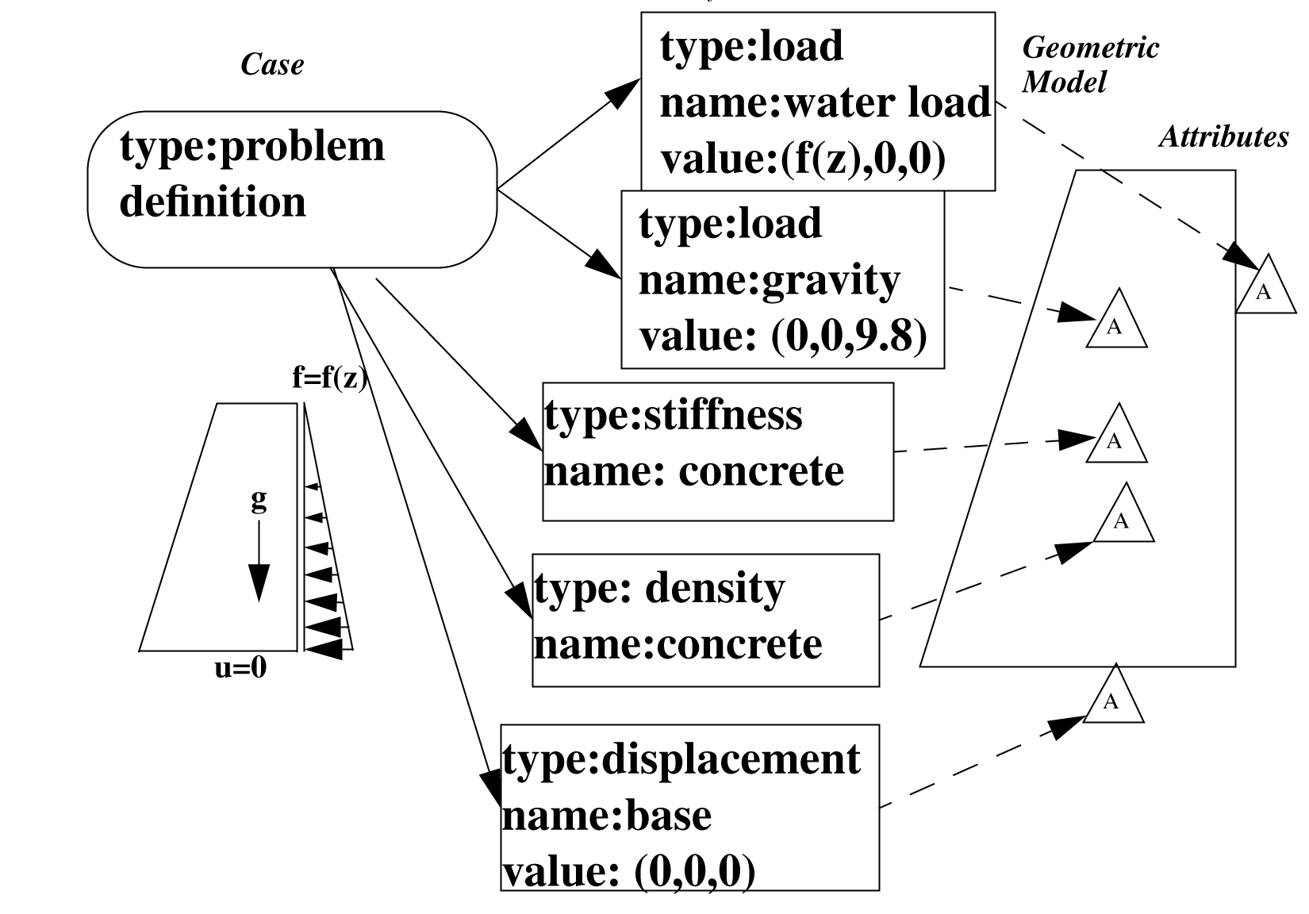
Attributes
Attributes provide the tensor information defining the given parameters in the mathematical model
material properties, loads, boundary conditions initial conditions
Attributes are applied to geometric model entities
Attributes may be general functional distributions, functions of space, time, fields, etc.
7

Slide 8
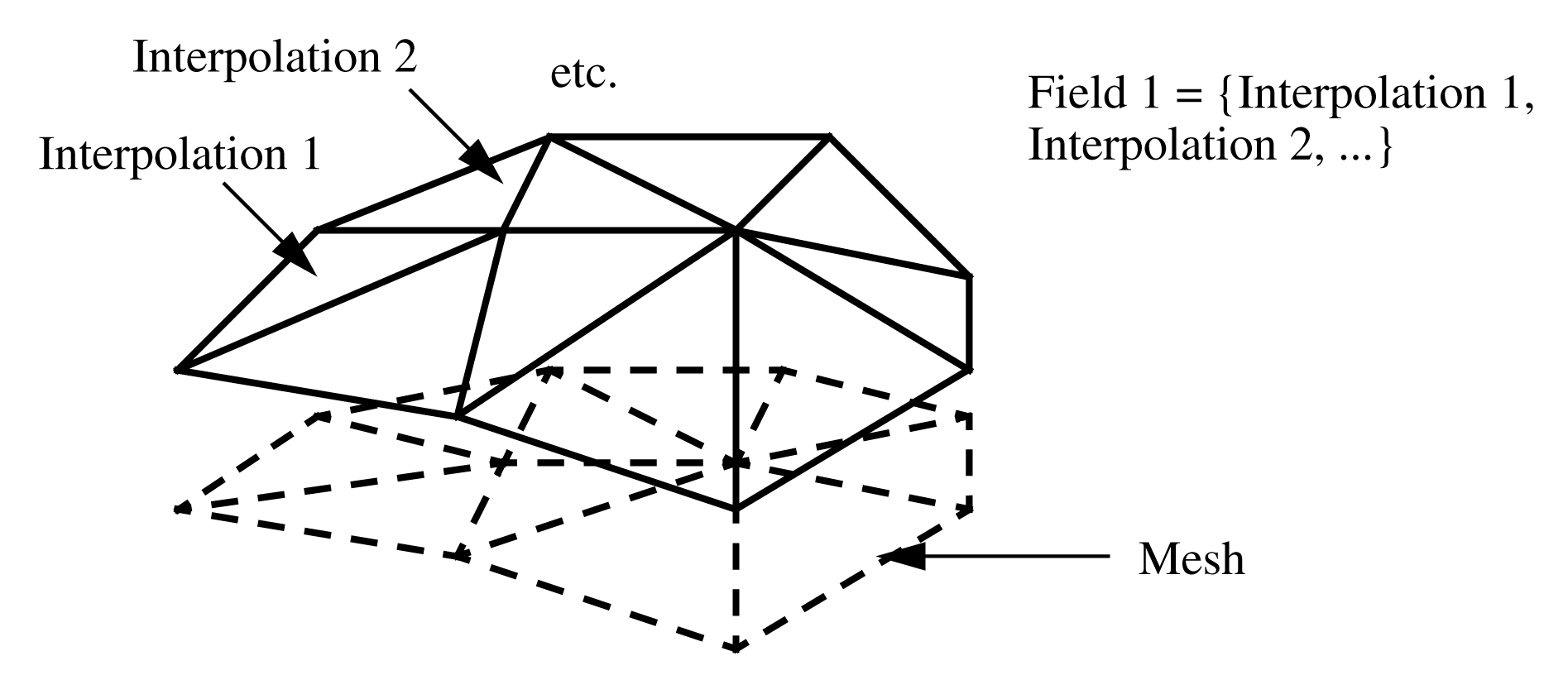
Fields
A field describes tensors over model entities (regions, faces, edges, vertices)
Best option for input fields: Defined on geometric model entities – procedures to map to mesh supported (remember there is not a single mesh)
Solved for fields defined over mesh entities

Slide 9
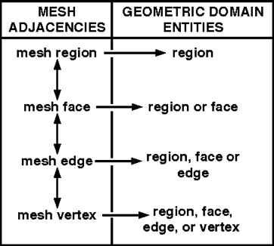
Mesh/Model Relationship
Critical to simulation processes
Relationship is termed “classification”
Mesh Classification: Unique association of a mesh entity, M_{i}^{di}, to a geometric model entity, G_{j}^{dj}, where d_{i}<d_{j} is denoted by
M_{i}^{di} G_{j}^{dj}
indicates the left-hand entity (or set) represents a portion of the right-hand entity in the discretization
Multiple M_{i}^{di} classified on a G_{j}^{dj}
Boundary mesh entities are identified in terms of their classifications
Classification critical to supporting adaptive simulations and high-level problem definitions
9
Notes:
The model and mesh are related using the concept of “classification”, which defines the unique association between a set of mesh entities and a model entity.

Slide 10
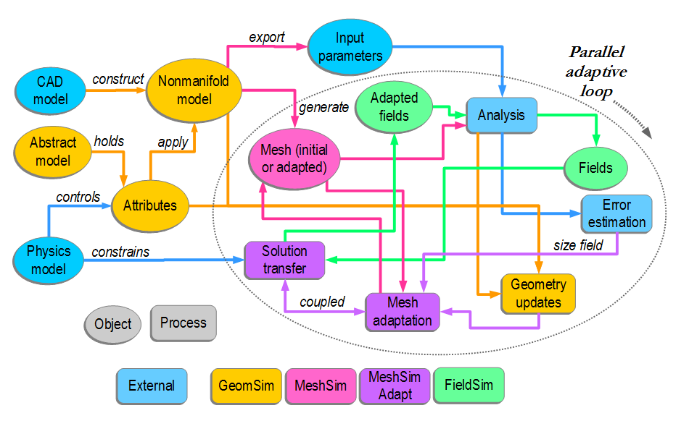
Simulation workflow with Simmetrix
Developing the needed geometry tools from scratch is huge job
Although there have been improvement, no open source tools meet the need or provide the needed support
Simmetrix has been developing these tool for 22 years – we have good working relationship with Simmetrix and they had SBIR money to do some of the specific work we needed
Parallel adaptive simulations using Simmetrix tools
10

Slide 11
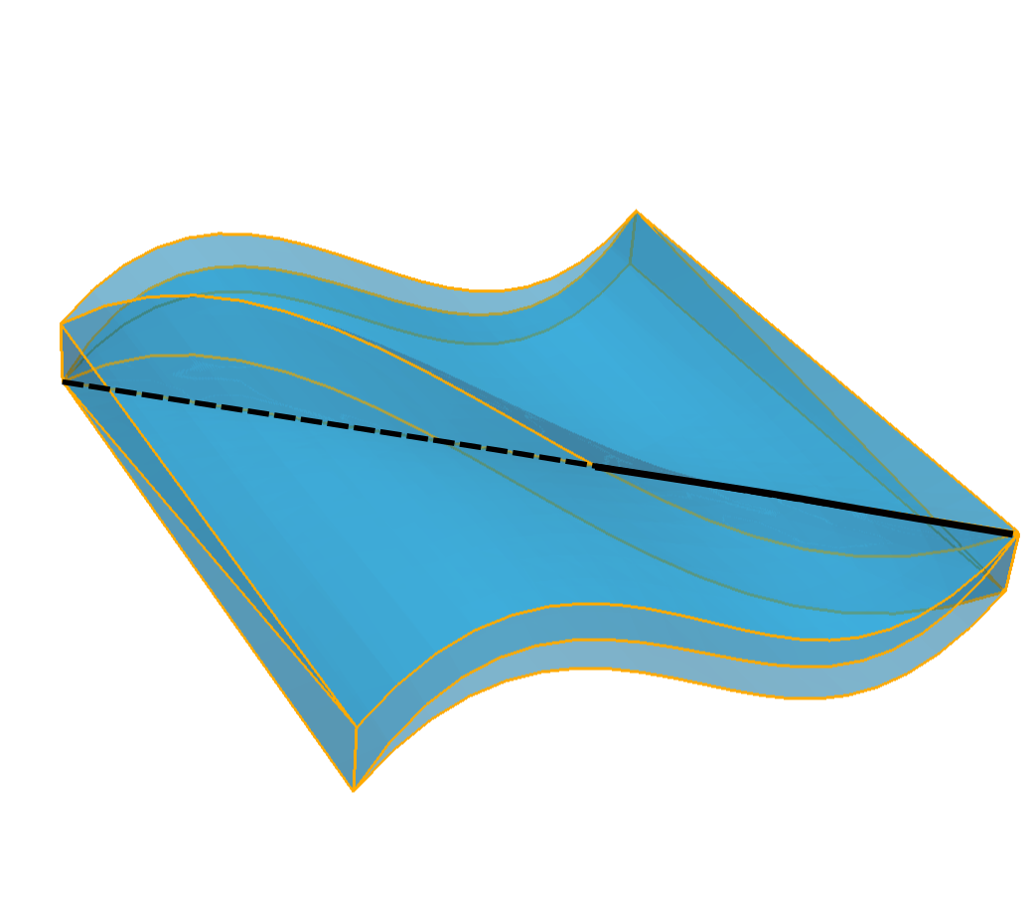
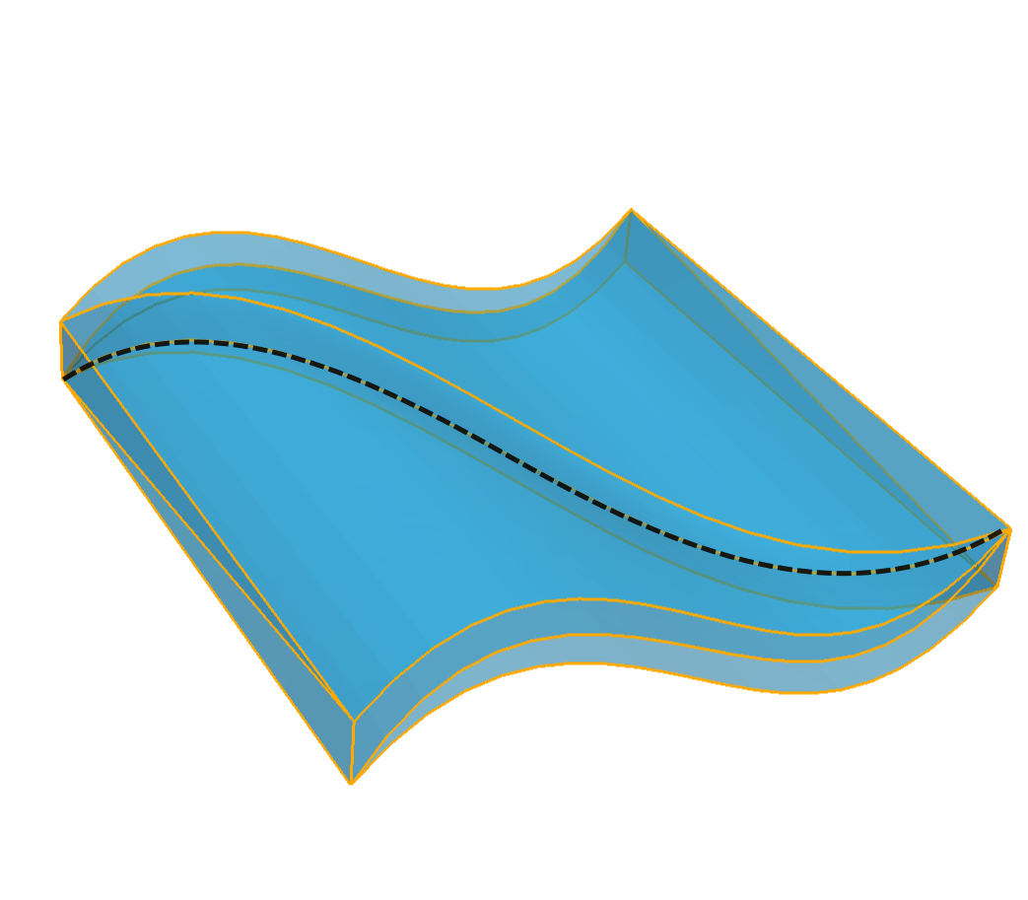
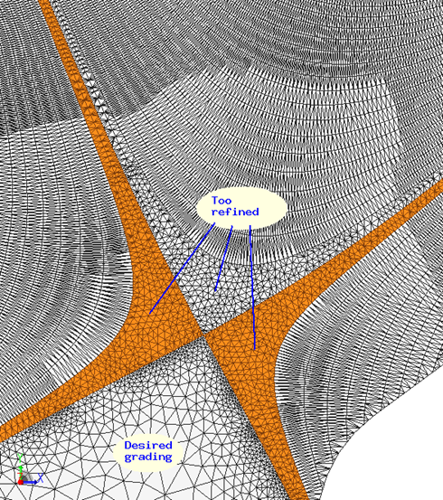
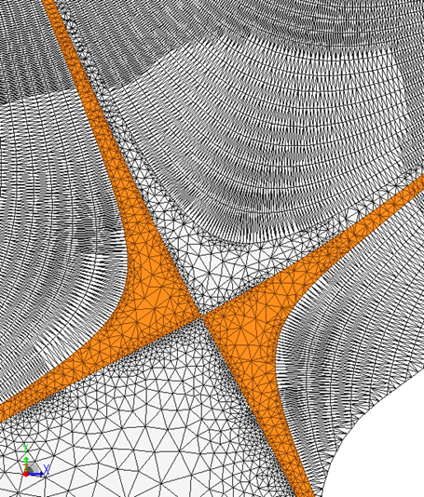
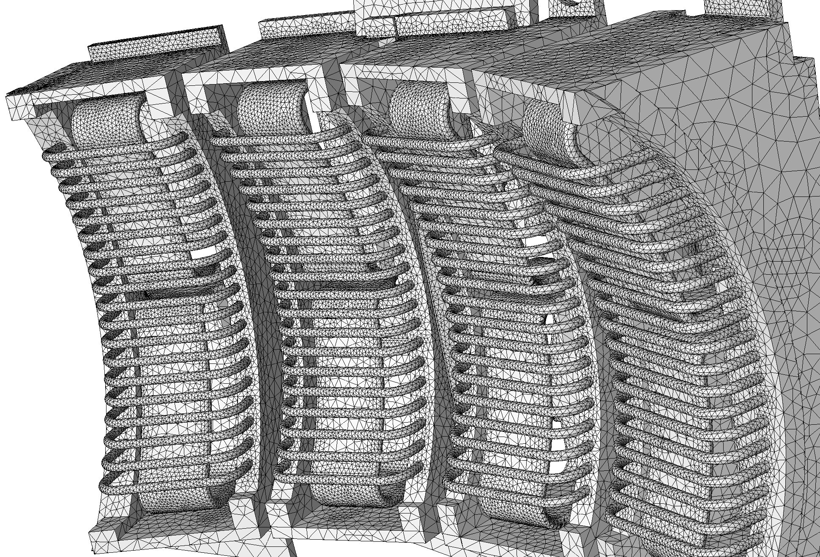
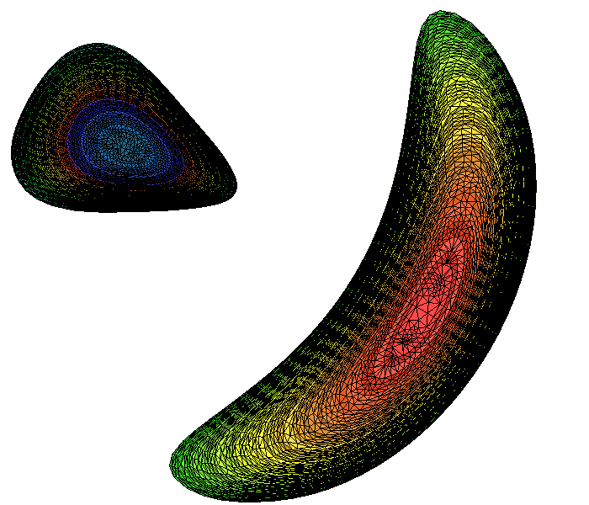
Fusion Geometry and Meshing Developments
Working directly with Simmetrix
Tokamak geometry and meshing
Multiple O- and X-point capabilities
ITER, DIII-D, Alcator C-MOD, NSTX, KSTAR, etc.
EFIT physics geometry
Improved mesh quality at x-point and at wall/flux curve interactions
Geometry combination and simplification
Graphical user interface enhanced, user documentation being written
Curved mesh generation
Higher order curved mesh adaptation
Investigation of stellalator meshing
Notes:
The basic Tokamak is a torus.
r starts from the axis point (the center of each cross section)

Slide 12
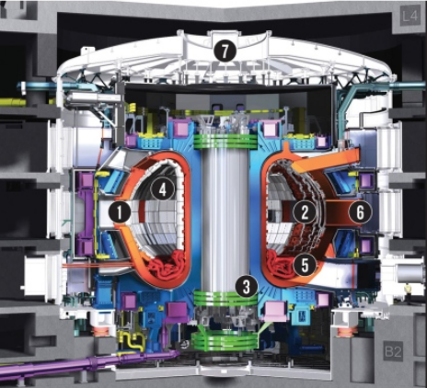
Tokamak RF Simulation Workflow
Motivation:
Accurate RF simulations of fusion systems like ITER requires the definition of high-fidelity analysis geometries that include detailed antenna, reactor wall, and physics regions. This Presentation will describe a workflow for the execution of adaptive simulations for RF fusion systems.
Workflow Steps:
Obtain and Clean-up CAD
Combine Antenna, Reactor & Physics Geometries
Assign Analysis Attributes
Generate Mesh
Finite Element Solve
Estimate Discretization Error, Terminate if Below Threshold
Adapt the Mesh & Return to 5
Tools Used:
Geometry Cleanup - Simmetrix Simmodeler
Analysis model construction - Simmetrix
Simmodeler
Mesh Generation - Simmetrix MeshSim
Curved Mesh Adapt - PUMI
High-Order FEM - MFEM
RF Simulation Setup - PiScope + PetraM
Error Estimation - PUMI
Model Prep.& Mesh Generation
Adaptive Solve
12

Slide 13
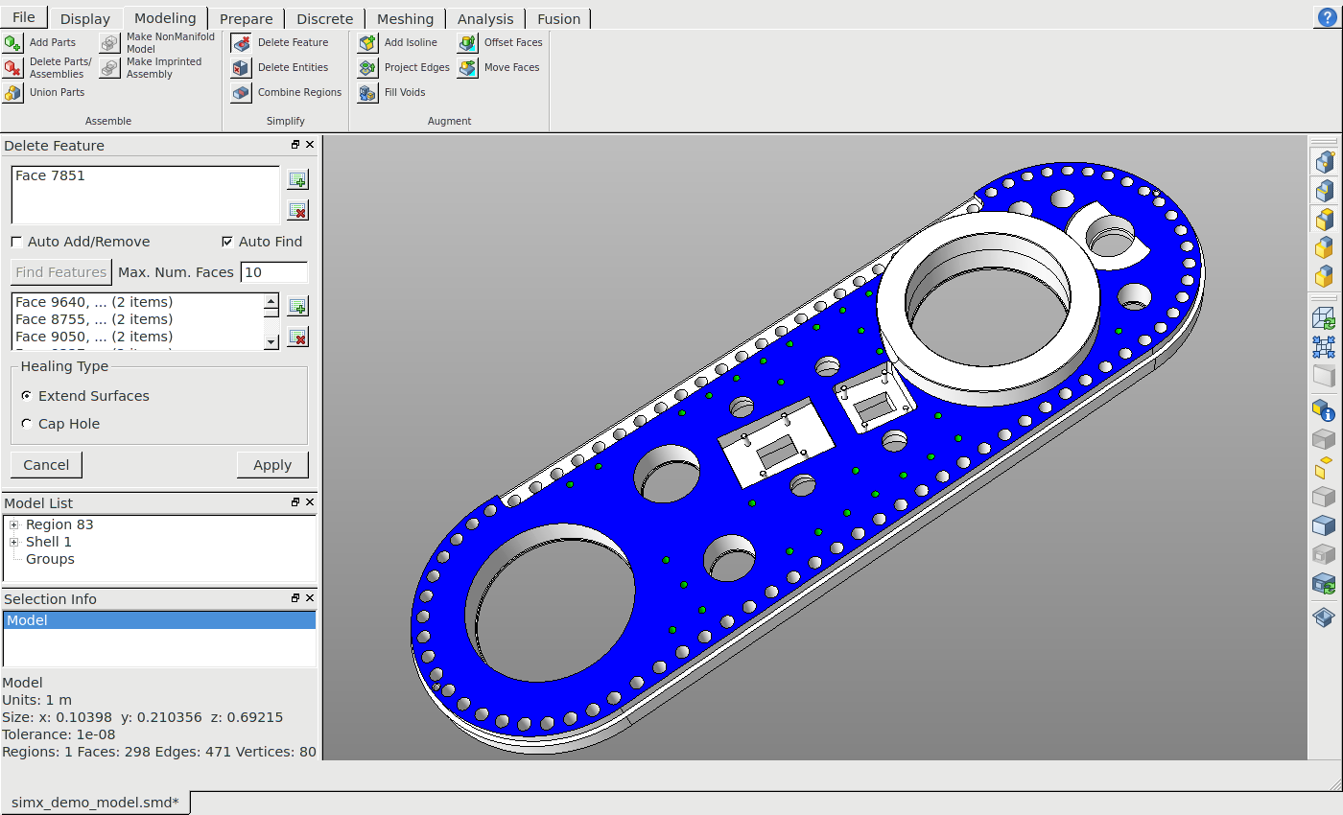
Simmetrix Defeaturing Tools & Mesh Generation
Simmetrix Modeling Tab:
Entities To Keep
Entities To Remove
Defeaturing Type
After Healing
13

Slide 14
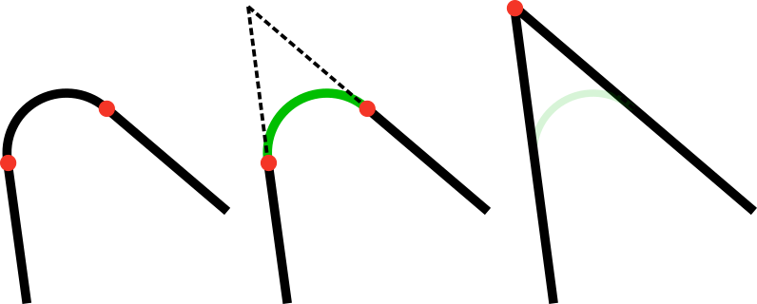
Simmetrix Defeaturing Tools & Mesh Generation
Defeaturing:
Feature Deletion (or Defeaturing) is one of the many “easy-to-use” modeling tools in Simmetrix. The philosophy behind this tool is that non-experts in CAD systems can use it with minimum effort.
Before
to be extended
Defeaturing By Extending Surfaces
“Extend Surface” is the most commonly used defeaturing tool
entity to be deleted
After
to be deleted
defeatured model
initial model
neighboring entities to be extended
Defeaturing By Capping Holes
A special case of “Extend Surface”
14

Slide 15
Simmetrix Defeaturing Tools & Mesh Generation
More Examples of Defeaturing in Simmetrix:
Before
After
15

Slide 16
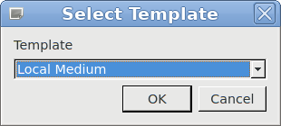
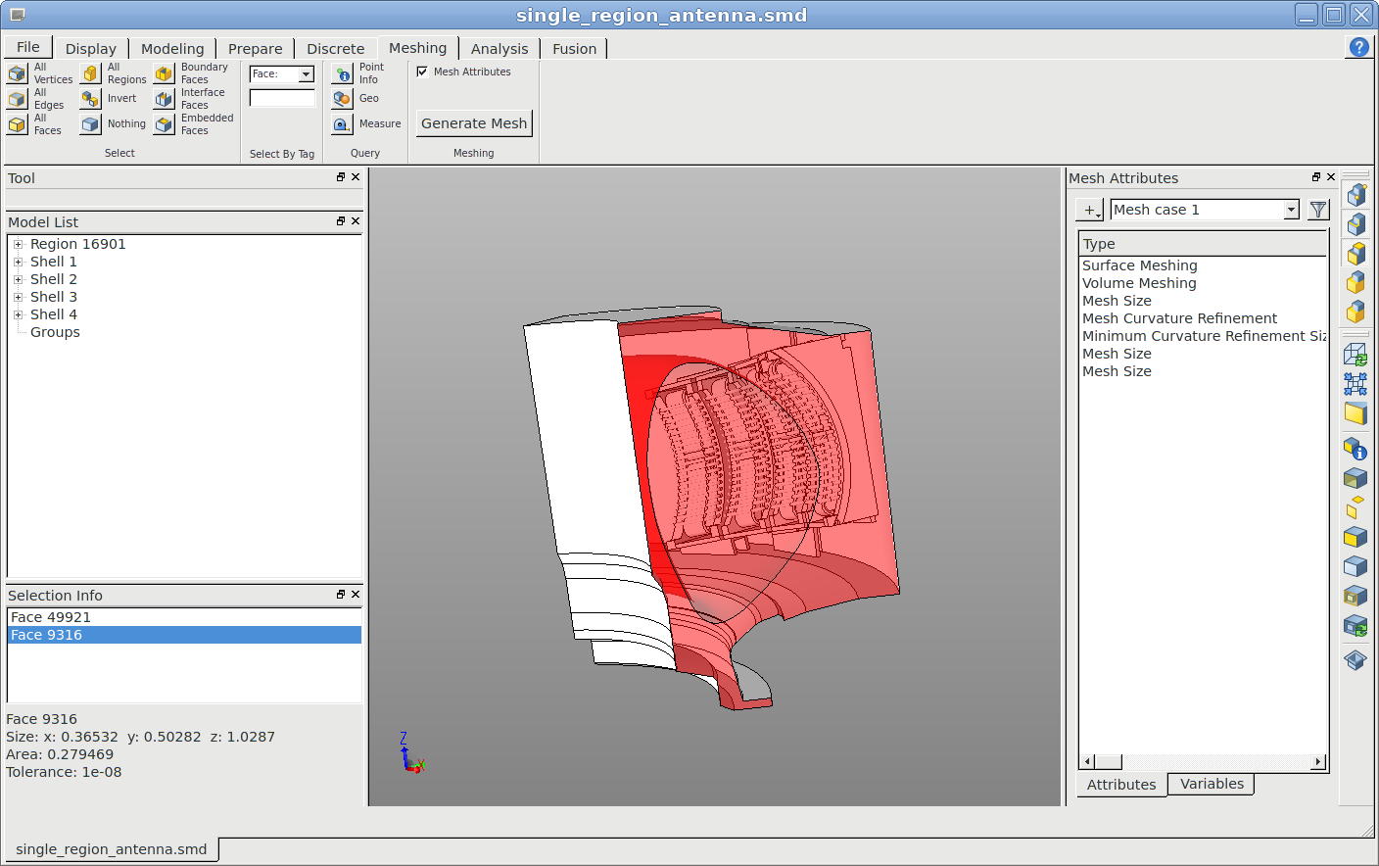
Simmetrix Defeaturing Tools & Mesh Generation
Simmetrix Meshing Tab:
Pre-defined Meshing Attribute Templates
More General Meshing Attributes

Slide 17
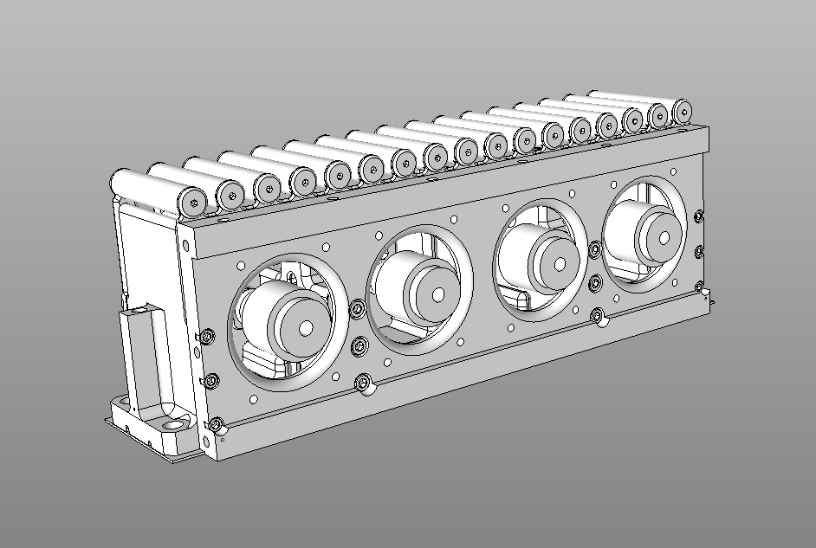
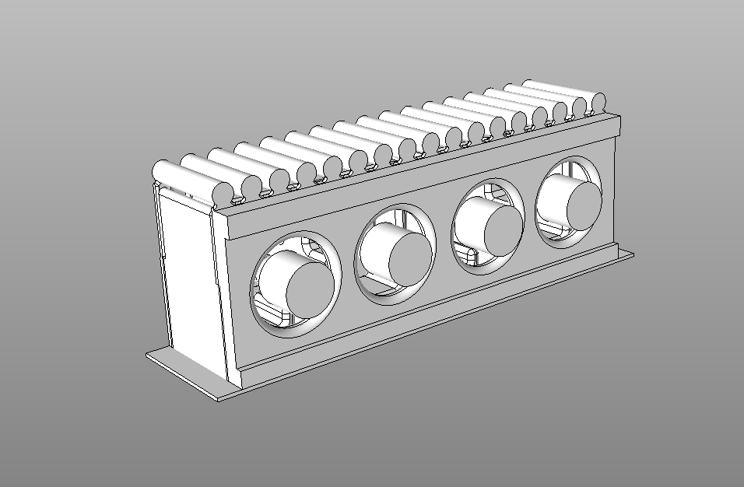
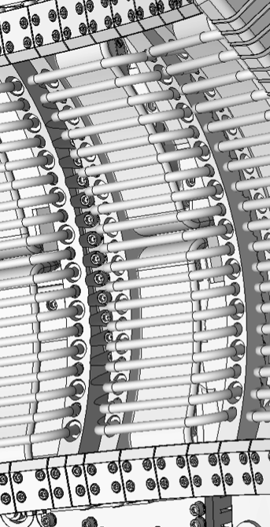
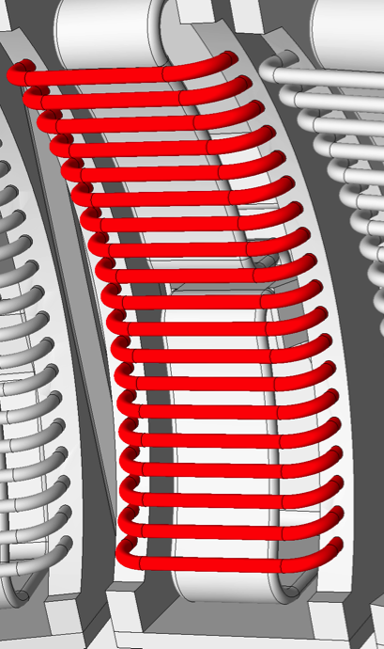
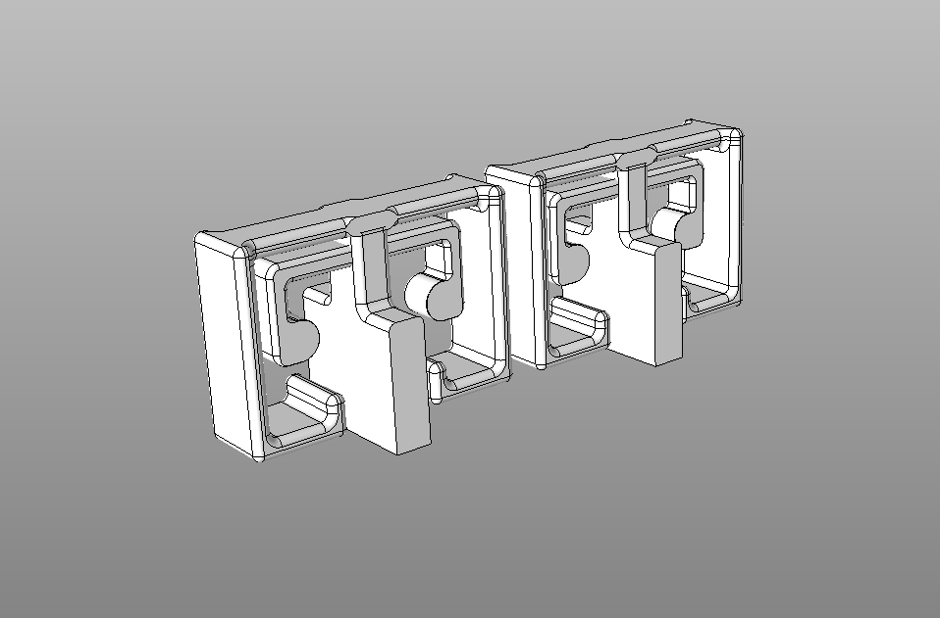
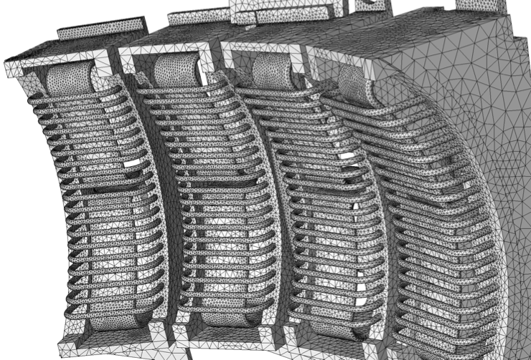
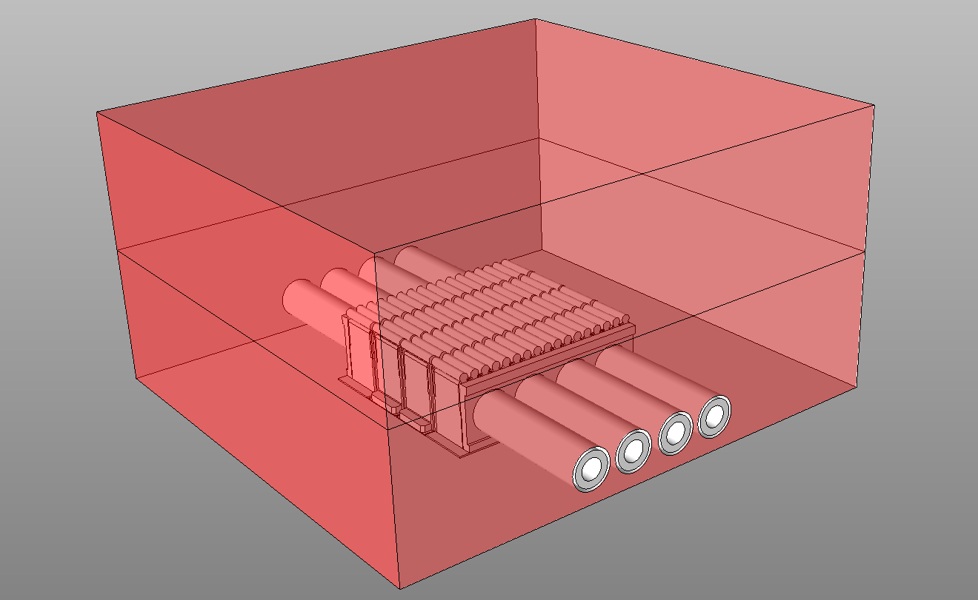
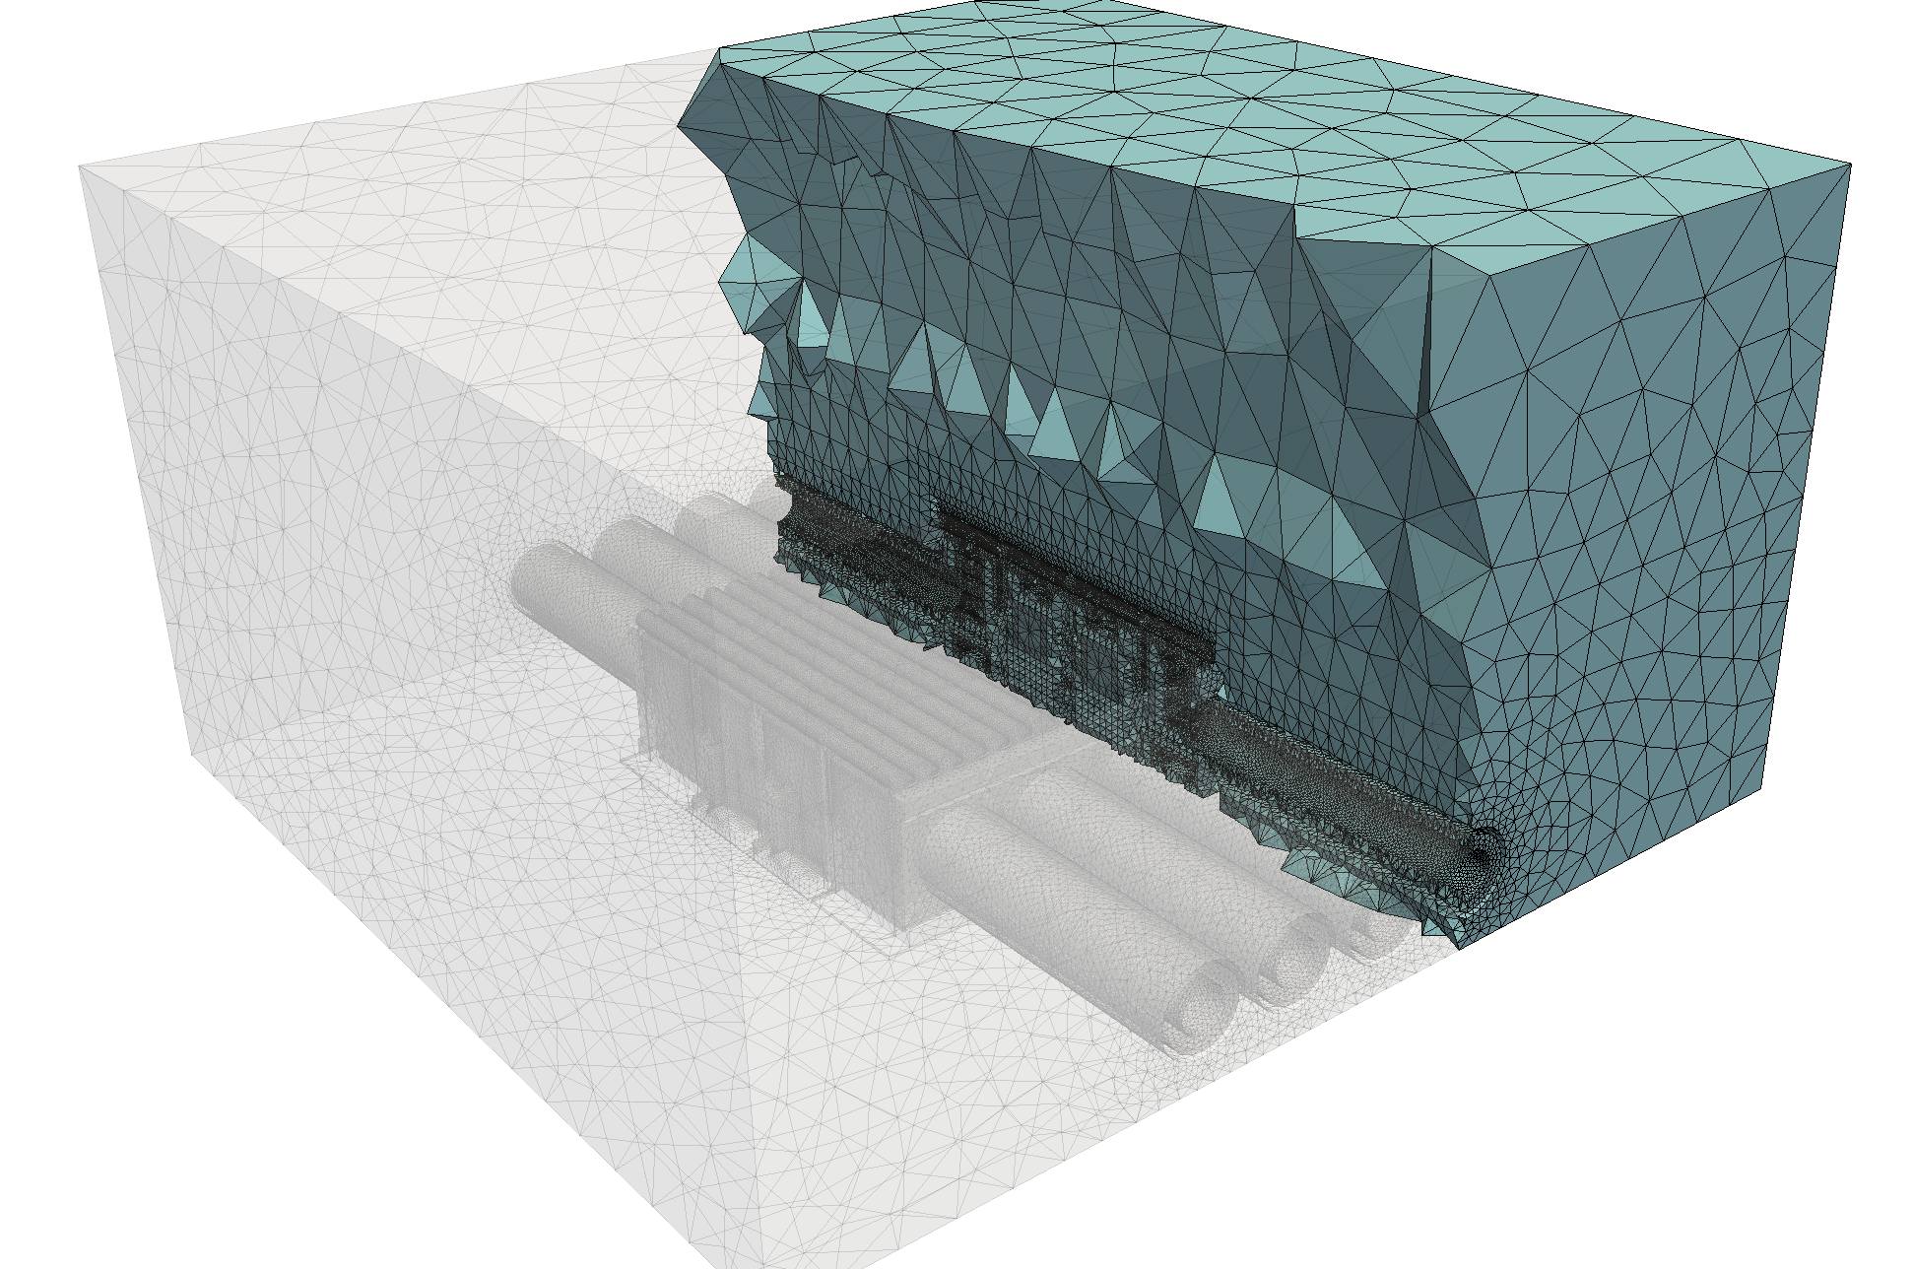
Simmetrix Defeaturing Tools & Mesh Generation
Sample Defeatured Models/Meshes Using Simmetrix Tools:
Engineering CAD
Defeatured CAD
Engineering CAD
Defeatured CAD
Analysis Ready Model/Mesh
Analysis Ready Model/Mesh

Slide 18
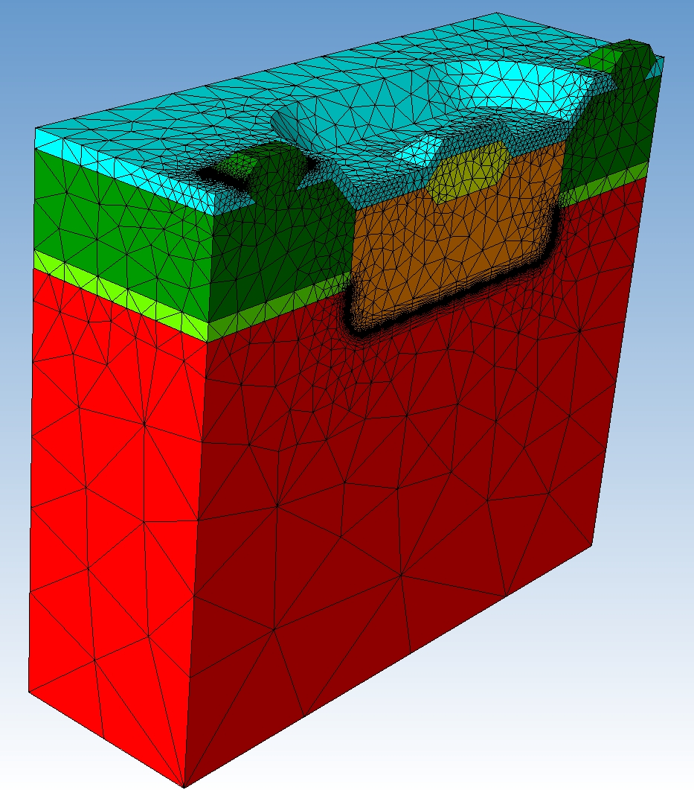
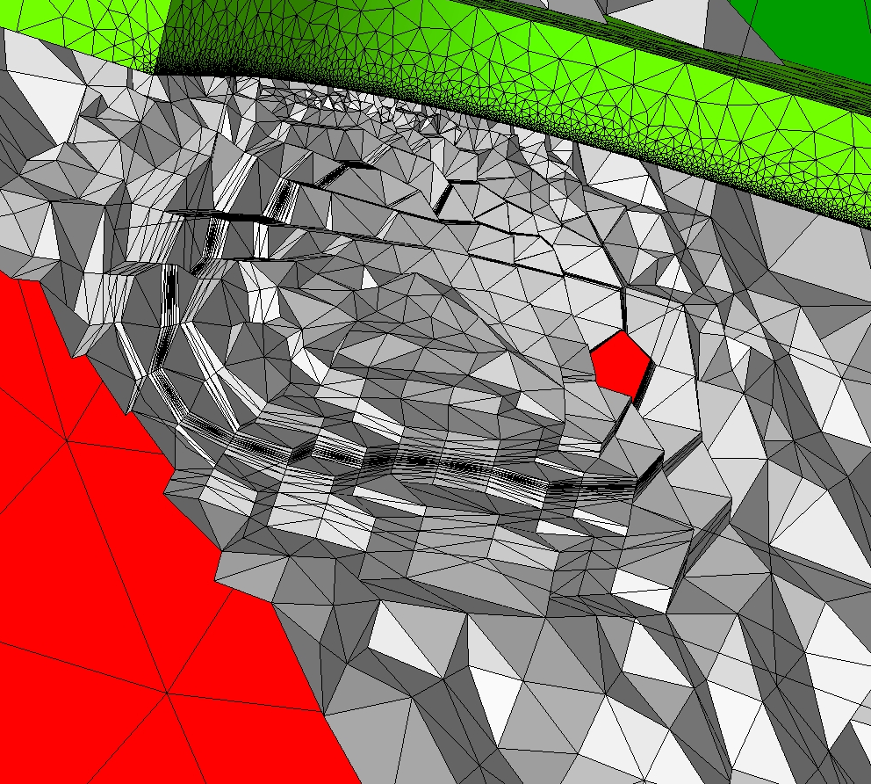
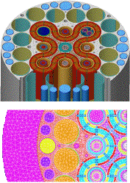
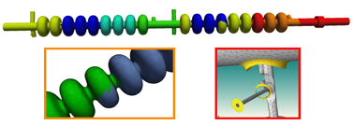
Unstructured Mesh Generation
Fully automatic for general non-manifold analysis domains
Boundary layer meshes
General mesh anisotropy
Mixed topology meshes
Curved mesh entity generation
General conforming mesh adaptation
Parallel implementation – meshes of 30 billion elements generated, meshes adapted to 92 billion elements
18

Slide 19
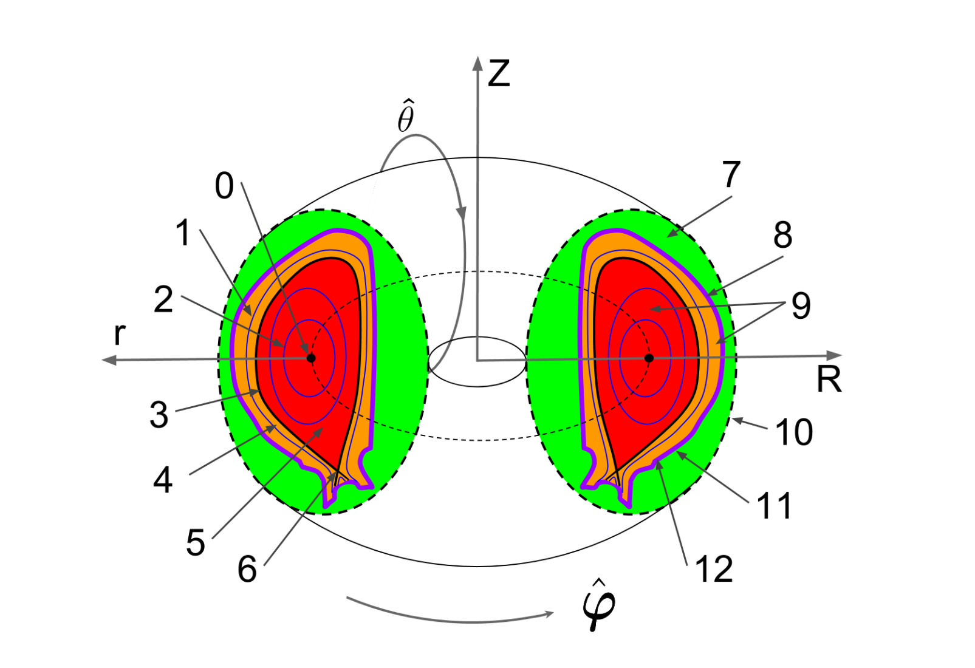
Components of Tokamak Geometry
Combination of physical components and physics components
physics components
physical components
magnetic axis
vacuum vessel
open flux surface
wall region
closed flux surface
plasma region
separatrix
vacuum boundary
scrape-off layer
outer wall boundary
plasma core
inner wall boundary
x point
19
Notes:
The basic Tokamak is a torus.
r starts from the axis point (the center of each cross section)

Slide 20
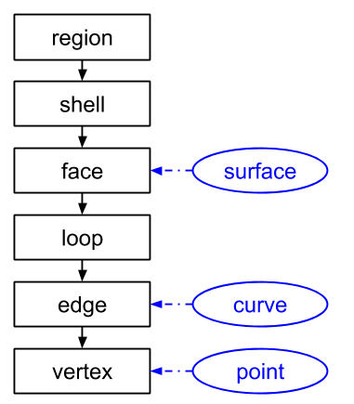
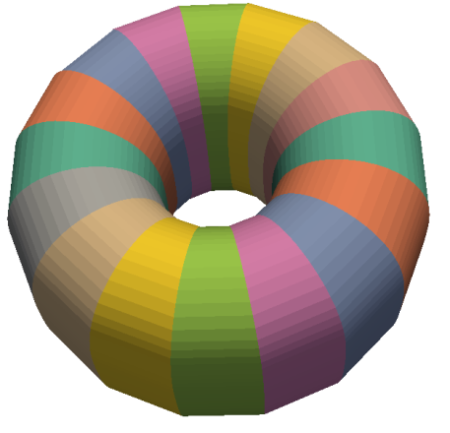
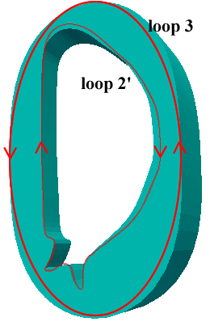
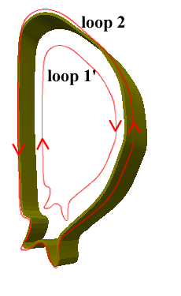
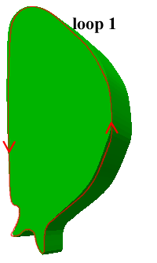
Tokamak Geometry Definition
Topological representation
Abstraction of the topological entities
Description of the adjacencies
Shape information:
Associated with the topological entities
Often defined parametrically
topological entities and shape infomation
topological entities in M3D-C1
20
Notes:
explain the convex hull, The figure on the right shows how we construct a piece of B-spline by 6 control points on a trapezoid directly.

Slide 21
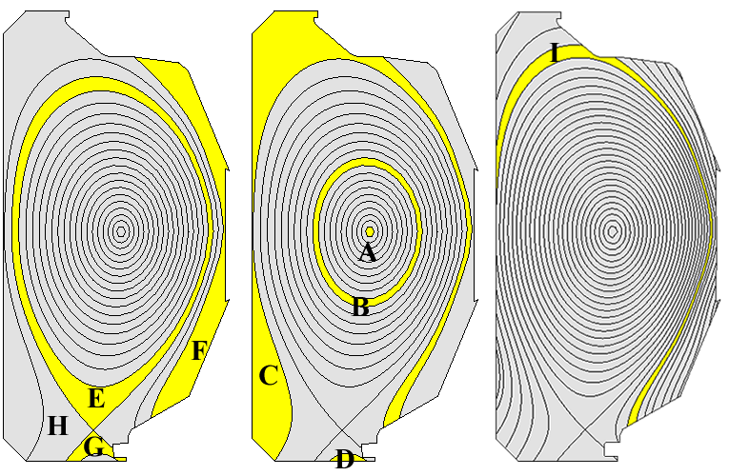
Geometry Definition
Topological entities in the geometry applied by XGC – flux curves constructed using EFIT data on background grid
21
Notes:
explain the convex hull, The figure on the right shows how we construct a piece of B-spline by 6 control points on a trapezoid directly.

Slide 22
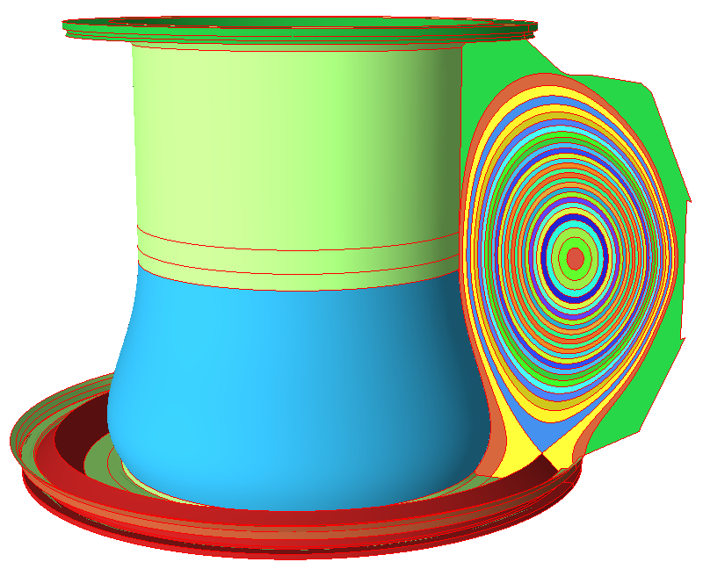
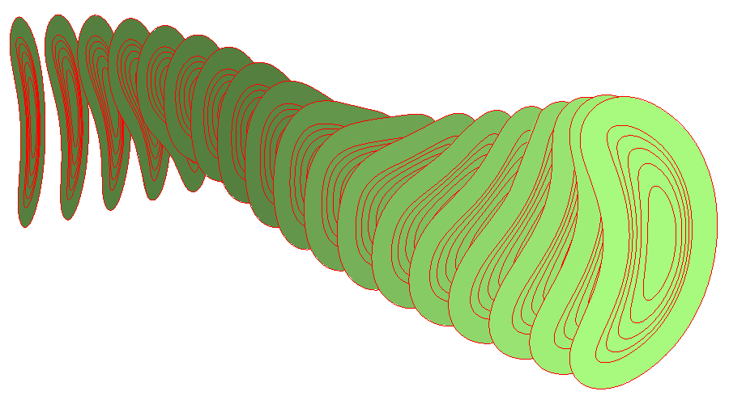
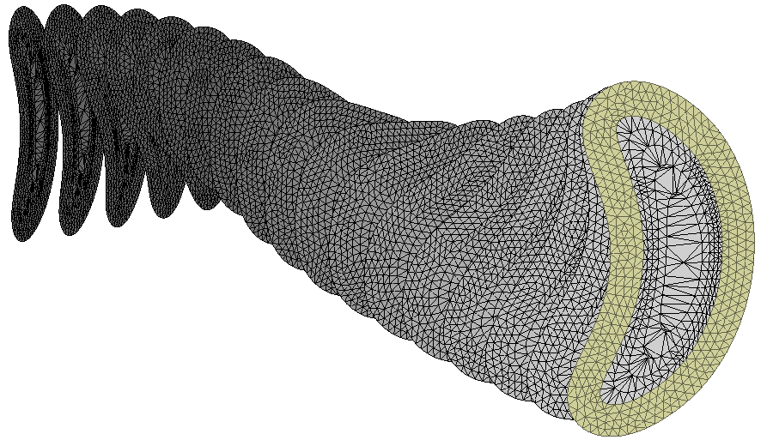
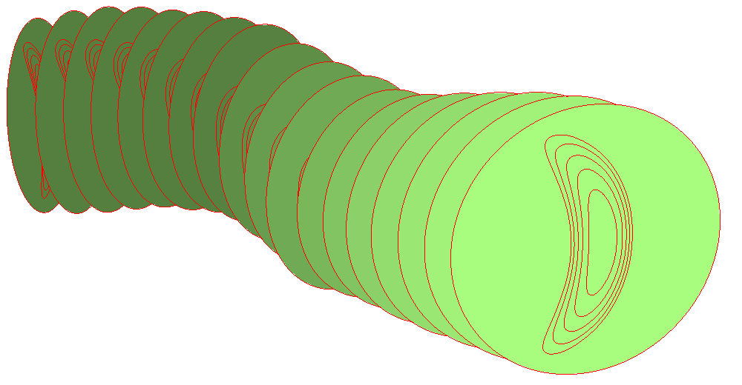
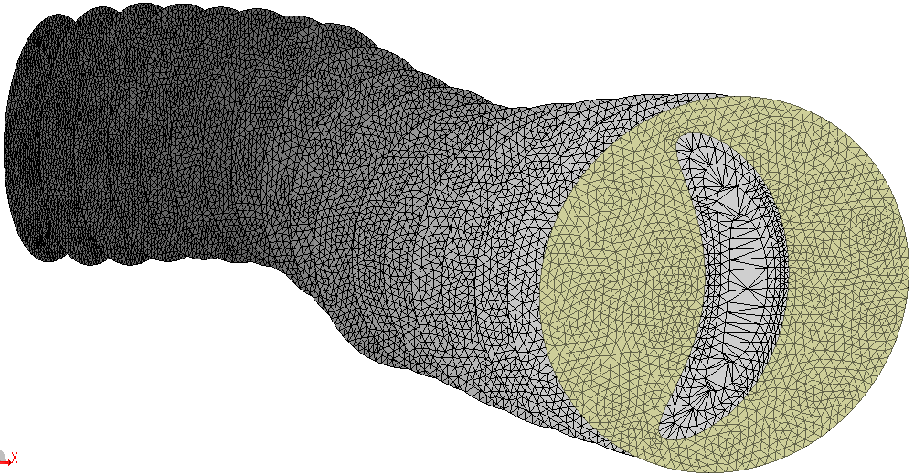
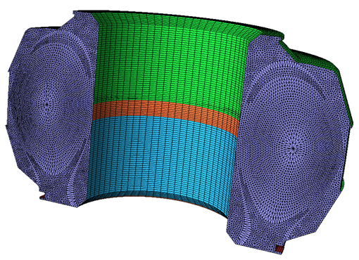
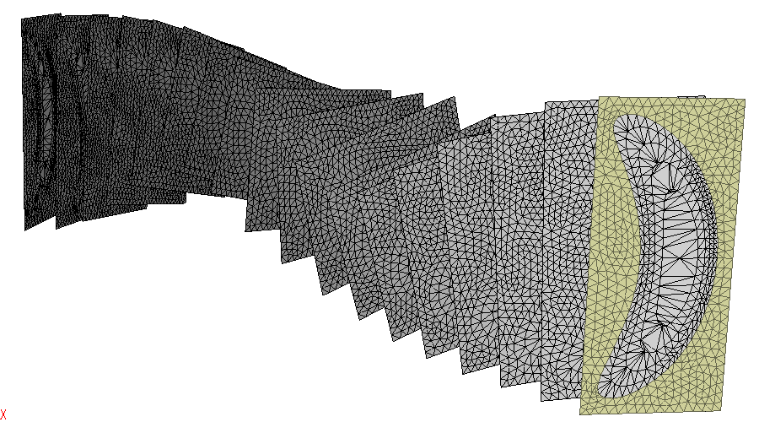
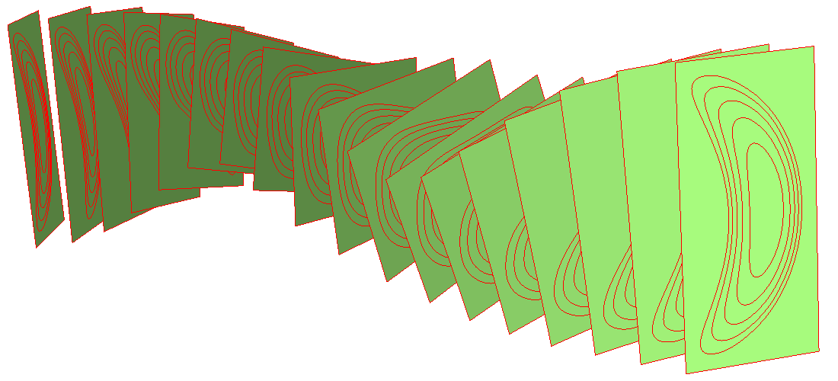
Recent Simmetrix Examples

Slide 23
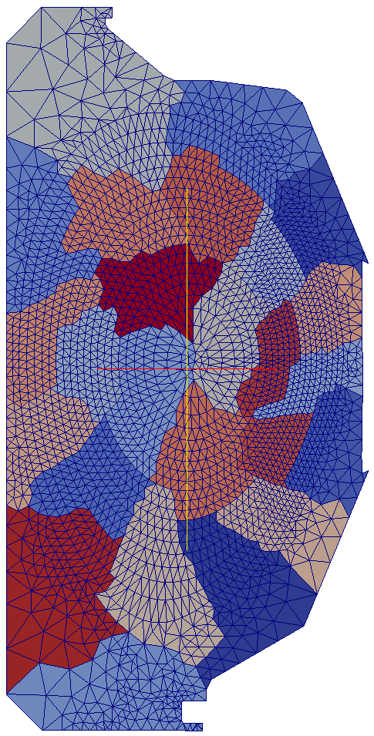
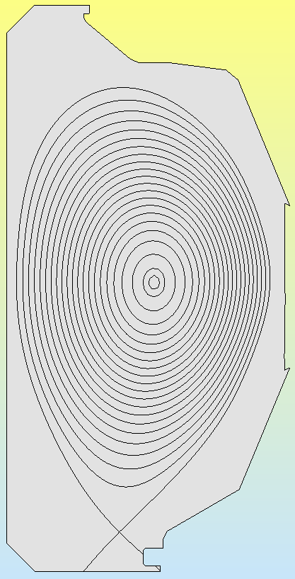
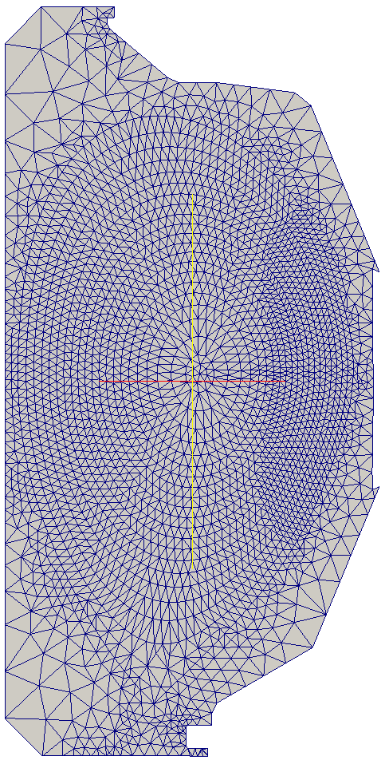
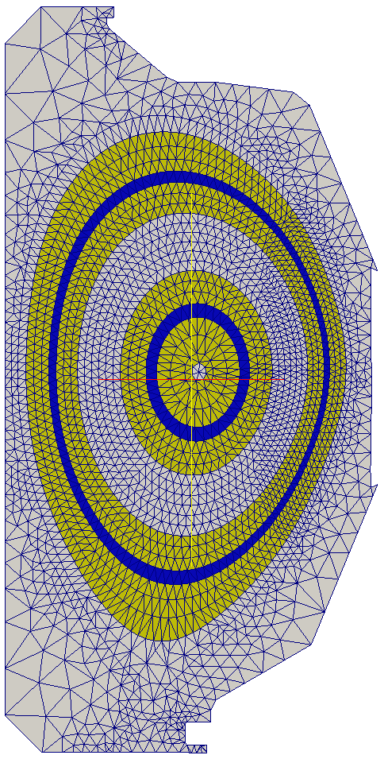
Partitioning
Model
Partition optimal for mesh-based field solve
Example showing two parts: Blue is the mesh between two flux surfaces and the yellow spans three layers on each side of the core
23

Slide 24
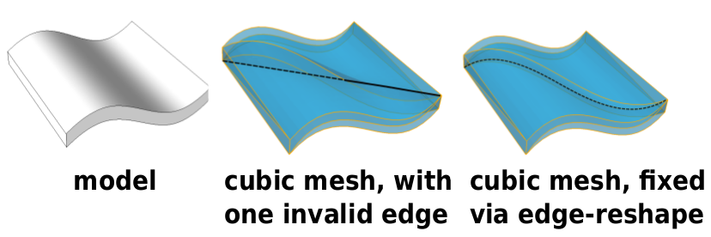
Higher than Quadratic Curved Mesh Adaptation
Inflation to Higher Order
To take advantage of high-order FEM analysis, mesh geometry needs to improve
PUMI provides tools to improve the geometric approximation of the mesh upto order 6
PUMI provides tools to fix invalidities after increasing the of geometric approximation
Before
After
Before
After
Self intersecting faces f0 & f1, before and
after reshape
24

Slide 25
Higher than Quadratic Curved Mesh Adaptation
Example : generation of a cubic mesh for the antenna model
Red elements invalid on curving
Initial Quadratic Mesh
Inflated Cubic Mesh
25

Slide 26
Error Estimation For Time Harmonic Maxwell’s Equations
Estimation of the Discretization Error:
Explicit Methods: these are more efficient computationally, and they are known to result in less accurate estimates for the error
Implicit Methods: these are less efficient computationally since they require a secondary solve, however they are known to result in more accurate estimates for the error
Implicit Error Estimation:
Form the residual weak form for the domain
Get the residual weak form for each element, this would correspond to a local BVP for each element with Neumann boundary conditions
Since the fluxes are not exact at element boundaries we need to perform self-equilibration of fluxes
Solve the local BVP for each element to get the element error indicator function
Use the L2 norm of element error indicator function to compute the size-field
26

Slide 27
Error Estimation For Time Harmonic Maxwell’s Equations
Self-Equilibration of Fluxes:
There will be mismatch between fluxes at element boundaries (since the FEM solution is not exact)
The fluxes are self-equilibrated by introducing a “correction” term
The correction terms are obtained by making sure each individual element is in equilibrium
This guarantees that the local BVPs for each element have well-defined solutions
Application to Nedelec Edge Elements:
The flux correction to a given face “f” (in our case a triangle) can be represented as follows:
The coefficient gs associated with edge “e” can be obtained by looking at the edge patches:
Here Gs are the weak residuals computed for each element in the patch (note that the weak form also includes the boundary integrals including the un-equilibrated fluxes)
The system of equation shown above is singular & special consideration must be taken for its solution (see [2])
[1]Demkowicz, Leszek. Computing with hp-adaptive finite elements: volume 1 one and two dimensional elliptic and Maxwell problems. Chapman and Hall/CRC, 2006.
[2]Ainsworth, Mark, and J. Tinsley Oden. "A posteriori error estimators for second order elliptic systems part 2. An optimal order process for calculating self-equilibrating fluxes." Computers & Mathematics with Applications 26.9 (1993): 75-87.
27

Slide 28
Error Estimation For Time Harmonic Maxwell’s Equations
Application to RF Antenna:
Two antenna RF heater with 4 ports with input phases equal 0, 90, 180 and 270 degrees.
solution-initial mesh
error-initial mesh
initial mesh
adapted mesh
solution-adapted mesh
28

Slide 29
Integration of Adaptive Workflow and PetraM
Adaptive Workflow & PetraM:
Development of python wrappers for PUMI “MeshAdapt” tools
Integration of the “MeshAdapt” into PetraM using the python wrappers
Collaboration with MIT to perform full adaptive RF simulations in PetraM starting from a realistic engineering CAD
Physics Setup in PetraM
Adaptive Setup in PetraM
Before/After Adapt Meshes for RF Antenna
Adapt Parameters
Input Model & Mesh
29

